Slide 1
Build your domain expert chatbot using azure open.ai and c# (R.A.G.)
Enrico Sabbadin MSC

Slide 2
rifrasando ..
Come far rispondere chatgpt sun ambito, un dominio di di conoscenza e sapere che non fa parte del set di informazioni iniziali utilizzate nell'adddestramento iniziale del modello
.. usando la tecnica che prende il nome di
Retrieval Augmented Generation (R.A.G.)

Slide 3
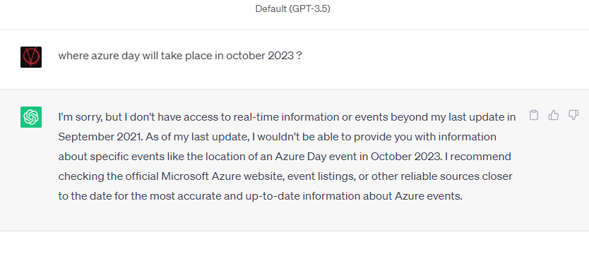
November 30, 2022
https://chat.openai.com
Developers' questions
Can I run chatgpt on my PC -> No
Can I access it as an api service? -> Yes
Can make a clone of the model, and train (fine-tune) it, so that it can reply about my domain specific data ? -> Ni
If fine tuning is not an option, is there another way to have it answer about my domain specific data ? -> Yes
This talk will elaborate on the last question

Slide 4
OpenAI GPT history
It's a "brand" : not only text but also images, (dalle-2, whisper)
All models are offered as api only, its a black box.
MS introduces Azure OpenAI services Nov 2021
- GPT 3.5 turbo (0613) - GPT 4 (0613) Jun 2023
GPT 3.5 Nov 2022
text-davinci-003
GPT3 June 2020
GPT 3.5 turbo (0301) March 2023
GPT 4 (0314) Mar 2023
First InstructGPT models Jan 2022
e.g. text-davinci-002
DALL-E 2 (GPT3 based) Jan 2021
ChatGpt (Web interface) Nov 2022
Azure OpenAI GA Jan 2023
Azure OpenAI on-your-data Jan 2023

Slide 5
Open.ai vs Azure Open.ai
Open.ai
Chatgpt web ui (free and plus version, the plus version allows to use plugins)
Open.ai api (pay per usage)
Auth via api key
Azure Open.ai
Added as additional offer in the MS AI ecosystem
Requires submission and approval of a request form (a separate one for Gpt4 access)
Auth via api key or Azure Ad
Allows network segregation and RBAC on your azure Ai instance
Quotas

Slide 6
Chat-completion api endpoint
Stateless
Streaming response supported
Message types
System messages
User messages
Assistant messages
Implement raw rest api call (swagger doc available) or use Sdks (MS provided and others)
MS Sdk works both with open.ai and Azure open.ai
Input: {"messages": [
{"role": "system", "content": "provide short and concise replies to user questions"}
{"role": "user", "content": "Who won second world war?"}
]
…
}
Output: {"message": {
"role": "assistant",
"content": "The Allied Powers, led by the United States .."
}

Slide 7
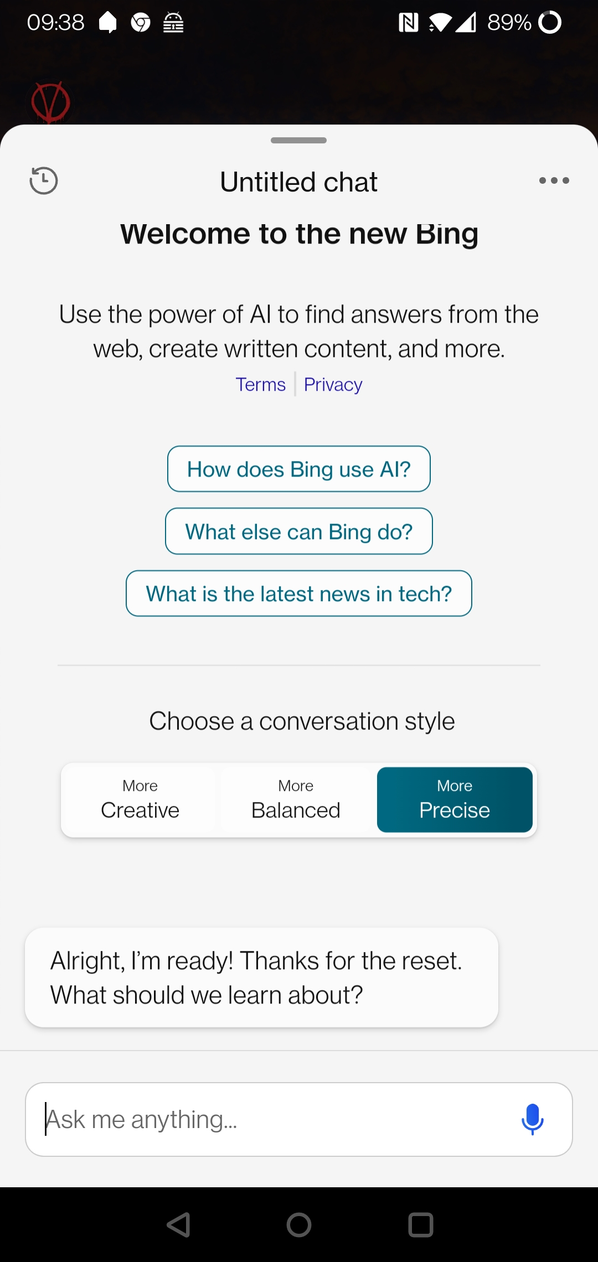
Temperature
0 to 2
0 more deterministic (but not totally)
higher level of temperature : more creative (random)

Slide 8
Conversation history management
Chat-completion api is stateless
You need to provide as input the previous conversation
Q1: {"messages": [
{"role": "user", "content": "Who won second world war?"}
]
}
A1: {"message": {
"role": "assistant",
"content": "The Allied Powers, led by the United States .."
}
}
-----------------------------------------------
Q2: {"messages": [
{"role": "user", "content": "Who won second world war?"},
{ "role": "assistant", "content": "The Allied Powers, led by the United States .." },
{"role": "user", "content": "and who lost it ?"}
] }

Slide 9
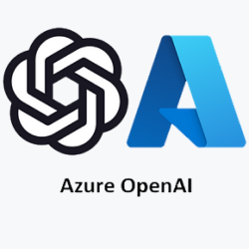
Chatbot Application layout
UI : JS / Windows app
backend : RestApi/Grpc/GraphQl
1
Conversation manager middleware In: load conversation by conversation Id Out: store new conversation iteration
DEMO 1

Slide 10
DEMO : meet Emma

Slide 11
Provide context with the question
Information (text document) can be provided to the ChatGpt along with the user question. ChatGpt will use them to answer user question
To provide info ChatGpt is not aware about
{"messages": [
{"role": "user", "content": "<some information about AzureDay 2023>"}
{"role": "user", "content": "Where Azure Day 2023 take place?"}
]

Slide 12
POSTMAN DEMO

Slide 13
Tokens
Chatgpt internally "reasons" in tokens
Tokens are related to words but are not words, roughly speaking, they are syllable
In English tokens = words * 4/3, e.g., 3k words are 4k tokens
Each model has a limit on the size of input + output tokens (and hence text)
Models
gpt-3.5-turbo (0301/0613) : 4096
gpt-3.5-turbo-16k (0613) : 16384
gpt-4 (0314/0613) : 8192
gpt-4-32k (0314/0613) : 32768
Api response returns input / output tokens consumed
No api endpoint to calculate them upfront
Open AI suggests to use the tik-token algorithm
Libraries are available (also for .NET as nuget packages) to use same algorithm used by chat-completion api on server side

Slide 14
Chatbot on your data
Technical word or this technique is: "Retrieval Augmented Generation"
As we saw, it's possible to provide as part of the input, as user message(s), text that contains relevant information for the AI to answer the user question.
Sounds easy, but if my chatbot must work on a list of document whose size is greater than the model token limit ? Ok, I can chunk my documentation in smaller pieces, but .. How do I extract among all the chunks all the ones relevant to the specific user question ?
Time to get to know embeddings … ☺

Slide 15
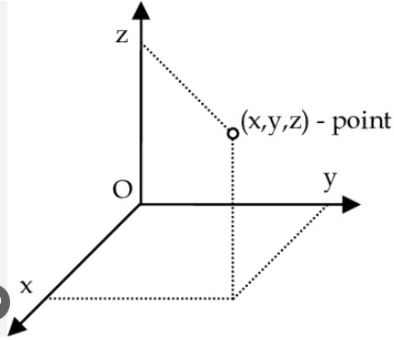
What "the hell" are embeddings ?
An embedding model converts a block of text into a vector (array) of numbers (floats) that "captures" the context/meaning of the provided text
text-embedding-ada-002 is currently recommended one (1536 elements )
Exposed as an api endpoint by open ai / azure open ai
Array and vector terms can be used interchangeable in this context
Using the term vector is more intuitive since vectors can be seen as arrows pointing from the origin to a point in a n dimensional space

Slide 16
Embedding "similarity"
Now we have converted text into vectors, we can define some math algorithm to evaluate the "similarity" between two block of texts
Roughly speaking we define a formula where the smaller is the angle between 2 vectors, the closer they are in semantic similarity
The actual used formula is the "cosine proximity formula"

Slide 17
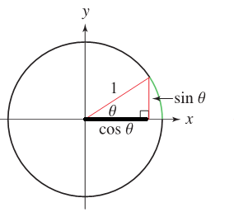
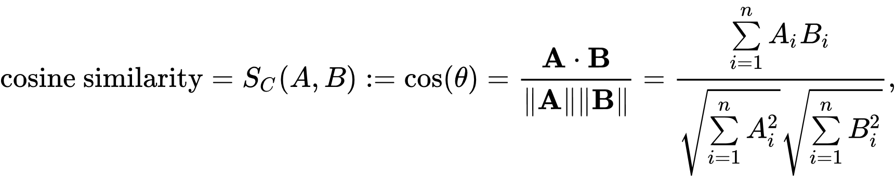

Cosine similarity
y
V1 (0.5,1)
Smaller is the angle, greater is the cosine
Smaller is the angle, more similar are the two corresponding texts
V2 (0.7,0.7)
x
n : 1536
A[1]*B[1] + A[2]*B[3] + A[4]*B[4] + A[5]*B[5] +
+ .. Up to 1536
V3 (-1.5,-0.5)
Don't be afraid : this is a for loop ☺
length of vector A
length of vector B

Slide 18
public float GetProximity(IReadOnlyList<float> A, IReadOnlyList<float> B)
{
// TO DO : check A and B has same length
var vectorLength = A.Count;
var sum = 0.0f;
var ALength = 0.0f;
var BLength = 0.0f;
for (var i = 0; i < vectorLength; i++) {
sum += A[i] * B[i];
// you can skip the code below with ..ada-002 model : vectors are normalized to a length = 1
ALength += Convert.ToSingle(Math.Pow(A[i], 2)); // A[i]^2
BLength += Convert.ToSingle(Math.Pow(B[i], 2)); // B[i]^2
}
var proximity = sum / (Math.Pow(ALength, 0.5) * Math.Pow(BLength, 0.5));
return Convert.ToSingle(proximity);
}

Slide 19
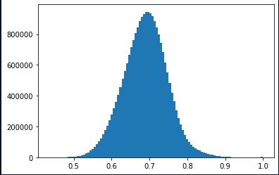
Note on Cosine proximity
With random vectors cosine distribution ranges from -1 to 1
Vectors coming from text-embedding-ada-002 have a bias, values always positive, approximately distributed in a gaussian shape around 0.7
Experiment with values in the range like 0,73 – 0.78 for minimum proximity threshold
https://community.openai.com/t/embeddings-and-cosine-similarity/17761/10

Slide 20
How can embeddings can help me then?
1/2: Chatbot up-front setup
Document preparation: conversion and splitting (if required)
AI understand text files only (markdown include, which is even better than "normal" text files)
PDF, HTML files must be converted to text format
Splitting: Suggestion is to try to stay below 1000 token (but it depends on the max token limit of the chat completion model) Use TextChunker class in MS Semantic Kernel SDK
Use Azure OpenAi embedding api endpoint to get corresponding embedding of your relevant "documents"
Save document & corresponding embedding vector in some storage

Slide 21
How can embeddings can help me then?
2/2: User question arrives to your Chatbot app: setup payload to be sent to open.ai completion api as follows
Calculate user question embedding vector
Calculate cosine proximity of user question embedding against each stored document embedding
Pick up the documents whose embeddings are closer to the question embedding using cosine proximity
In the text selection define a minimum proximity threshold (e.g. 0.73) and possibly a max num of documents to pick
Push text blocks as Role="user" messages in the request before the actual user question

Slide 22
About Embeddings & documents storage and cosine proximity calculations
There are vectors databases that provide vector operations (cosine similarity included) out-of-the-box
Azure Cognitive Services Vector Search (public preview)
PineCone, etc ..
Or
SQL server as storage is ok to start with, and for cosine calculation
C# in memory cosine proximity calculation, or ..
Have SQL do the math https://devblogs.microsoft.com/azure-sql/vector-similarity-search-with-azure-sql-database-and-openai/
SELECT SUM(a.value * b.value) / (
SQRT(SUM(a.value * a.value)) * SQRT(SUM(b.value * b.value))
) AS cosine_similarity
FROM
vectors_values

Slide 23
Application layout
UI : JS / Windows app
backend : RestApi/Grpc/GraphQl
Context provider middleware In: add relevant context documents as user messages
1
2
Conversation manager middleware In: load conversation by conversation Id Out: store new conversation iteration

Slide 24
System message for chatbot
Do not let users use your chatbot for generic queries
Instruct ai model via proper system message, such as
Your name is Emma, you are an Assistant for the mymsc web site that allows user to book container to ship goods around the world.
If the context is not enough to generate a relevant and coherent response, or if the question is out of the scope of the assistant domain, please say "I don't know" and apologize for the inconvenience. Do not use your existing knowledge to answer questions that are unrelated to the chatbot's purpose.

Slide 25
Application layout
UI : JS / Windows app
backend : RestApi/Grpc/GraphQl
Context provider middleware In: add relevant context documents as user messages
1
2
3
Conversation manager middleware In: load conversation by conversation Id Out: store new conversation iteration
System message provider middleware
DEMO 2

Slide 26
Multilanguage support
Chat-completion api knows a lot of languages, so what's the issue ?
Problem is that cosine proximity of two vectors generated from text of different languages does not work well.
But my documents are only in a single language !!
Solution
Convert user question to language of the documentation, and detect user language
Pick up relevant documents and send them to AI together with translated user question
Convert ai answer to original language
Can be done with chat-completions api itself or Azure Translator (part of Azure Cognitive Service)

Slide 27
Application layout
UI : JS / Windows app
backend : RestApi/Grpc/GraphQl
Context provider middleware In: add relevant context documents as user messages
1
2
3
4
System message provider middleware
Translator manager middleware In: convert to desired language and detect user language Out: Convert ai response to user language
Conversation manager middleware In: load conversation by conversation Id Out: store new conversation iteration
DEMO 3

Slide 28
Keep input token count under control
Token count of input message can get quite "big", due to the presence of context documents retrieved with the embedding technique
Put a limit on conversation iteration
A conversation length limit cannot be enough. It's a good practice to have some logic to keep token count under control
If <input token count> * (1- <fraction of tokens to keep for reply) > max allowed total token count for the model , then …
Drop older conversation item and corresponding context documents, until above condition is not true any more

Slide 29
Application layout
Context provider middleware In: add relevant context documents as user messages
UI : JS / Windows app
backend : RestApi/Grpc/GraphQl
System message provider middleware
1
2
3
4
5
6
Max tokens guard middleware Keep tokens count in input message "under control"
Translator manager middleware In: convert to desired language and detect user language Out: Convert ai response to user language
Conversation manager middleware In: load conversation by conversation Id Out: store new conversation iteration
Change topic detector middleware In: If the user has changed topic, push to the execution context this information, so that Context provider middleware and Conversation manager middleware act accordingly

Slide 30
Talk and Hear with your chatbot
Use Azure speech-to-text and text-to-speech on top of client
UI : JS / Windows app
speech-to-text
Text-to-speech
DEMO on UI

Slide 31
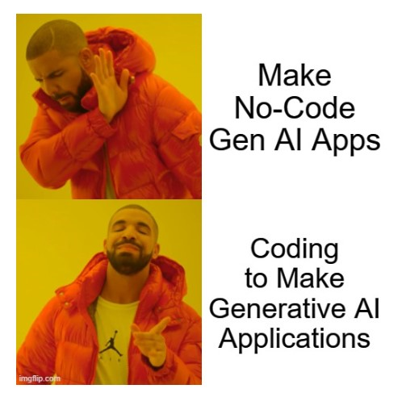
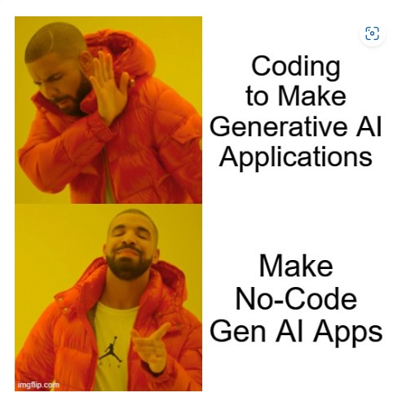
Ad-hoc or out of the shelf solution, or in between (MS Semantic Kernel)
????

Slide 32
Ad-hoc or out of the shelf solution, or in between (MS Semantic Kernel)
It depends, however now you know what is under the cover
Embeddings
Token limits
etc..
So that you have the knowledge to take the right decision
And this stuff applies to other LLM as well (e.g. Llama2)

Slide 34
Thank You!!!

