Slide 1
Build your domain expert chatbot using azure open.ai and c# (R.A.G.)
Enrico Sabbadin MSC

Slide 3
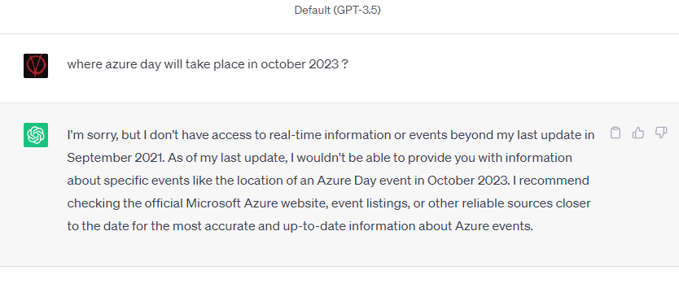
November 30, 2022
https://chat.openai.com
Developers' questions
Can I run chatgpt on my PC -> No
Can I access it as an api service? -> Yes
Can make a clone of the model, and train (fine-tune) it, so that it can reply about my domain specific data ? -> Ni
If fine tuning is not an option, is there another way to have it answer about my domain specific data ? -> Yes
This talk will elaborate on the last question

Slide 4
OpenAI GPT history
It's a "brand" : not only text but also images, (dalle-2, whisper)
All models are offered as api only, its a black box.
MS introduces Azure OpenAI services Nov 2021
- GPT 3.5 turbo (0613) - GPT 4 (0613) Jun 2023
GPT 3.5 Nov 2022
text-davinci-003
GPT3 June 2020
GPT 3.5 turbo (0301) March 2023
GPT 4 (0314) Mar 2023
First InstructGPT models Jan 2022
e.g. text-davinci-002
DALL-E 2 (GPT3 based) Jan 2021
ChatGpt (Web interface) Nov 2022
Azure OpenAI GA Jan 2023
Azure OpenAI on-your-data Jan 2023

Slide 5
Open.ai vs Azure Open.ai
Open.ai
Chatgpt web ui (free and plus version, the plus version allows to use plugins)
Open.ai api (pay per usage)
Auth via api key
Azure Open.ai
Added as additional offer in the MS AI ecosystem
Requires submission and approval of a request form (a separate one for Gpt4 access)
Auth via api key or Azure Ad
Allows network segregation and RBAC on your azure Ai instance
Quotas

Slide 6
Chat-completion api endpoint
Do not confuse it with completion api (legacy)
Stateless
Message types
System messages
User messages
Assistant messages
Temperature (and other parameters)
Tokens (and max tokens)
C# Sdk (MS provided and others)
MS one works both with open.ai and Azure open.ai

Slide 7
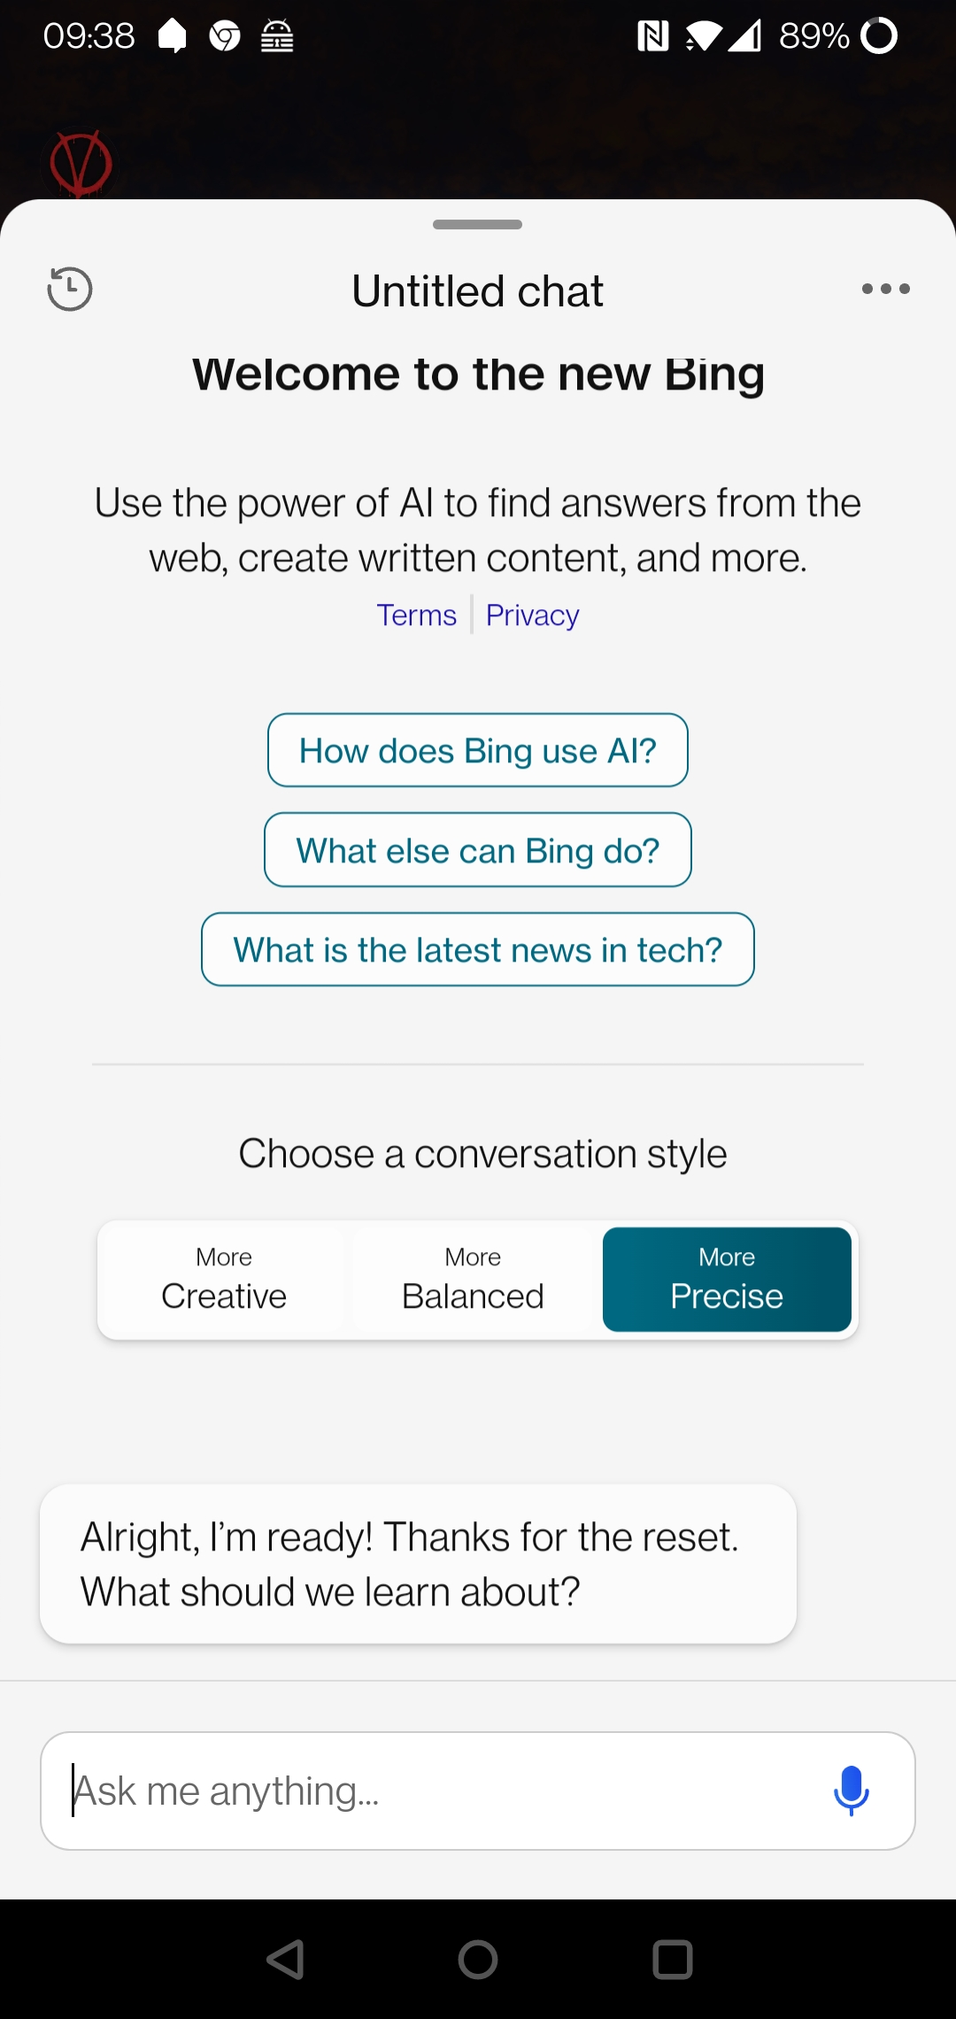
Temperature
0 to 2
0 more deterministic (but not totally)
higher level of temperature : more creative (random)

Slide 8
Conversation history management
Chat-completion api is stateless
You need to provide as input the previous conversation
Q1: {"messages": [
{"role": "user", "content": "Who won second world war?"}
]
}
A1: {"message": {
"role": "assistant",
"content": "The Allied Powers, led by the United States .."
}
}
-----------------------------------------------
Q2: {"messages": [
{"role": "user", "content": "Who won second world war?"},
{ "role": "assistant", "content": "The Allied Powers, led by the United States .." },
{"role": "user", "content": "and who lost it ?"}
] }

Slide 9
Postman demo

Slide 10
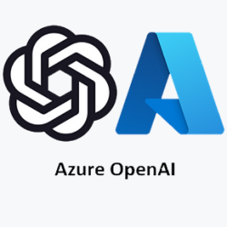
Chatbot Application layout
UI : JS / Windows app
backend : RestApi/Grpc/GraphQl
1
Conversation manager middleware In: load conversation by conversation Id Out: store new conversation iteration
DEMO 1

Slide 11
Tokens
Chatgpt internally "reasons" in tokens
Tokens are related to words but are not words, roughly speaking they are syllable
In English tokens = words * 4/3, e.g., 3k words are 4k tokens
Each model has a limit on the size of input + output tokens (and hence text)
Models
gpt-3.5-turbo (0301/0613) : 4096
gpt-3.5-turbo-16k (0613) : 16384
gpt-4 (0314/0613) : 8192
gpt-4-32k (0314/0613) : 32768
Api response returns input / output tokens consumed
No api endpoint to calculate them upfront
Open AI suggests to use the tik-token algorithm
Libraries are available (also for .NET as nuget packages) to use same algorithm used by chat-completion api on server side

Slide 12
Chatbot on your data
Technical word or this technique is: "Retrieval Augmented Generation"
The basic idea is to provide as part of the input, as user message(s), text that contains relevant information for the AI to answer the user question.
Sounds easy, but if my chatbot must work on a list of document whose size is greater than the model token limit ? How do I extract the documents relevant to the specific user question ?
Time to get to know embeddings … ☺

Slide 13
What "the hell" are embeddings ?
An embedding model converts a block of text into a vector (array) of numbers (floats) that "captures" the context/meaning of the provided text
text-embedding-ada-002 is currently recommended one
text-embedding-ada-002 response vector has 1536 elements
Exposed as an api endpoint by open ai / azure open ai

Slide 14
Embedding "similarity"
Given the corresponding two embedding vectors, It's possible to evaluate the "similarity" between two block of texts
Calculate the "distance" of the corresponding two embedding vectors
Small distance means more similarity
Cosine similarity is currently the recommended method to calculate the distance

Slide 15
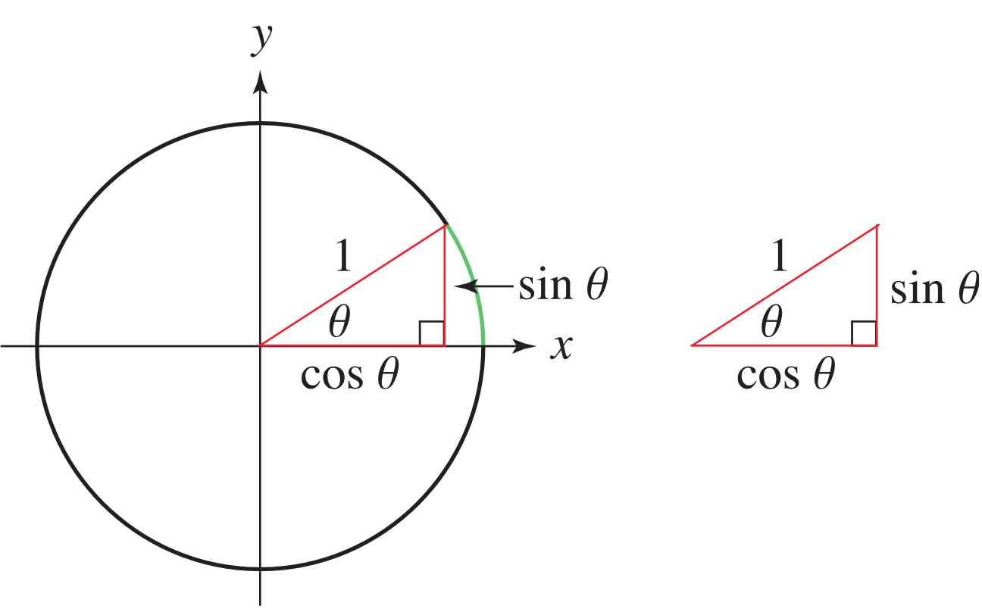
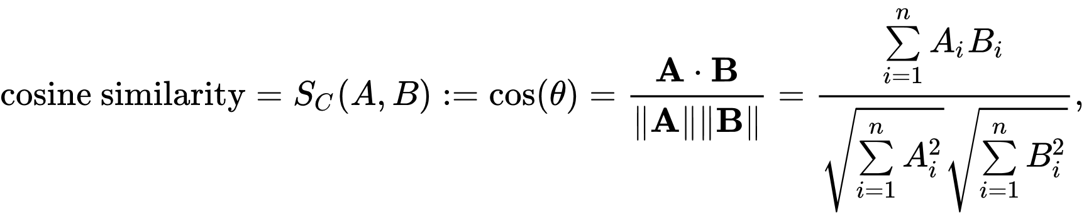

Cosine similtarity
y
V1 (0.5,1)
V2 (0.7,0.7)
x
n : 1536
V3 (-1.5,-0.5)
Don't be afraid : this is a for loop ☺

Slide 16
public float GetProximity(IReadOnlyList<float> A, IReadOnlyList<float> B)
{
// TO DO : check A and B has same length
var vectorLength = A.Count;
var sum = 0.0f;
var ALength = 0.0f;
var BLength = 0.0f;
for (var i = 0; i < vectorLength; i++) {
sum += A[i] * B[i];
ALength += Convert.ToSingle(Math.Pow(A[i], 2)); // A[i]^2
BLength += Convert.ToSingle(Math.Pow(B[i], 2)); // B[i]^2
}
var proximity = sum / (Math.Pow(ALength, 0.5) * Math.Pow(BLength, 0.5));
return Convert.ToSingle(proximity);
}

Slide 17
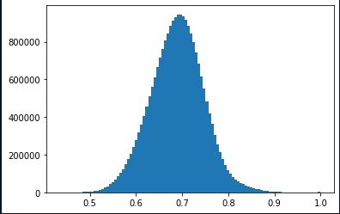
Note on Cosine proximity
With random vectors distribution it ranges from -1 to 1
Vectors coming from text-embedding-ada-002 have a bias, values always positive, approximately distributed in a gaussian shape around 0.7
Experiment with values in the range like 0,75 – 0.8 for minimum proximity threshold
https://community.openai.com/t/embeddings-and-cosine-similarity/17761/10

Slide 18
How can embeddings can help me then?
1/2: Chatbot up-front setup
Document preparation conversion (and splitting if required)
AI understand text files only (markdown include, which is even better than "normal" text files)
PDF, HTML files must be converted to text format
Splitting: Suggestion is to try to stay below 1000 token (but it depends on the max token limit of the chat completion model)
Use Azure OpenAi embedding api endpoint to get corresponding embedding of your relevant "documents"
Store document -> corresponding embedding vector "somewhere"

Slide 19
About document preparation/splitting
Best if based on token count, not words count
Keep some text overlapping when splitting (experiment from 15% to 30%)
LangChain suggests "RecursiveCharacterTextSplitter"
but it's python
MS Semantic Kernel SDK come to rescue: TextChunker class where one will obviously pass a tik-token tokenizer as counter function

Slide 20
How can embeddings can help me then?
2/2: User question arrives to your Chatbot app: setup payload to be sent to open.ai completion api as follows
Calculate user question embedding vector
Calculate cosine proximity of user question embedding against each stored document embedding
Pick up the documents whose embeddings are closer to the question embedding using cosine proximity
In the text selection define a minimum proximity threshold (e.g. 0.73) and possibly a max num of documents to pick
Push text blocks as Role="user" messages in the request before the actual user question

Slide 21
Embeddings and documents storage
There are vectors databases that provide vector operations (cosine similarity included) out-of-the-box
Azure Cognitive Services Vector Search (public preview)
PineCone, etc ..
Or
SQL server as storage is ok to start with, and for cosine calculation
C# in memory cosine proximity calculation, or ..
Have SQL do the math https://devblogs.microsoft.com/azure-sql/vector-similarity-search-with-azure-sql-database-and-openai/
SELECT SUM(a.value * b.value) / (
SQRT(SUM(a.value * a.value)) * SQRT(SUM(b.value * b.value))
) AS cosine_similarity
FROM
vectors_values

Slide 22
Application layout
UI : JS / Windows app
backend : RestApi/Grpc/GraphQl
Context provider middleware In: add relevant context documents as user messages
1
2
Conversation manager middleware In: load conversation by conversation Id Out: store new conversation iteration

Slide 23
System message for chatbot
Do not let users use your chatbot for generic queries
Instruct ai model via proper system message, such as
You are a bot that assists users of the myMSC web site. If the answer is not related to myMSC, if no context is provided with the question or the context is irrelevant to the user question, never absolutely provide an answer to the questions, just say: 'Sorry I couldn't get your question, or I am not allowed to reply to it. Know that I am not a general-purpose bot, I provide myMSC related information only'

Slide 24
Application layout
UI : JS / Windows app
backend : RestApi/Grpc/GraphQl
Context provider middleware In: add relevant context documents as user messages
1
2
3
Conversation manager middleware In: load conversation by conversation Id Out: store new conversation iteration
System message provider middleware
DEMO 2

Slide 25
Multilanguage support
Chat-completion api knows a lot of languages, so what's the issue ?
Problem is that cosine proximity of two vectors generated from text of different languages does not work well.
But my documents are only in a single language !!
Solution
Convert user question to language of the documentation, and detect user language
Pick up relevant documents and send them to AI together with translated user question
Convert ai answer to original language
Can be done with chat-completions api itself or Azure Translator (part of Azure Cognitive Service)

Slide 26
Application layout
UI : JS / Windows app
backend : RestApi/Grpc/GraphQl
Context provider middleware In: add relevant context documents as user messages
1
2
3
4
System message provider middleware
Translator manager middleware In: convert to desired language and detect user language Out: Convert ai response to user language
Conversation manager middleware In: load conversation by conversation Id Out: store new conversation iteration
DEMO 3

Slide 27
Houston, we have a problem
.. Calculating relevant documents on "last question only" does not work ☹
One simple option is to send context document also for previous questions
A more sophisticated one is trying to detect the user has changed topic, and, if it's the case, avoid sending context from previous conversation history
Obviously, "Has the user changed the topic?" is a question to do to the AI ☺
Q: What is Instant Quote
A: ...
Q: Tell me more about it

Slide 28
Application layout
System message provider middleware
Context provider middleware In: add relevant context documents as user messages
UI : JS / Windows app
backend : RestApi/Grpc/GraphQl
1
2
3
4
5
Conversation manager middleware In: load conversation by conversation Id Out: store new conversation iteration
Change topic detector middleware In: If the user has changed topic, push to the execution context this information, so that Context provider middleware and Conversation manager middleware act accordingly
Translator manager middleware In: convert to desired language and detect user language Out: Convert ai response to user language

Slide 29
Keep input token count under control
Token count of input message can get quite "big" due to the presence of context documents retrieved with the embedding technique
Put a limit on conversation iteration
Even with a conversation length limit, it's a good practice to keep token count under control
If <input token count> * (1- <fraction of tokens to keep for reply) > max allowed total token count for the model , then …
Drop older conversation item and corresponding context documents, until above condition is not true any more

Slide 30
Application layout
Max tokens guard middleware Keep tokens count in input message "under control"
Context provider middleware In: add relevant context documents as user messages
System message provider middleware
UI : JS / Windows app
backend : RestApi/Grpc/GraphQl
1
2
3
4
5
6
Conversation manager middleware In: load conversation by conversation Id Out: store new conversation iteration
Change topic detector middleware In: If the user has changed topic, push to the execution context this information, so that Context provider middleware and Conversation manager middleware act accordingly
Translator manager middleware In: convert to desired language and detect user language Out: Convert ai response to user language

Slide 31
Talk and Hear with your chatbot
Use Azure speech-to-text and text-to-speech on top in our client
speech-to-text
Text-to-speech
DEMO on UI

Slide 32
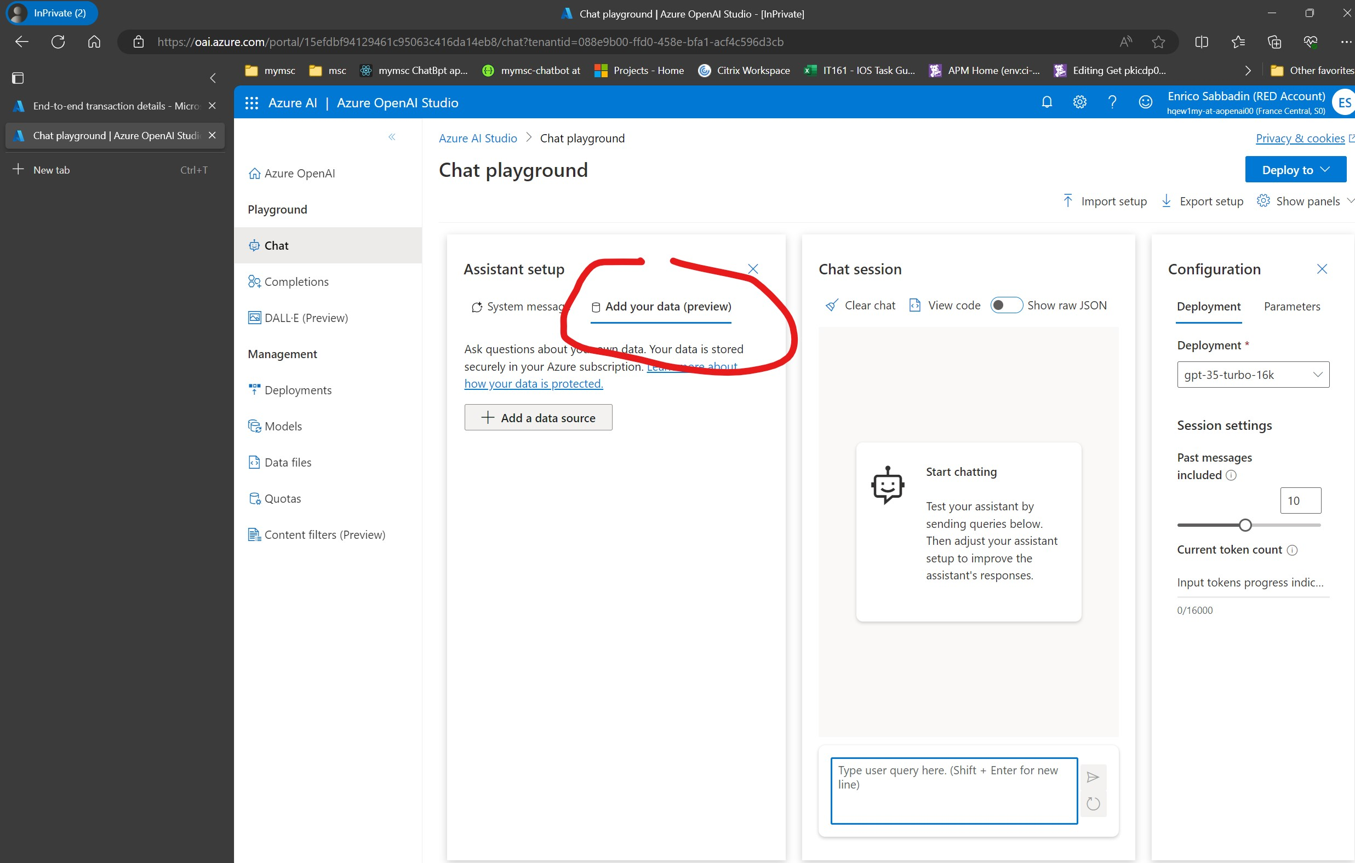
Azure OpenAI on your data

Slide 33
Azure OpenAI on your data
No-Code experience to develop "your domain expert chatbot using azure open.ai"
Exposed as an api extension of competition-chat
YOUR_RESOURCE_NAME/openai/deployments/YOUR_DEPLOYMENT_NAME/extensions/chat/completions?api-version=..
Document upload
Automatic conversion of html, pdf, word, etc .. files to text files
Splitting of docs is still under your responsibility

Slide 34
Azure OpenAI on your data
Requires a storage account where documents are uploaded
Requires an Azure Cognitive Search index
Recently vector search (cosine proximity) has been made available
Recently a persistent storage for conversation con be used (Cosmo db)
One quick deployment as an Azure web app
https://github.com/microsoft/sample-app-aoai-chatGPT (Python code)

Slide 35
MS Semantic Kernel
Set of libraries in Python, Java and Net that abstract to a certain degree
Interaction with LLM
Conversation management
Text splitting
etc ..

Slide 36
Ad-hoc or out of the shelf solution, or in between (MS Semantic Kernel)
It depends, however now you know what is under the cover
Embeddings
Token limits
etc..
So that you have the knowledge to take the right decision
And this stuff applies to other LLM as well (e.g. Llama2)

Slide 38
Thank You!!!

