Slide 1
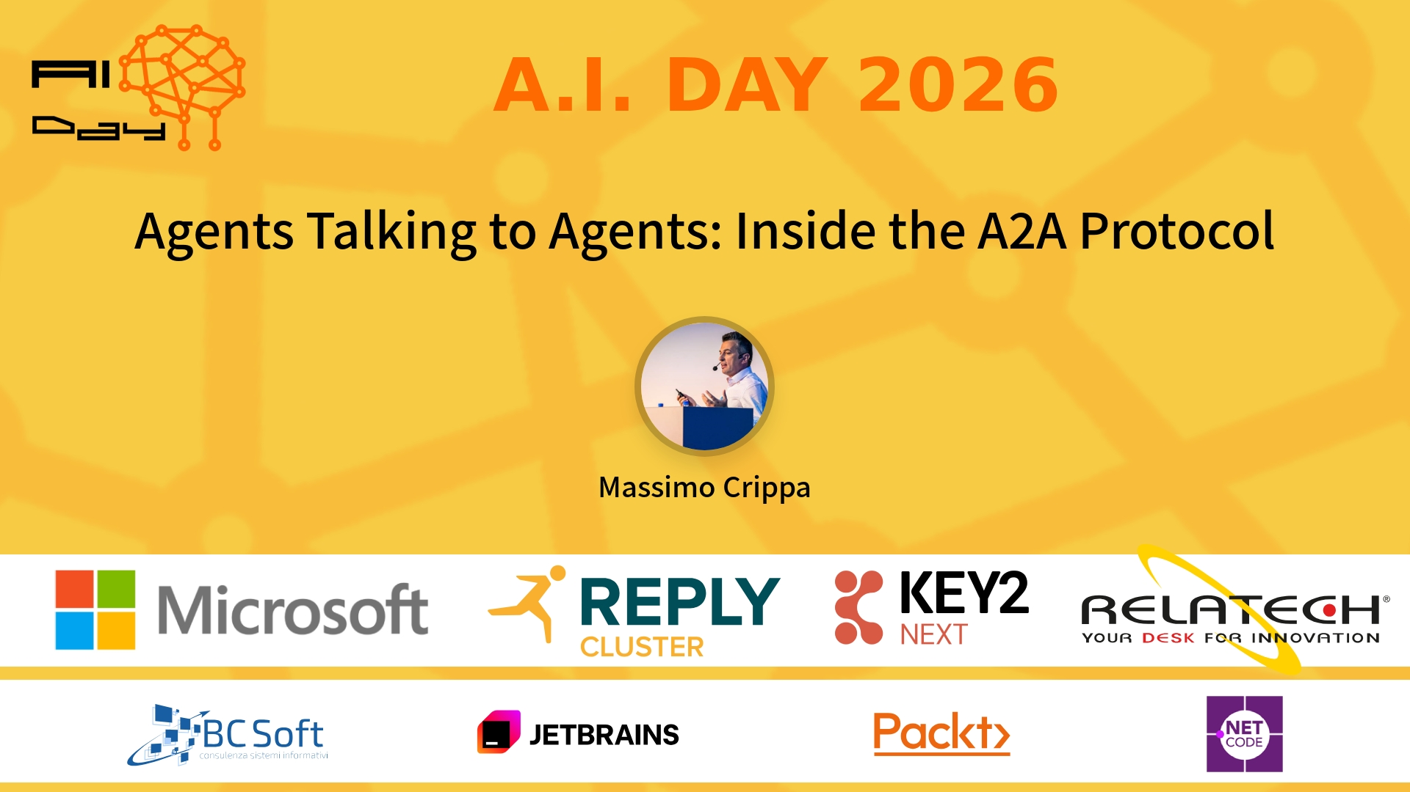
Session Banner - Agents Talking to Agents: Inside the A2A Protocol
Notes:
Notes for banner slide.

Slide 2
Event Sponsors
Notes:
Notes for sponsors slide.

Slide 3
Demo: Agents Talking to Agents: Inside the A2A Protocol
Notes:
Notes for demo slide.

Slide 4
Questions & Discussion
Notes:
Notes for questions slide.

Slide 5
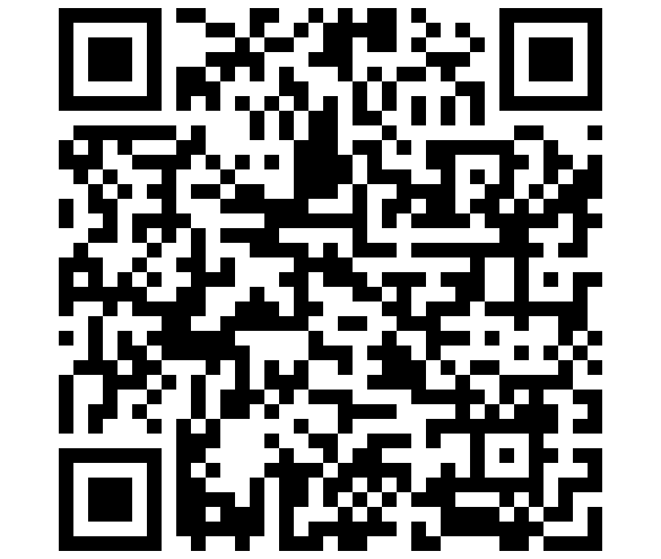
Please Vote for This Session
Vote for Session - Agents Talking to Agents: Inside the A2A Protocol
Notes:
Notes for vote slide.

