Slide 1
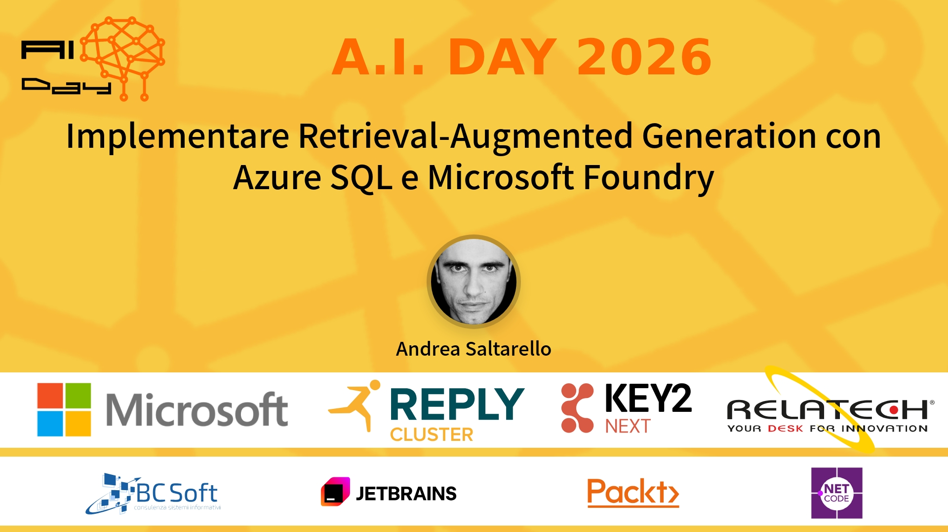
Session Banner - Implementare Retrieval-Augmented Generation con Azure SQL e Microsoft Foundry
Notes:
Notes for banner slide.

Slide 2
Event Sponsors
Notes:
Notes for sponsors slide.

Slide 3
Demo: Implementare Retrieval-Augmented Generation con Azure SQL e Microsoft Foundry
Notes:
Notes for demo slide.

Slide 4
Questions & Discussion
Notes:
Notes for questions slide.

Slide 5
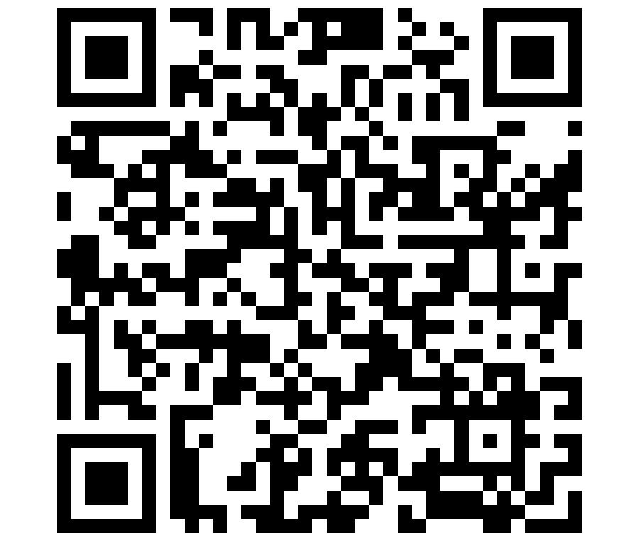
Please Vote for This Session
Vote for Session - Implementare Retrieval-Augmented Generation con Azure SQL e Microsoft Foundry
Notes:
Notes for vote slide.

