Slide 1
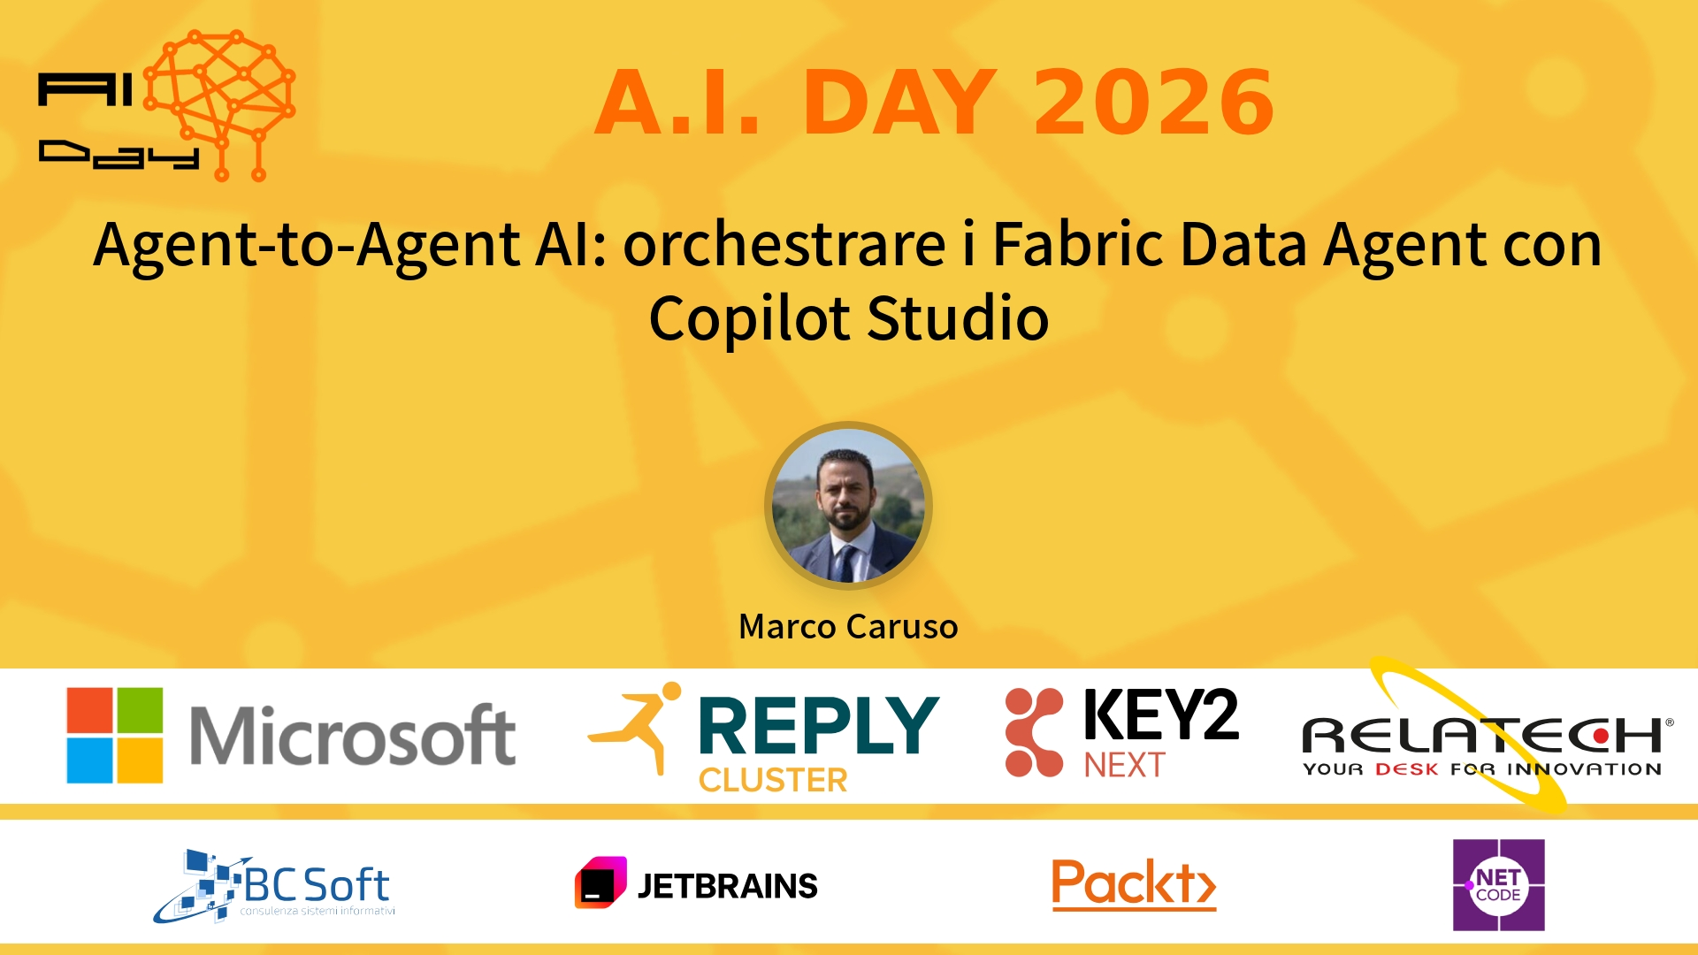
Session Banner - Agent‑to‑Agent AI: orchestrare i Fabric Data Agent con Copilot Studio
Notes:
Notes for banner slide.

Slide 2
Event Sponsors
Notes:
Notes for sponsors slide.

Slide 3
Demo: Agent‑to‑Agent AI: orchestrare i Fabric Data Agent con Copilot Studio
Notes:
Notes for demo slide.

Slide 4
Questions & Discussion
Notes:
Notes for questions slide.

Slide 5
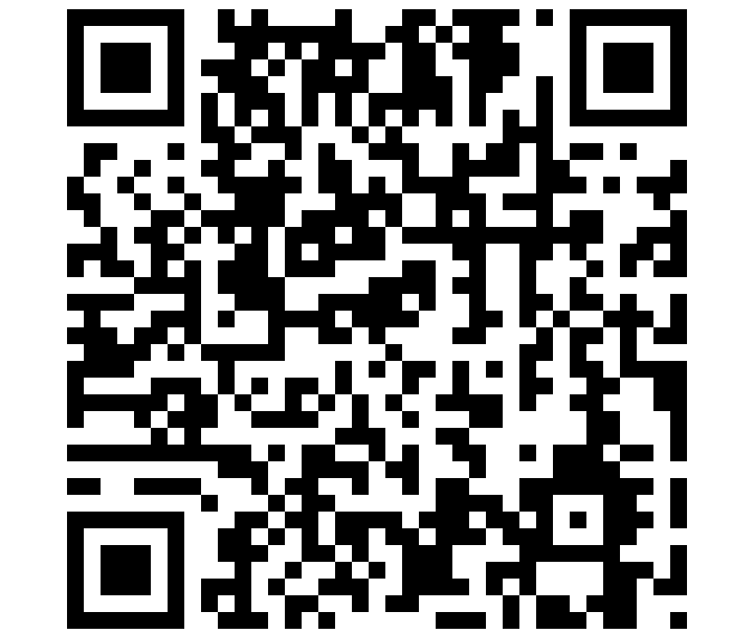
Please Vote for This Session
Vote for Session - Agent‑to‑Agent AI: orchestrare i Fabric Data Agent con Copilot Studio
Notes:
Notes for vote slide.

