Slide 1
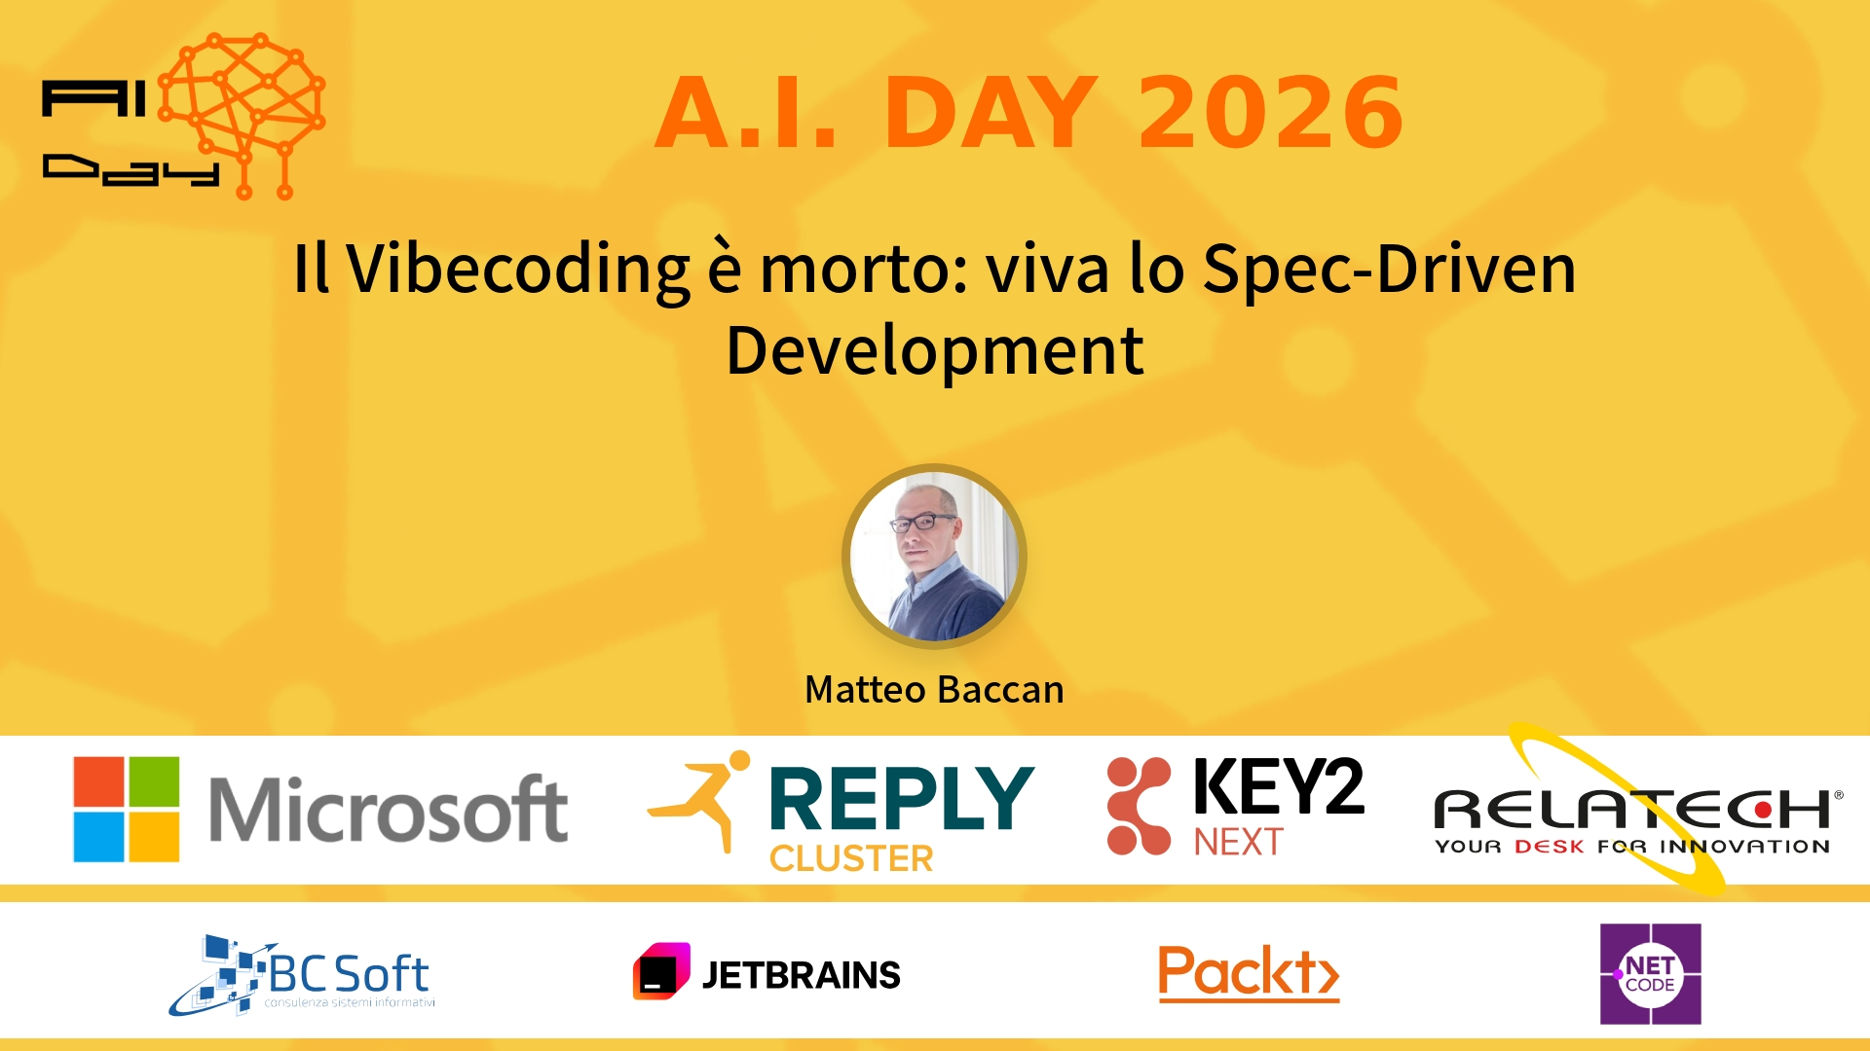
Session Banner - Il Vibecoding è morto: viva lo Spec-Driven Development
Notes:
Notes for banner slide.

Slide 2
Event Sponsors
Notes:
Notes for sponsors slide.

Slide 3
Demo: Il Vibecoding è morto: viva lo Spec-Driven Development
Notes:
Notes for demo slide.

Slide 4
Questions & Discussion
Notes:
Notes for questions slide.

Slide 5

Please Vote for This Session
Vote for Session - Il Vibecoding è morto: viva lo Spec-Driven Development
Notes:
Notes for vote slide.

