Slide 1
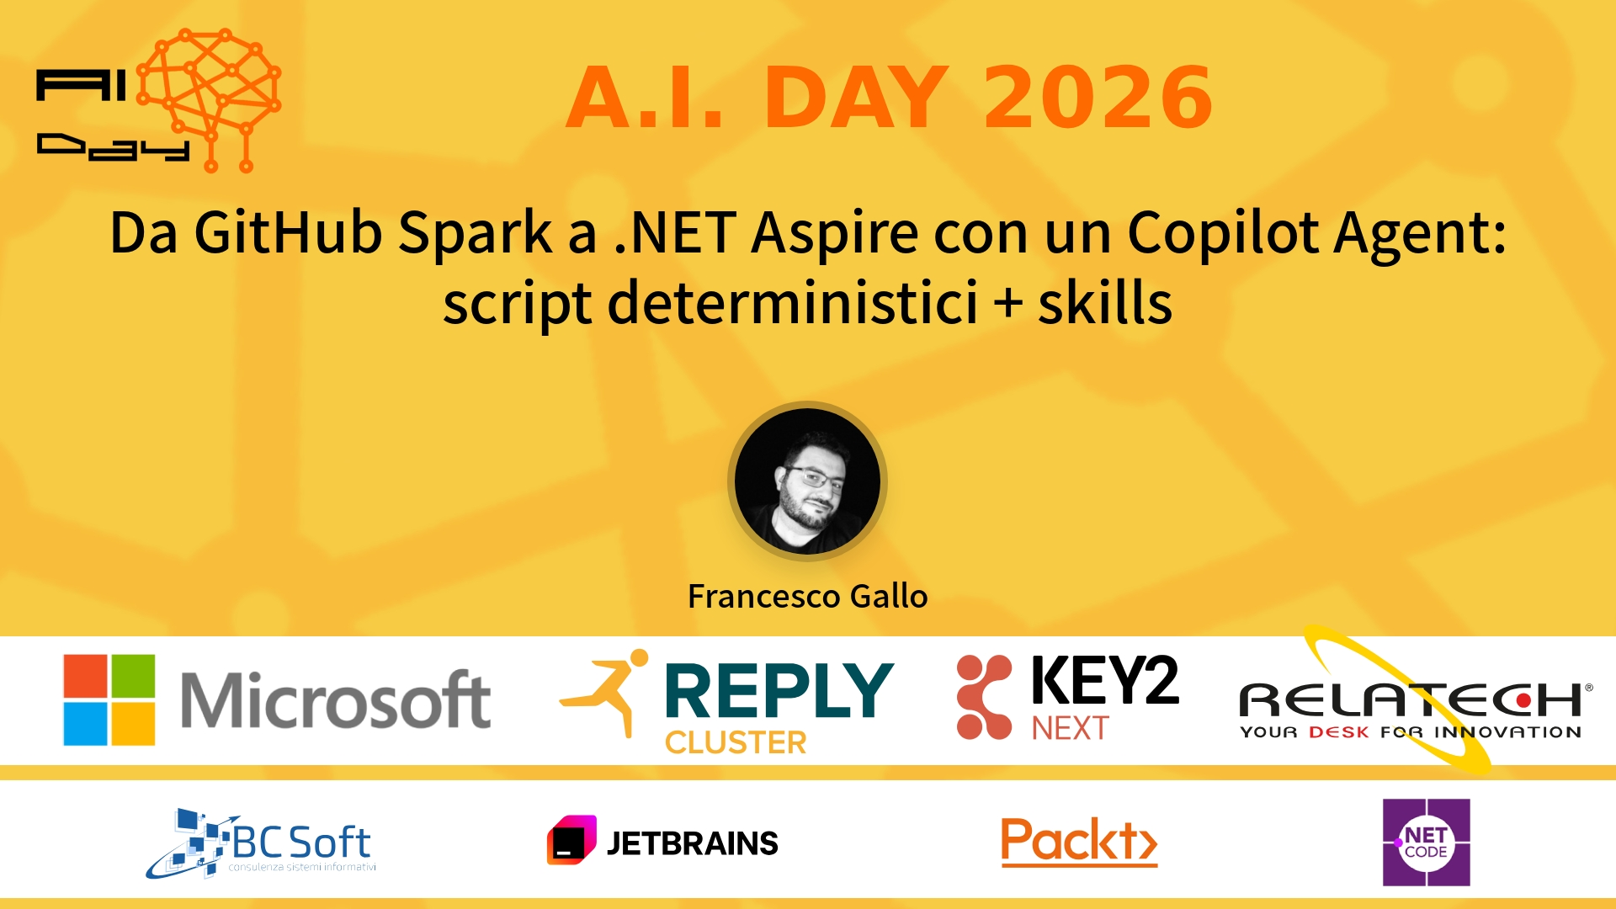
Session Banner - Da GitHub Spark a .NET Aspire con un Copilot Agent: script deterministici + skills
Notes:
Notes for banner slide.

Slide 2
Event Sponsors
Notes:
Notes for sponsors slide.

Slide 3
Demo: Da GitHub Spark a .NET Aspire con un Copilot Agent: script deterministici + skills
Notes:
Notes for demo slide.

Slide 4
Questions & Discussion
Notes:
Notes for questions slide.

Slide 5
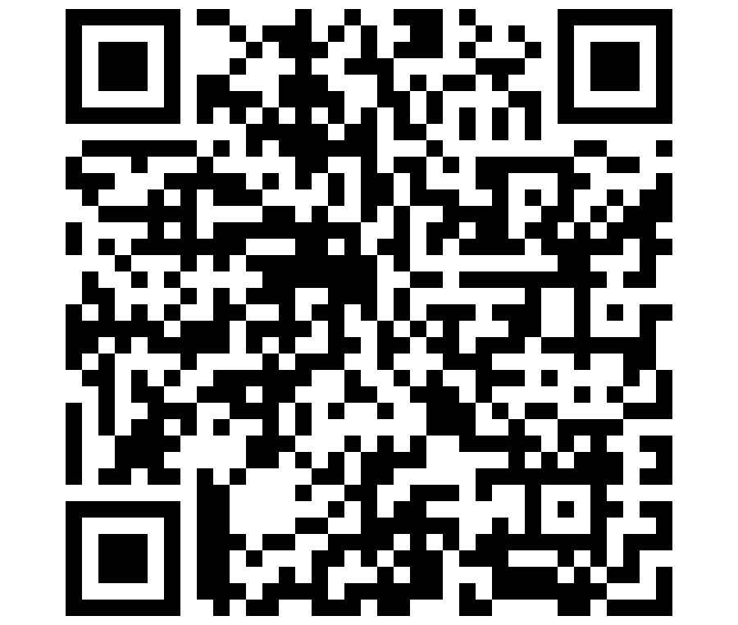
Please Vote for This Session
Vote for Session - Da GitHub Spark a .NET Aspire con un Copilot Agent: script deterministici + skills
Notes:
Notes for vote slide.

