Slide 1
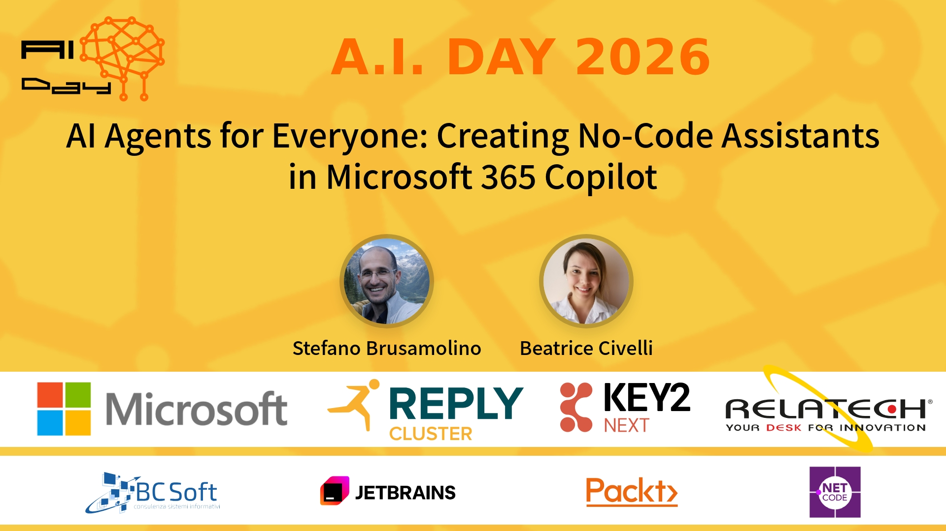
Session Banner - AI Agents for Everyone: Creating No-Code Assistants in Microsoft 365 Copilot
Notes:
Notes for banner slide.

Slide 2
Event Sponsors
Notes:
Notes for sponsors slide.

Slide 3
Demo: AI Agents for Everyone: Creating No-Code Assistants in Microsoft 365 Copilot
Notes:
Notes for demo slide.

Slide 4
Questions & Discussion
Notes:
Notes for questions slide.

Slide 5
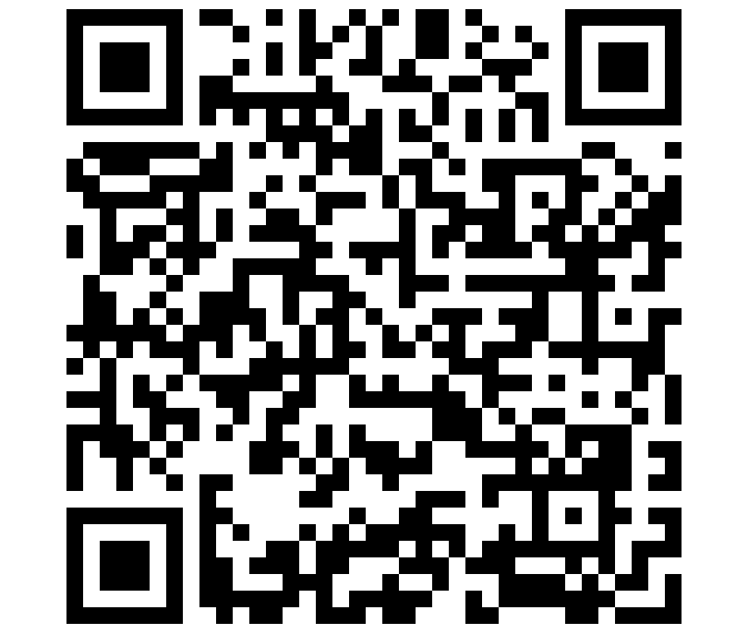
Please Vote for This Session
Vote for Session - AI Agents for Everyone: Creating No-Code Assistants in Microsoft 365 Copilot
Notes:
Notes for vote slide.

