Slide 1
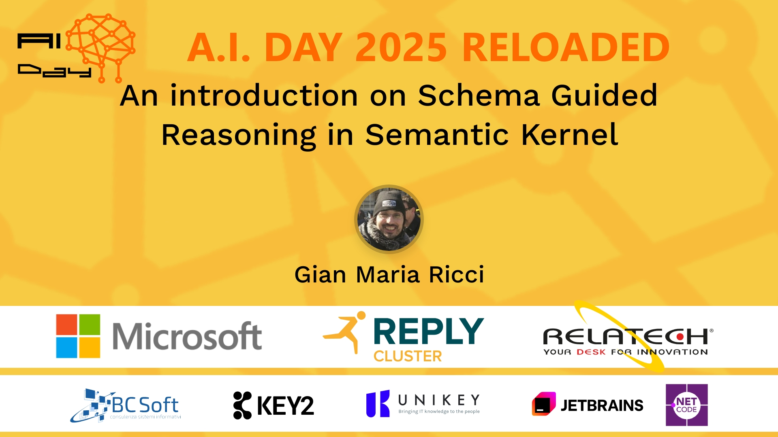
Session Banner - An introduction on Schema Guided Reasoning in Semantic Kernel
Notes:
This is the opening banner slide for 'An introduction on Schema Guided Reasoning in Semantic Kernel'. The session is presented by: Gian Maria Ricci. This slide sets the visual theme for the presentation.

Slide 2
An introduction on Schema Guided Reasoning in Semantic Kernel
Presented by: Gian Maria Ricci
Notes:
Main title slide displaying 'An introduction on Schema Guided Reasoning in Semantic Kernel'. Presented by: Gian Maria Ricci. Use this slide to introduce the session topic.

Slide 3
Event Sponsors
Notes:
Sponsor acknowledgment slide. Take a moment to thank the event sponsors and explain their support for the conference.

Slide 4
An introduction on Schema Guided Reasoning in Semantic Kernel
Speaker(s): Gian Maria Ricci
Notes:
Detailed session information for 'An introduction on Schema Guided Reasoning in Semantic Kernel'. Session description: Schema Guided Reasoning è un semplice framework che utilizza la funzionalità Structured Output di OpenAi per spingere un LLM al ragionamento ma avendo un output con uno schema ben preciso e predittibi.... Review the session objectives and speaker credentials.

Slide 5
Demo: An introduction on Schema Guided Reasoning in Semantic Kernel
Notes:
Demo section for 'An introduction on Schema Guided Reasoning in Semantic Kernel'. This slide is for live demonstrations. Ensure all demo materials are prepared and tested.

Slide 6
Questions & Discussion
Notes:
Q&A slide for 'An introduction on Schema Guided Reasoning in Semantic Kernel'. This is time for audience questions and discussion. Prepare to address common questions about the topic and invite participation.

Slide 7

Please Vote for This Session
Vote for Session - An introduction on Schema Guided Reasoning in Semantic Kernel
Notes:
Voting slide for 'An introduction on Schema Guided Reasoning in Semantic Kernel'. Ask audience to scan the QR code or visit https://vote.dotnetdev.it/vote/lp0trhq1/1020087 to vote. Emphasize the importance of feedback.

