Slide 1

Session Banner - AI on device con le nuove Windows AI foundry API
Notes:
This is the opening banner slide for 'AI on device con le nuove Windows AI foundry API'. The session is presented by: Alessio Iafrate. This slide sets the visual theme for the presentation.

Slide 2
AI on device con le nuove Windows AI foundry API
Presented by: Alessio Iafrate
Notes:
Main title slide displaying 'AI on device con le nuove Windows AI foundry API'. Presented by: Alessio Iafrate. Use this slide to introduce the session topic.

Slide 3
Event Sponsors
Notes:
Sponsor acknowledgment slide. Take a moment to thank the event sponsors and explain their support for the conference.

Slide 4
AI on device con le nuove Windows AI foundry API
Speaker(s): Alessio Iafrate
Notes:
Detailed session information for 'AI on device con le nuove Windows AI foundry API'. Session description: Tra le novità dell'ultimo build, le Windows AI foundry API hanno aperto nuove possibilità di sviluppo, portando l'intelligenza artificiale direttamente su Windows. Questo permette alle applicazioni di.... Review the session objectives and speaker credentials.

Slide 5
Demo: AI on device con le nuove Windows AI foundry API
Notes:
Demo section for 'AI on device con le nuove Windows AI foundry API'. This slide is for live demonstrations. Ensure all demo materials are prepared and tested.

Slide 6
Questions & Discussion
Notes:
Q&A slide for 'AI on device con le nuove Windows AI foundry API'. This is time for audience questions and discussion. Prepare to address common questions about the topic and invite participation.

Slide 7
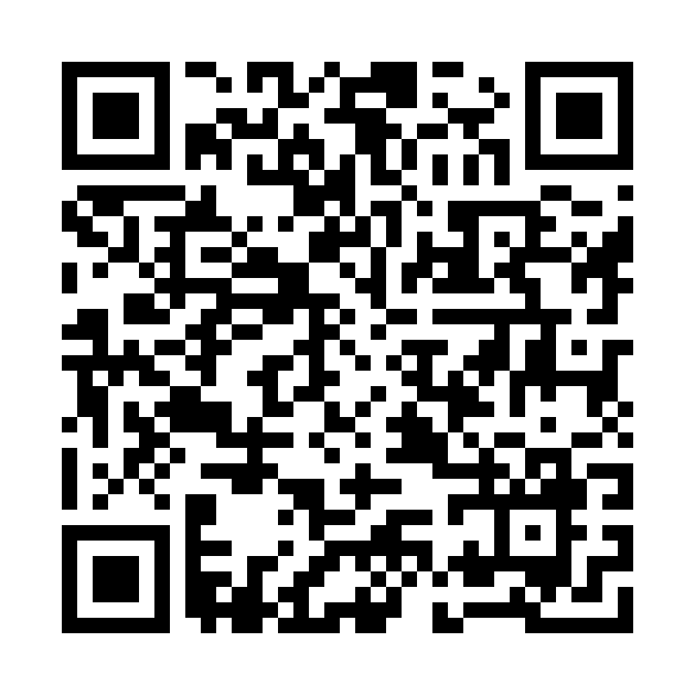
Please Vote for This Session
Vote for Session - AI on device con le nuove Windows AI foundry API
Notes:
Voting slide for 'AI on device con le nuove Windows AI foundry API'. Ask audience to scan the QR code or visit https://vote.dotnetdev.it/vote/lp0trhq1/1028397 to vote. Emphasize the importance of feedback.

