Slide 1
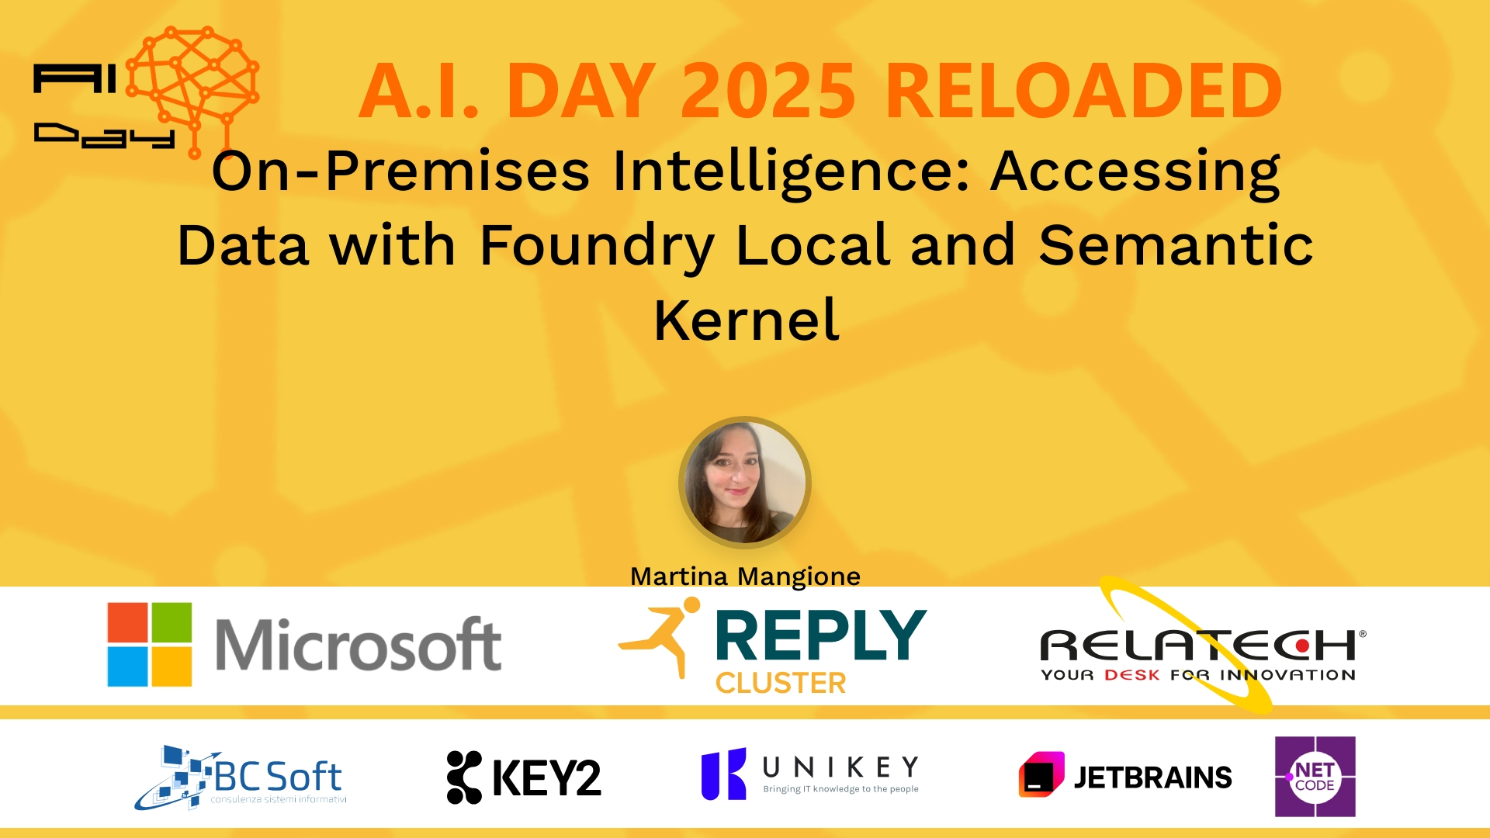
Session Banner - On-Premises Intelligence: Accessing Data with Foundry Local and Semantic Kernel
Notes:
This is the opening banner slide for 'On-Premises Intelligence: Accessing Data with Foundry Local and Semantic Kernel'. The session is presented by: Martina Mangione. This slide sets the visual theme for the presentation.

Slide 2
On-Premises Intelligence: Accessing Data with Foundry Local and Semantic Kernel
Presented by: Martina Mangione
Notes:
Main title slide displaying 'On-Premises Intelligence: Accessing Data with Foundry Local and Semantic Kernel'. Presented by: Martina Mangione. Use this slide to introduce the session topic.

Slide 3
Event Sponsors
Notes:
Sponsor acknowledgment slide. Take a moment to thank the event sponsors and explain their support for the conference.

Slide 4
On-Premises Intelligence: Accessing Data with Foundry Local and Semantic Kernel
Speaker(s): Martina Mangione
Notes:
Detailed session information for 'On-Premises Intelligence: Accessing Data with Foundry Local and Semantic Kernel'. Session description: Is your data locked behind complex SQL? This session reveals how to build a powerful AI layer using Semantic Kernel and Foundry Local. We’ll show you a fully disconnected .NET solution that translates.... Review the session objectives and speaker credentials.

Slide 5
Demo: On-Premises Intelligence: Accessing Data with Foundry Local and Semantic Kernel
Notes:
Demo section for 'On-Premises Intelligence: Accessing Data with Foundry Local and Semantic Kernel'. This slide is for live demonstrations. Ensure all demo materials are prepared and tested.

Slide 6
Questions & Discussion
Notes:
Q&A slide for 'On-Premises Intelligence: Accessing Data with Foundry Local and Semantic Kernel'. This is time for audience questions and discussion. Prepare to address common questions about the topic and invite participation.

Slide 7
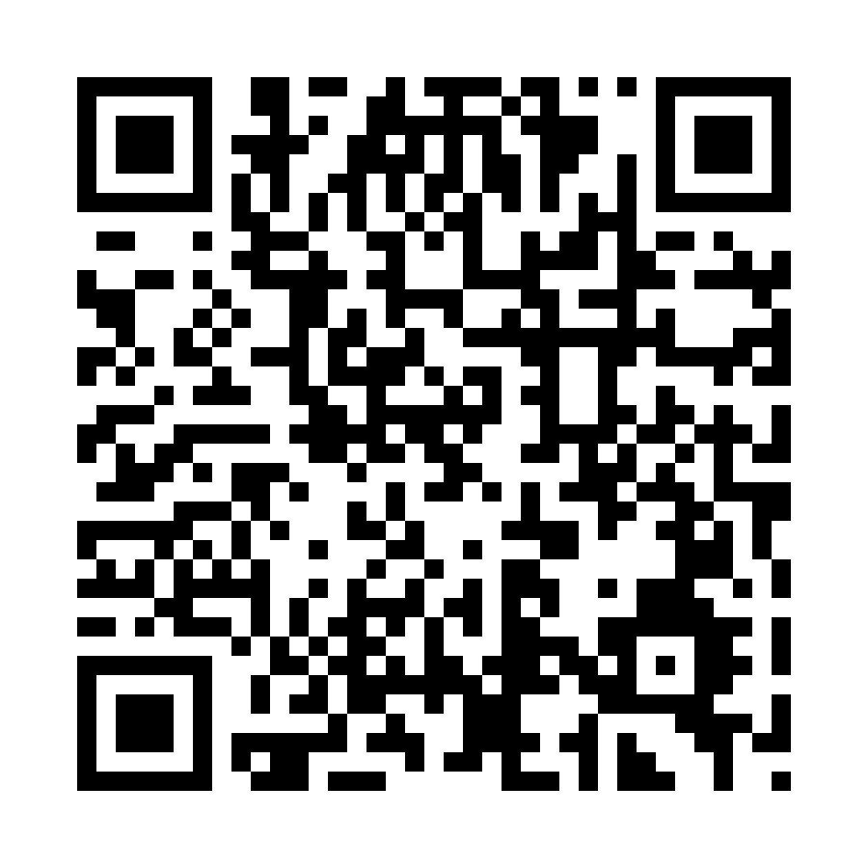
Please Vote for This Session
Vote for Session - On-Premises Intelligence: Accessing Data with Foundry Local and Semantic Kernel
Notes:
Voting slide for 'On-Premises Intelligence: Accessing Data with Foundry Local and Semantic Kernel'. Ask audience to scan the QR code or visit https://vote.dotnetdev.it/vote/lp0trhq1/1039985 to vote. Emphasize the importance of feedback.

