Slide 1

Session Banner - AI@YourService
Notes:
This is the opening banner slide for 'AI@YourService'. The session is presented by: Mirko Venditti, Francesca Venditti. This slide sets the visual theme for the presentation.

Slide 2
AI@YourService
Presented by: Mirko Venditti, Francesca Venditti
Notes:
Main title slide displaying 'AI@YourService'. Presented by: Mirko Venditti, Francesca Venditti. Use this slide to introduce the session topic.

Slide 3
Event Sponsors
Notes:
Sponsor acknowledgment slide. Take a moment to thank the event sponsors and explain their support for the conference.

Slide 4
AI@YourService
Speaker(s): Mirko Venditti; Francesca Venditti
Notes:
Detailed session information for 'AI@YourService'. Session description: Quando l’intelligenza artificiale supporta il customer service: dal messaggio al ticket, fino alla risoluzione._x000D_
In un mondo in cui le interazioni con i clienti diventano sempre più complesse e immedi.... Review the session objectives and speaker credentials.

Slide 5
Demo: AI@YourService
Notes:
Demo section for 'AI@YourService'. This slide is for live demonstrations. Ensure all demo materials are prepared and tested.

Slide 6
Questions & Discussion
Notes:
Q&A slide for 'AI@YourService'. This is time for audience questions and discussion. Prepare to address common questions about the topic and invite participation.

Slide 7
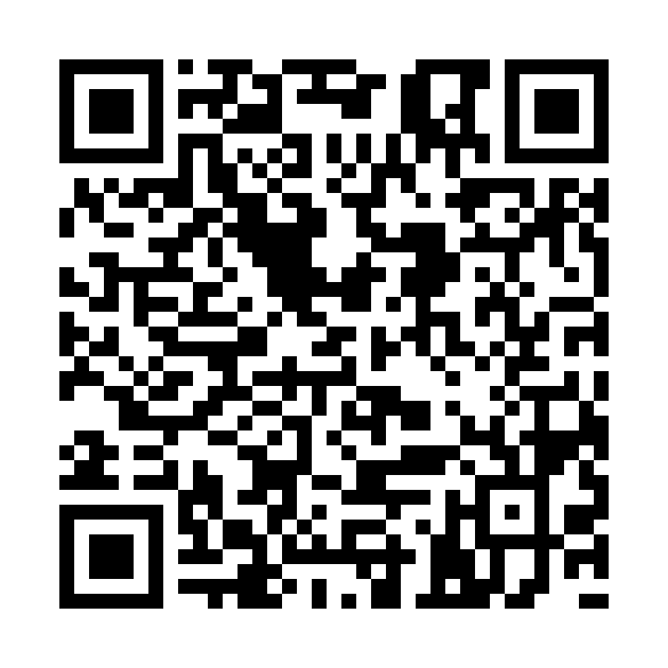
Please Vote for This Session
Vote for Session - AI@YourService
Notes:
Voting slide for 'AI@YourService'. Ask audience to scan the QR code or visit https://vote.dotnetdev.it/vote/lp0trhq1/1055531 to vote. Emphasize the importance of feedback.

