Slide 1
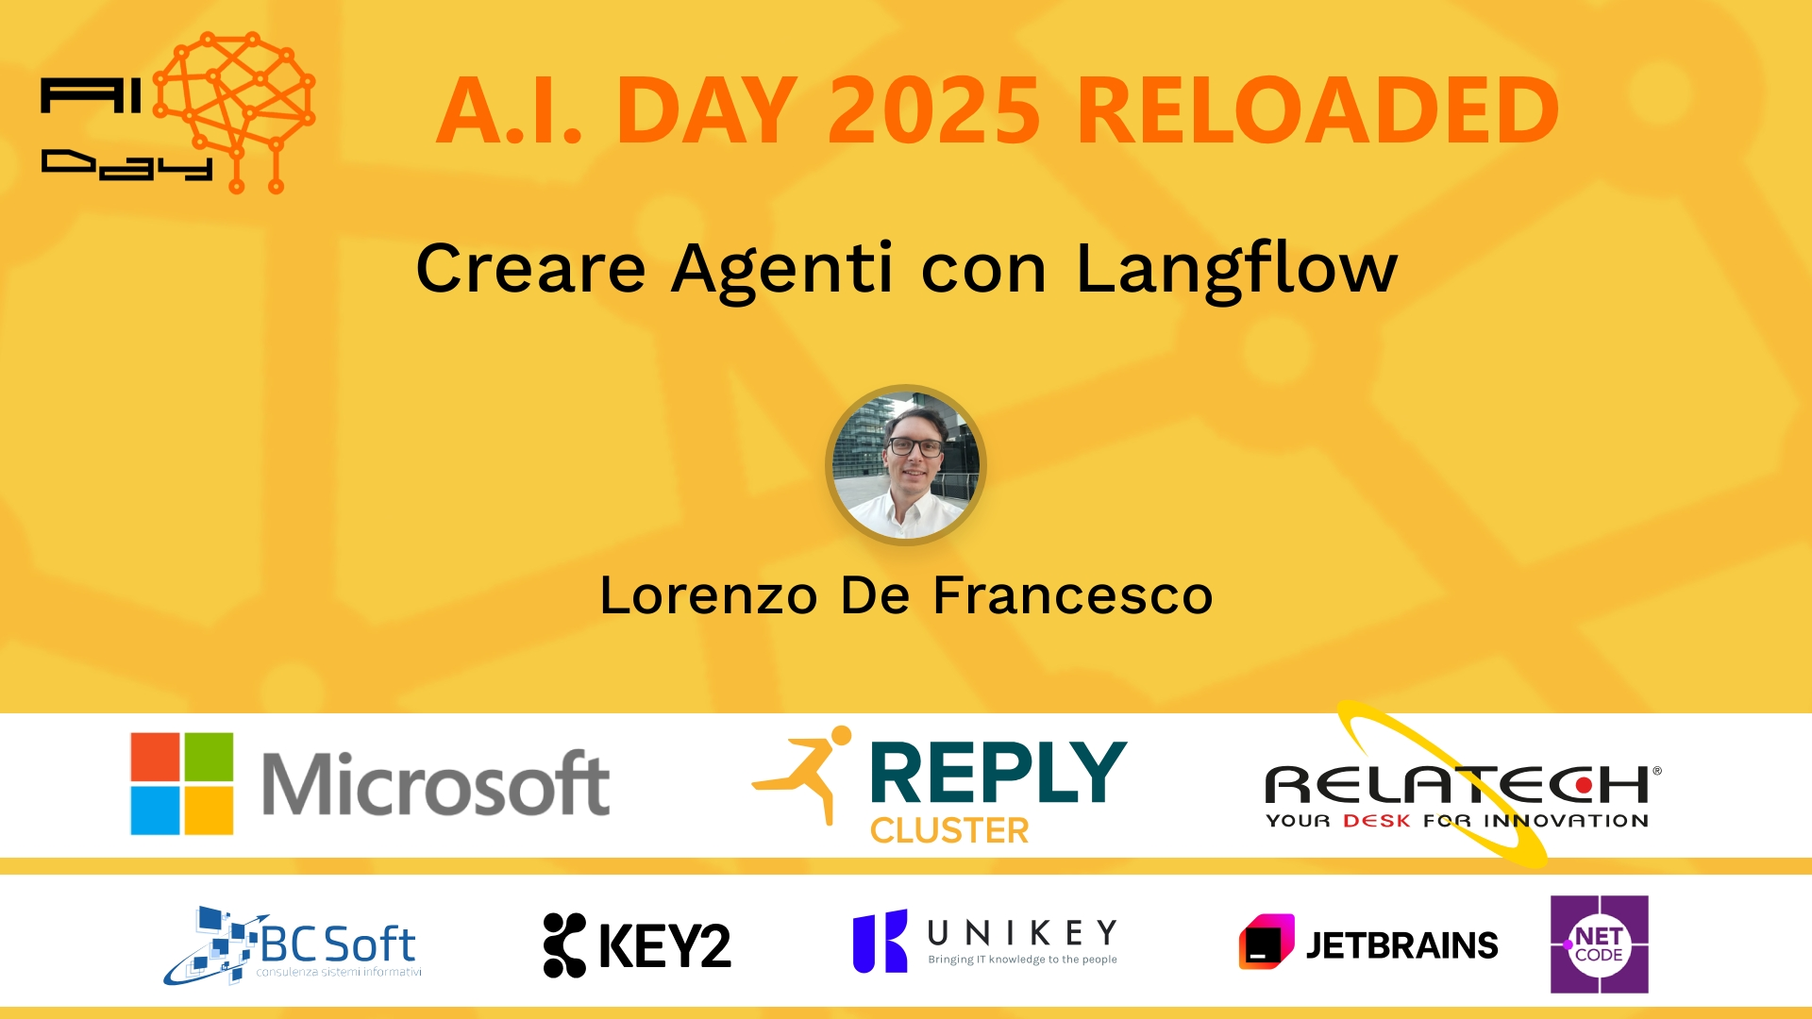
Session Banner - Creare Agenti con Langflow
Notes:
This is the opening banner slide for 'Creare Agenti con Langflow'. The session is presented by: Lorenzo De Francesco. This slide sets the visual theme for the presentation.

Slide 2
Creare Agenti con Langflow
Presented by: Lorenzo De Francesco
Notes:
Main title slide displaying 'Creare Agenti con Langflow'. Presented by: Lorenzo De Francesco. Use this slide to introduce the session topic.

Slide 3
Event Sponsors
Notes:
Sponsor acknowledgment slide. Take a moment to thank the event sponsors and explain their support for the conference.

Slide 4
Creare Agenti con Langflow
Speaker(s): Lorenzo De Francesco
Notes:
Detailed session information for 'Creare Agenti con Langflow'. Session description: Per anni ho cercato di capire come creare un agente AI “serio”, che non fosse solo un giocattolo da demo. Tutti parlavano di RAG, agenti, orchestrazione... ma alla prova dei fatti, era sempre la solit.... Review the session objectives and speaker credentials.

Slide 5
Demo: Creare Agenti con Langflow
Notes:
Demo section for 'Creare Agenti con Langflow'. This slide is for live demonstrations. Ensure all demo materials are prepared and tested.

Slide 6
Questions & Discussion
Notes:
Q&A slide for 'Creare Agenti con Langflow'. This is time for audience questions and discussion. Prepare to address common questions about the topic and invite participation.

Slide 7
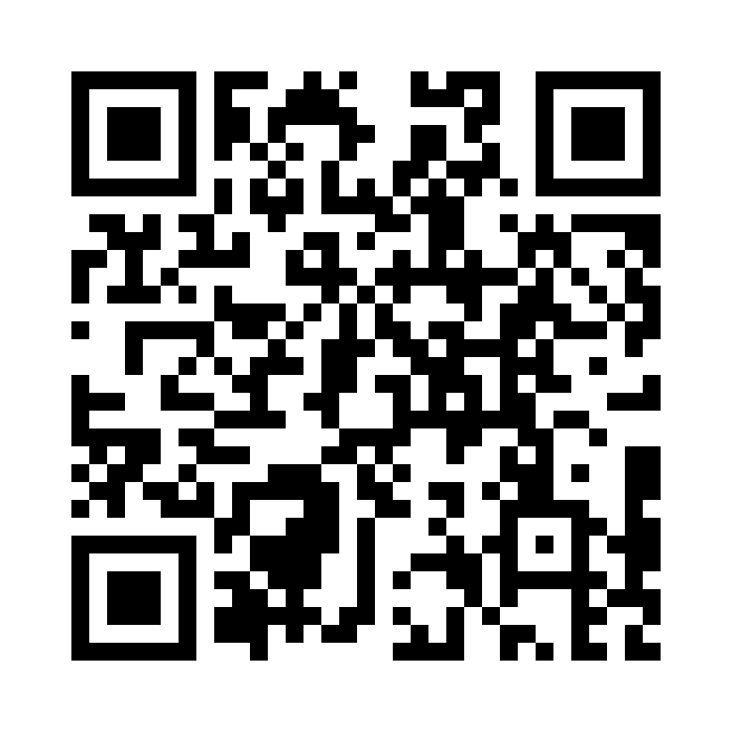
Please Vote for This Session
Vote for Session - Creare Agenti con Langflow
Notes:
Voting slide for 'Creare Agenti con Langflow'. Ask audience to scan the QR code or visit https://vote.dotnetdev.it/vote/lp0trhq1/978439 to vote. Emphasize the importance of feedback.

