Slide 1
Welcome
Notes:
Main title slide displaying 'An introduction on Schema Guided Reasoning in Semantic Kernel'. Presented by: Gian Maria Ricci. Use this slide to introduce the session topic.

Slide 2
Agenda
Sala 1
Sala 2
9:30 – 10:50
🗣️ Keynote & Sessioni 🗣️
10:50 – 11:20
☕ Coffee Break ☕
11:20 – 13:00
🗣️ Sessioni 🗣️
🗣️ Sessioni 🗣️
13:00 – 14:00
🍴 Pranzo 🍴
14:00 – 15:40
🗣️ Sessioni 🗣️
🗣️ Sessioni 🗣️
15:40 – 16:10
☕ Coffee Break ☕
16:10 – 17:45
🗣️ Sessioni 🗣️
🗣️ Sessioni 🗣️
17:45 – 18:15
🎉 Lottery ! 🎉

Slide 3
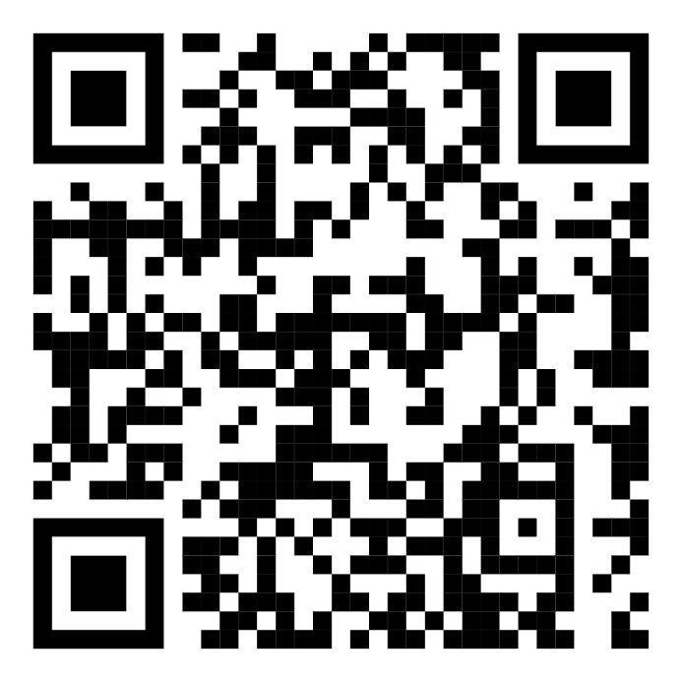
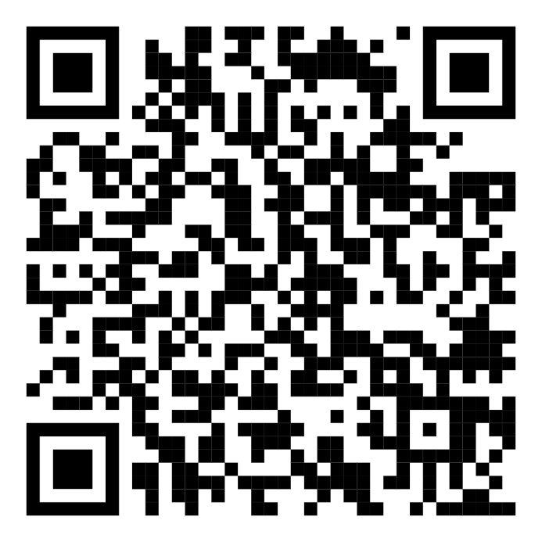



Chi siamo?

Slide 4
Event Sponsors
Notes:
Sponsor acknowledgment slide. Take a moment to thank the event sponsors and explain their support for the conference.

Slide 5
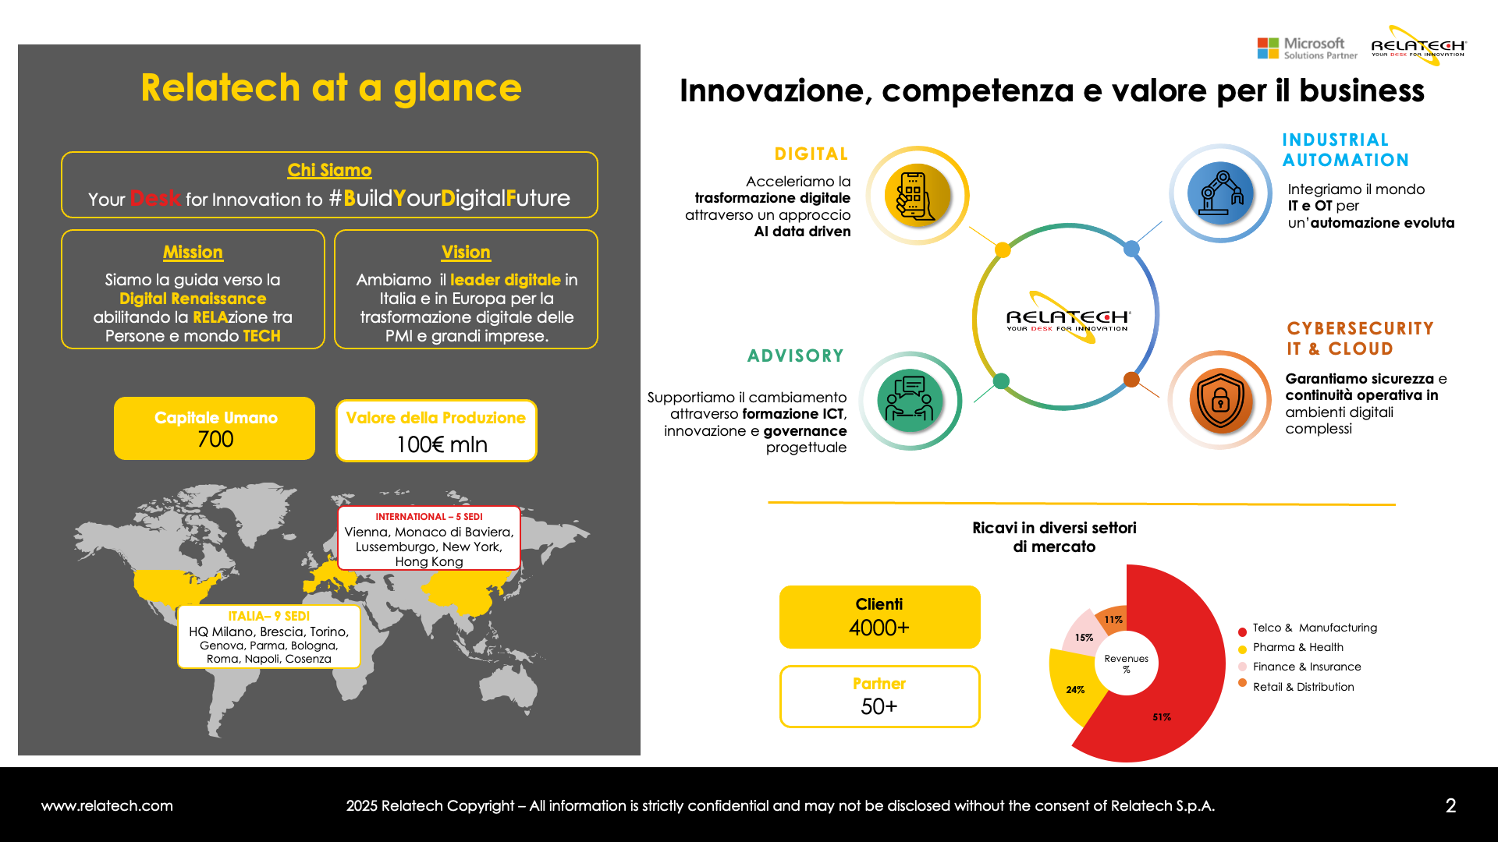

Slide 6
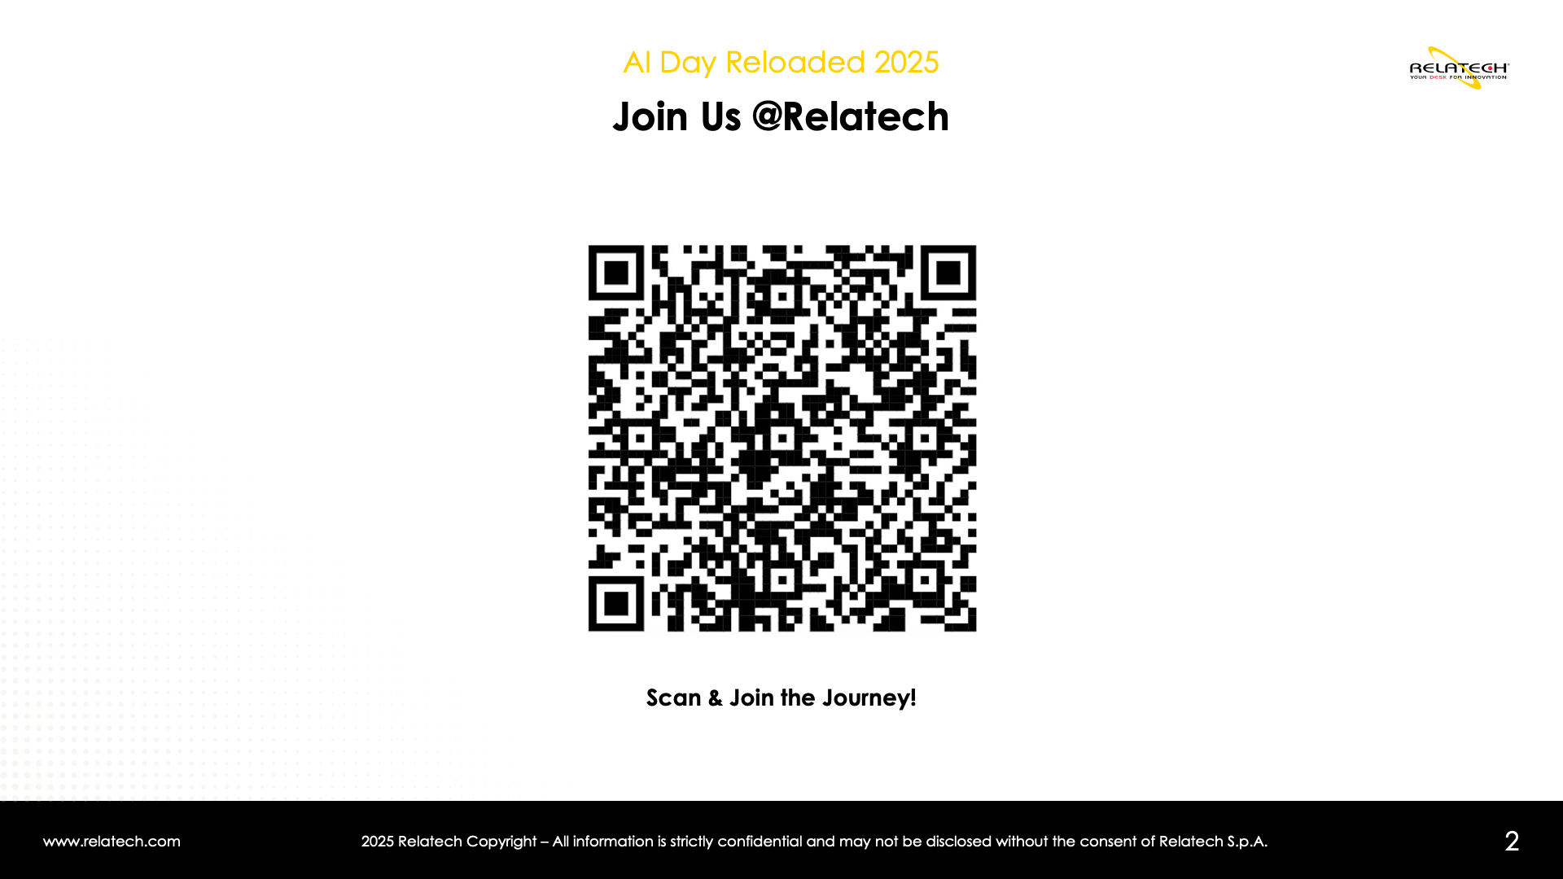

Slide 7
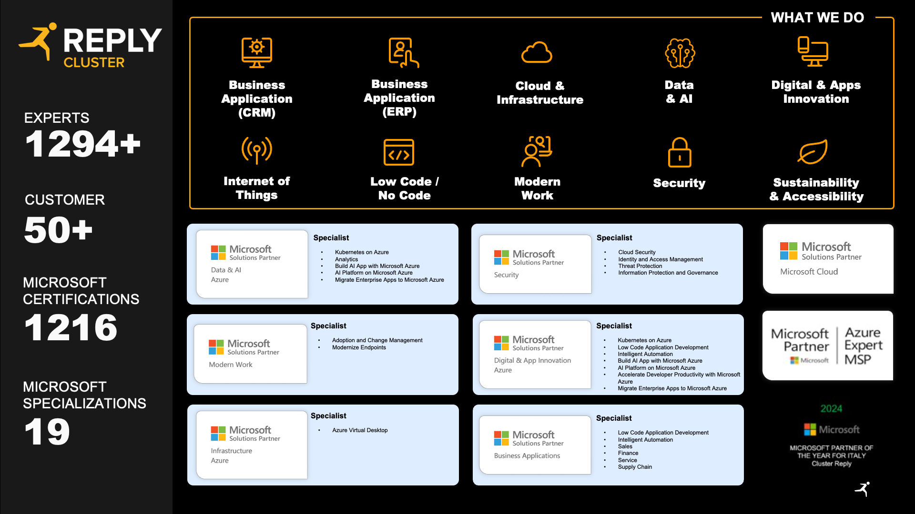

Slide 8


Slide 9

Prossimi eventi – .NET Conf 2025 Watch Party
📅 Quando 📅
🌍 Dove 🌍
11 Novembre
QUI !

Slide 10


Prossimi eventi – .NET Conf 2025 Watch Party
📅 Quando 📅
🌍 Dove 🌍
12 Dicembre
QUI !
La call for speaker è ancora aperta!

Slide 11
Buona Conferenza!
Notes:
Main title slide displaying 'An introduction on Schema Guided Reasoning in Semantic Kernel'. Presented by: Gian Maria Ricci. Use this slide to introduce the session topic.

