Slide 1
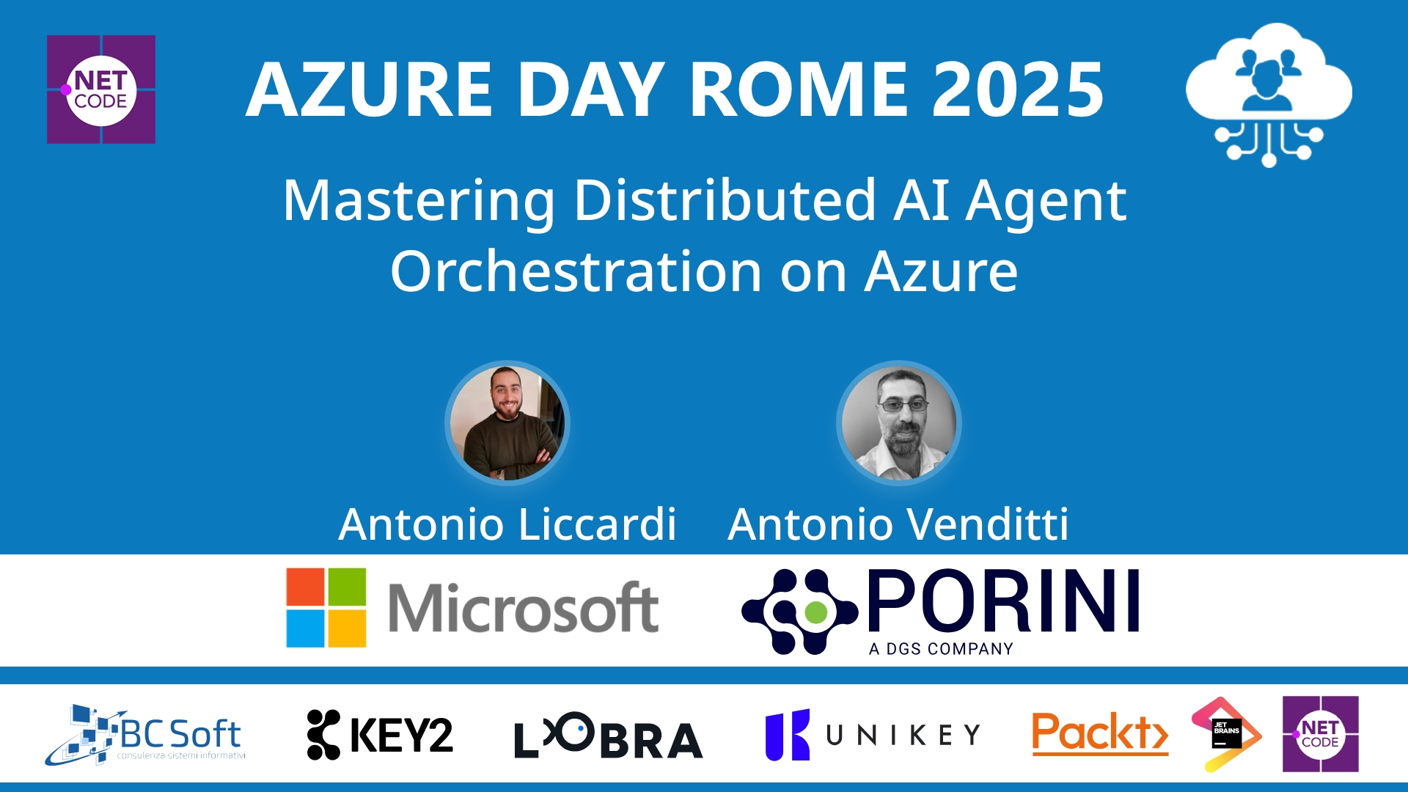
Session Banner - Mastering Distributed AI Agent Orchestration on Azure
Notes:
This is the opening banner slide for 'Mastering Distributed AI Agent Orchestration on Azure'. The session is presented by: Antonio Liccardi, Antonio Venditti. This slide sets the visual theme for the presentation.

Slide 2
Mastering Distributed AI Agent Orchestration on Azure
Notes:
Main title slide displaying 'Mastering Distributed AI Agent Orchestration on Azure'. Presented by: Antonio Liccardi, Antonio Venditti. Use this slide to introduce the session topic.

Slide 3
Event Sponsors
Notes:
Sponsor acknowledgment slide. Take a moment to thank the event sponsors and explain their support for the conference.

Slide 4
Mastering Distributed AI Agent Orchestration on Azure
Speaker(s): Antonio Liccardi; Antonio Venditti
Notes:
Detailed session information for 'Mastering Distributed AI Agent Orchestration on Azure'. Session description: Esplora come orchestrare sistemi distribuiti di agenti AI specializzati usando Azure Functions. La sessione mostra come decomporre flussi di lavoro complessi in task gestibili da agenti autonomi, coor.... Review the session objectives and speaker credentials.

Slide 5
Demo: Mastering Distributed AI Agent Orchestration on Azure
Notes:
Demo section for 'Mastering Distributed AI Agent Orchestration on Azure'. This slide is for live demonstrations. Ensure all demo materials are prepared and tested.

Slide 6
Questions & Discussion
Notes:
Q&A slide for 'Mastering Distributed AI Agent Orchestration on Azure'. This is time for audience questions and discussion. Prepare to address common questions about the topic and invite participation.

Slide 7
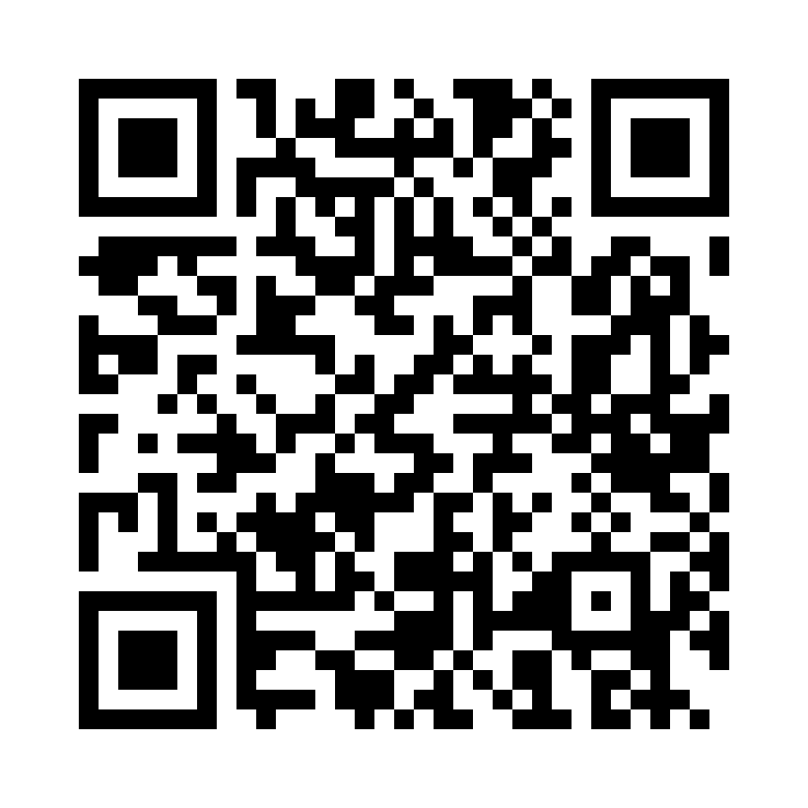
Please Vote for This Session
Vote for Session - Mastering Distributed AI Agent Orchestration on Azure
Notes:
Voting slide for 'Mastering Distributed AI Agent Orchestration on Azure'. Ask audience to scan the QR code or visit https://vote.dotnetdev.it/vote/6juwwd7a/927867 to vote. Emphasize the importance of feedback.

