Slide 1
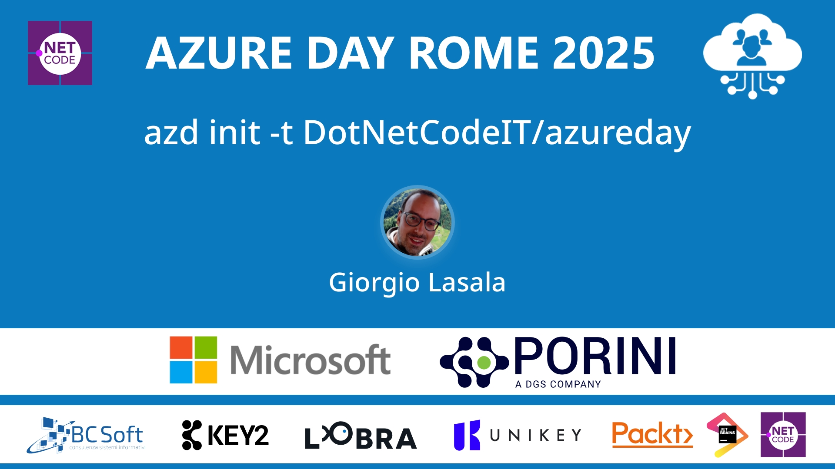
Session Banner - azd init -t DotNetCodeIT/azureday
Notes:
This is the opening banner slide for 'azd init -t DotNetCodeIT/azureday'. The session is presented by: Giorgio Lasala. This slide sets the visual theme for the presentation.

Slide 2
azd init -t DotNetCodeIT/azureday
Notes:
Main title slide displaying 'azd init -t DotNetCodeIT/azureday'. Presented by: Giorgio Lasala. Use this slide to introduce the session topic.

Slide 3
Event Sponsors
Notes:
Sponsor acknowledgment slide. Take a moment to thank the event sponsors and explain their support for the conference.

Slide 4
azd init -t DotNetCodeIT/azureday
Speaker(s): Giorgio Lasala
Notes:
Detailed session information for 'azd init -t DotNetCodeIT/azureday'. Session description: Per anni, le CLI sono state il regno degli Ops: comandi criptici, tool orientati all’infrastruttura, e una curva di apprendimento ripida per chi scrive codice tutti i giorni. Ma ora qualcosa è cambiat.... Review the session objectives and speaker credentials.

Slide 5
Demo: azd init -t DotNetCodeIT/azureday
Notes:
Demo section for 'azd init -t DotNetCodeIT/azureday'. This slide is for live demonstrations. Ensure all demo materials are prepared and tested.

Slide 6
Questions & Discussion
Notes:
Q&A slide for 'azd init -t DotNetCodeIT/azureday'. This is time for audience questions and discussion. Prepare to address common questions about the topic and invite participation.

Slide 7
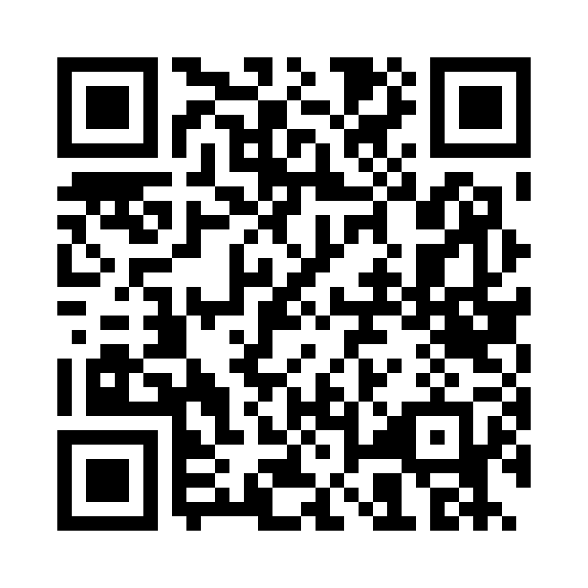
Please Vote for This Session
Vote for Session - azd init -t DotNetCodeIT/azureday
Notes:
Voting slide for 'azd init -t DotNetCodeIT/azureday'. Ask audience to scan the QR code or visit https://vote.dotnetdev.it/vote/6juwwd7a/928974 to vote. Emphasize the importance of feedback.

