Slide 1
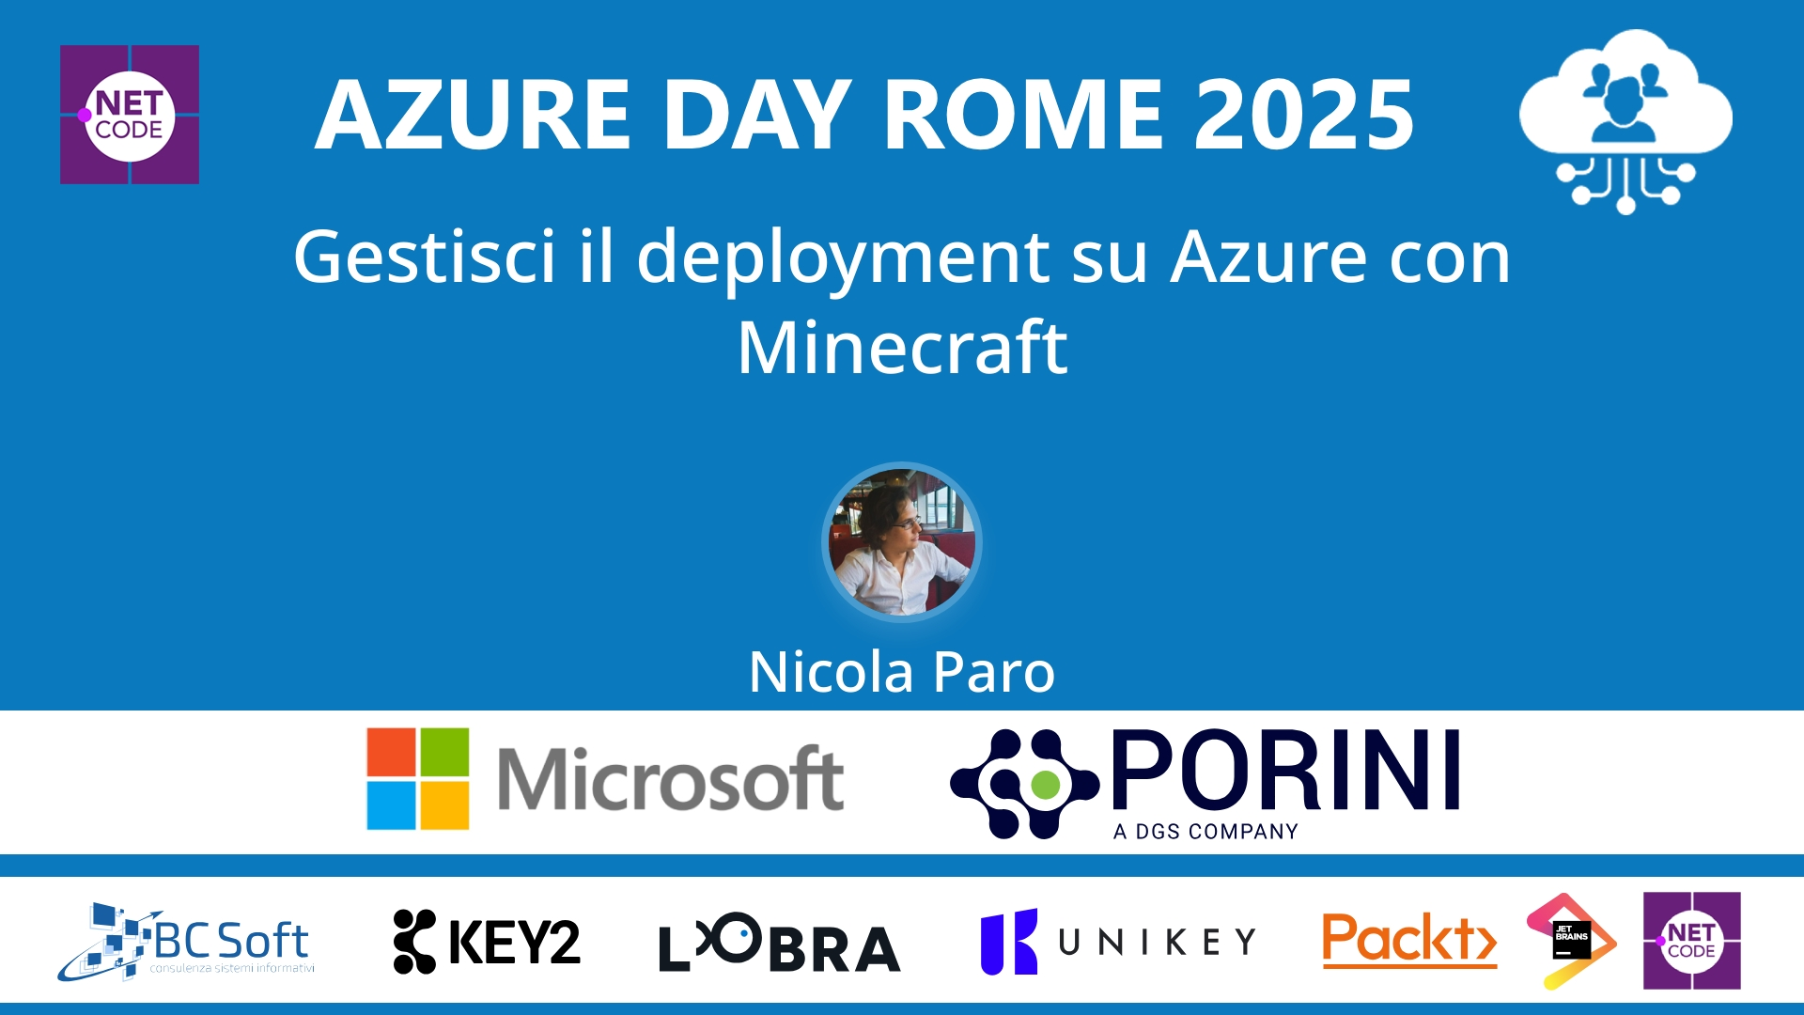
Session Banner - Gestisci il deployment su Azure con Minecraft
Notes:
This is the opening banner slide for 'Gestisci il deployment su Azure con Minecraft'. The session is presented by: Nicola Paro. This slide sets the visual theme for the presentation.

Slide 2
Gestisci il deployment su Azure con Minecraft
Notes:
Main title slide displaying 'Gestisci il deployment su Azure con Minecraft'. Presented by: Nicola Paro. Use this slide to introduce the session topic.

Slide 3
Event Sponsors
Notes:
Sponsor acknowledgment slide. Take a moment to thank the event sponsors and explain their support for the conference.

Slide 4
Gestisci il deployment su Azure con Minecraft
Speaker(s): Nicola Paro
Notes:
Detailed session information for 'Gestisci il deployment su Azure con Minecraft'. Session description: Hai mai pensato di controllare il cloud con Minecraft? In questa sessione esploreremo i modi per gestire le risorse Azure oltre al portale. E perchè no? Vedremo anche modi diversi per utilizzare le AP.... Review the session objectives and speaker credentials.

Slide 5
Demo: Gestisci il deployment su Azure con Minecraft
Notes:
Demo section for 'Gestisci il deployment su Azure con Minecraft'. This slide is for live demonstrations. Ensure all demo materials are prepared and tested.

Slide 6
Questions & Discussion
Notes:
Q&A slide for 'Gestisci il deployment su Azure con Minecraft'. This is time for audience questions and discussion. Prepare to address common questions about the topic and invite participation.

Slide 7
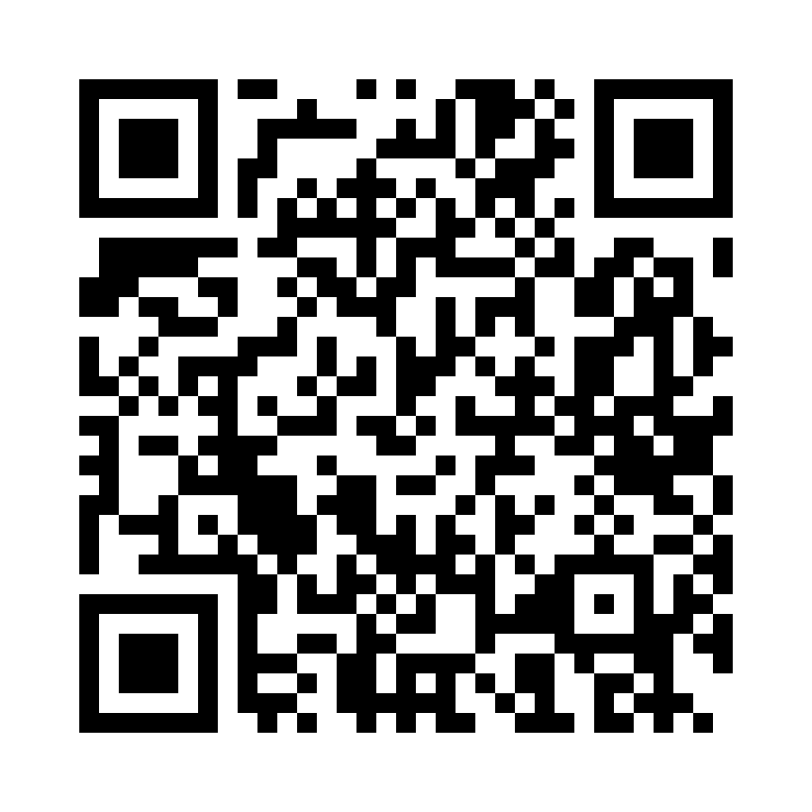
Please Vote for This Session
Vote for Session - Gestisci il deployment su Azure con Minecraft
Notes:
Voting slide for 'Gestisci il deployment su Azure con Minecraft'. Ask audience to scan the QR code or visit https://vote.dotnetdev.it/vote/6juwwd7a/929304 to vote. Emphasize the importance of feedback.

