Slide 1
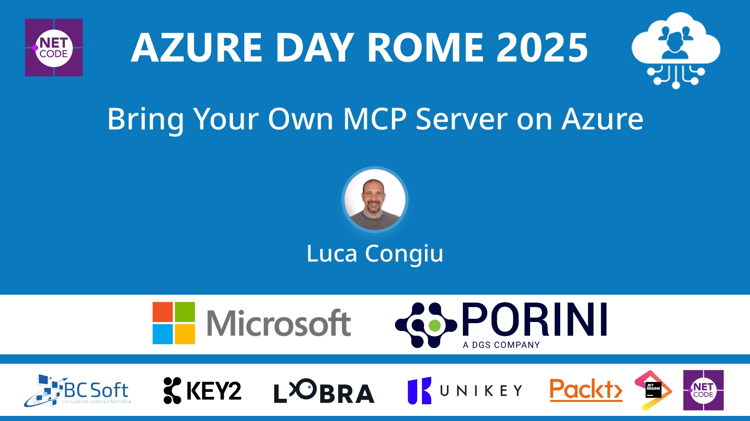
Session Banner - Bring Your Own MCP Server on Azure
Notes:
This is the opening banner slide for 'Bring Your Own MCP Server on Azure'. The session is presented by: Luca Congiu. This slide sets the visual theme for the presentation.

Slide 2
Bring Your Own MCP Server on Azure
Notes:
Main title slide displaying 'Bring Your Own MCP Server on Azure'. Presented by: Luca Congiu. Use this slide to introduce the session topic.

Slide 3
Event Sponsors
Notes:
Sponsor acknowledgment slide. Take a moment to thank the event sponsors and explain their support for the conference.

Slide 4
Bring Your Own MCP Server on Azure
Speaker(s): Luca Congiu
Notes:
Detailed session information for 'Bring Your Own MCP Server on Azure'. Session description: Il Model Context Protocol (MCP) si sta attestando come uno degli strumenti più importanti per lo sviluppo di agenti e di applicazioni che sfruttano l'A.I._x000D_
In questa sessione approfondiremo la realizz.... Review the session objectives and speaker credentials.

Slide 5
Demo: Bring Your Own MCP Server on Azure
Notes:
Demo section for 'Bring Your Own MCP Server on Azure'. This slide is for live demonstrations. Ensure all demo materials are prepared and tested.

Slide 6
Questions & Discussion
Notes:
Q&A slide for 'Bring Your Own MCP Server on Azure'. This is time for audience questions and discussion. Prepare to address common questions about the topic and invite participation.

Slide 7
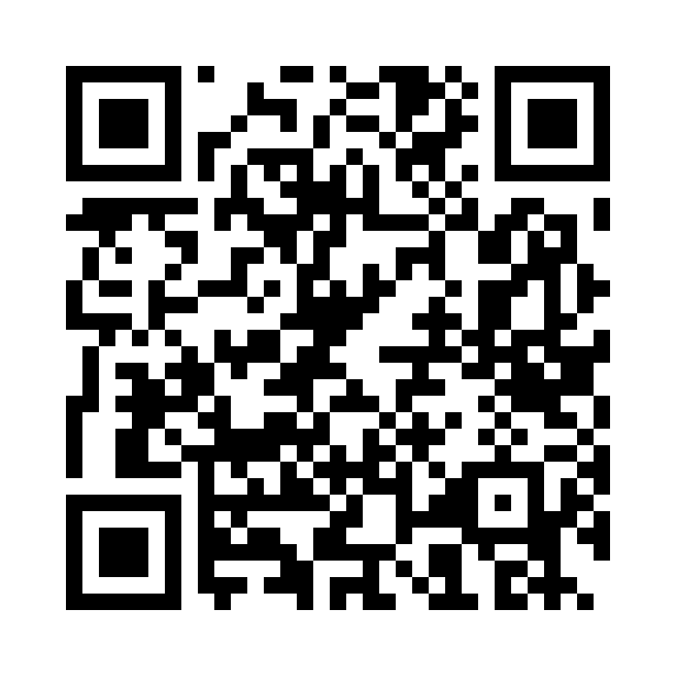
Please Vote for This Session
Vote for Session - Bring Your Own MCP Server on Azure
Notes:
Voting slide for 'Bring Your Own MCP Server on Azure'. Ask audience to scan the QR code or visit https://vote.dotnetdev.it/vote/6juwwd7a/930135 to vote. Emphasize the importance of feedback.

