Slide 1
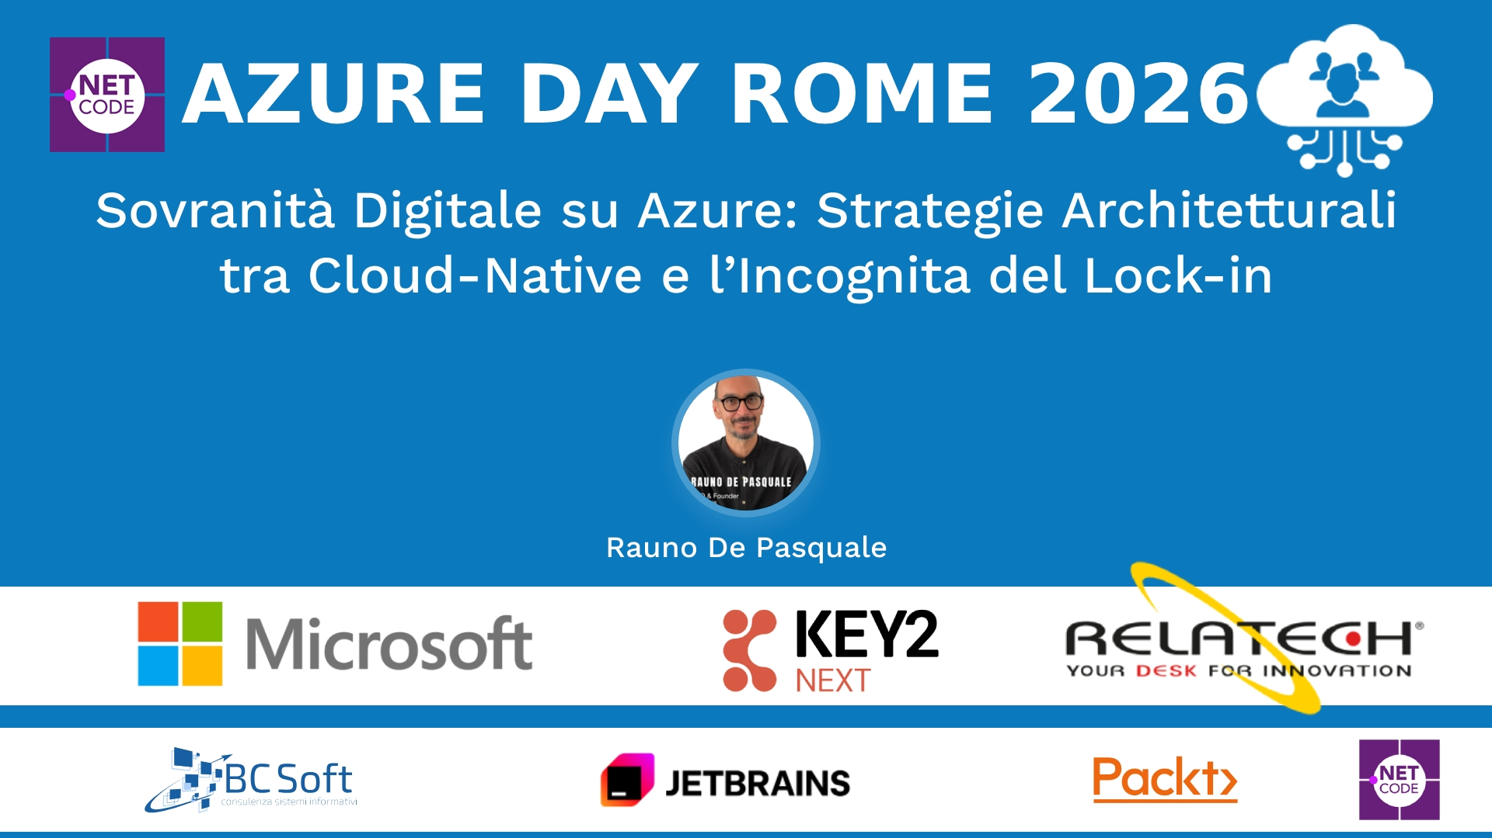
Session Banner - Sovranità Digitale su Azure: Strategie Architetturali tra Cloud-Native e l’Incognita del Lock-in
Notes:
Notes for banner slide.

Slide 2
Event Sponsors
Notes:
Notes for sponsors slide.

Slide 3
Demo
Notes:
Notes for demo slide.

Slide 4
Questions & Discussion
Notes:
Notes for questions slide.

Slide 5
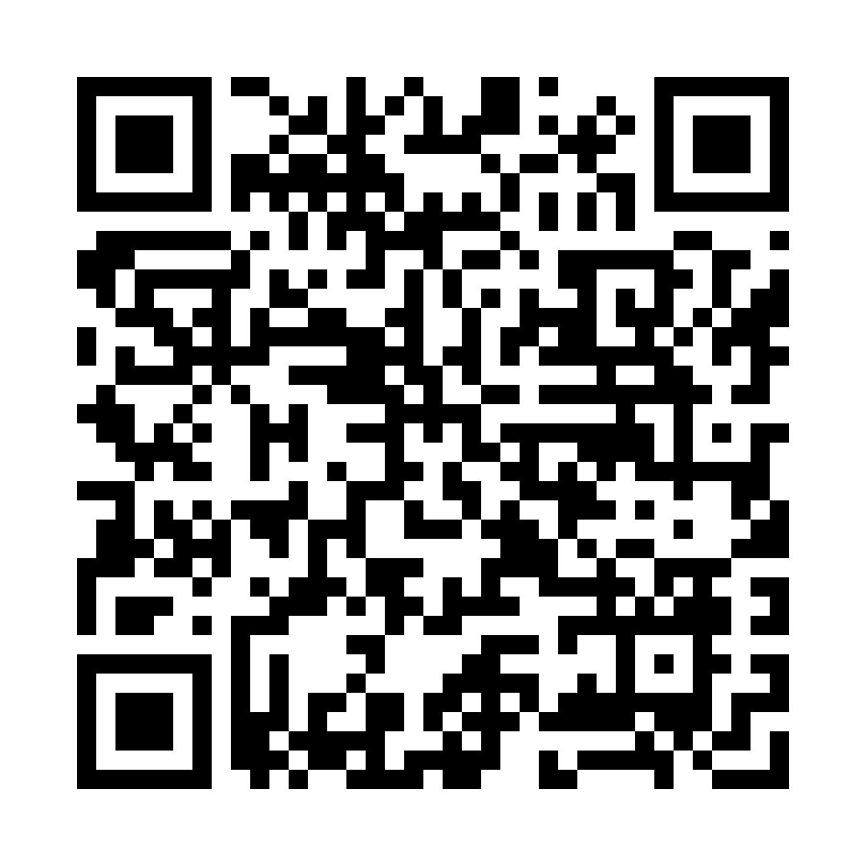
Please Vote for This Session
Vote for Session - Sovranità Digitale su Azure: Strategie Architetturali tra Cloud-Native e l’Incognita del Lock-in
Notes:
Notes for vote slide.

