Slide 1

Session Banner - Azure Communication Services: voce, chat ed emai su Azure
Notes:
Notes for banner slide.

Slide 2
Event Sponsors
Notes:
Notes for sponsors slide.

Slide 3
Demo
Notes:
Notes for demo slide.

Slide 4
Questions & Discussion
Notes:
Notes for questions slide.

Slide 5
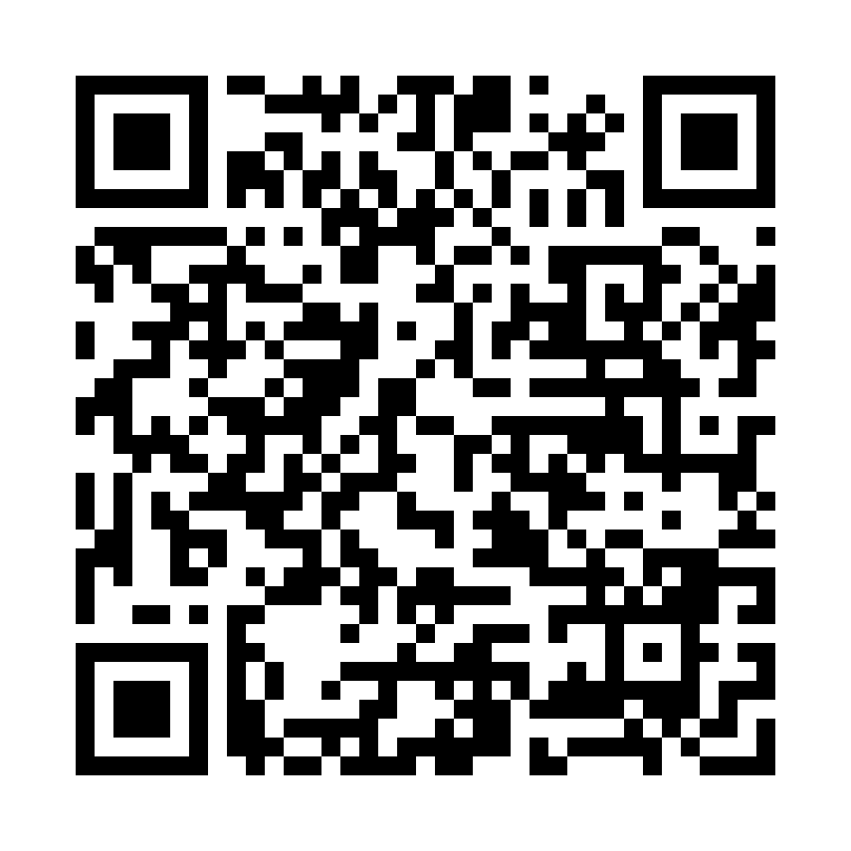
Please Vote for This Session
Vote for Session - Azure Communication Services: voce, chat ed emai su Azure
Notes:
Notes for vote slide.

