Slide 1
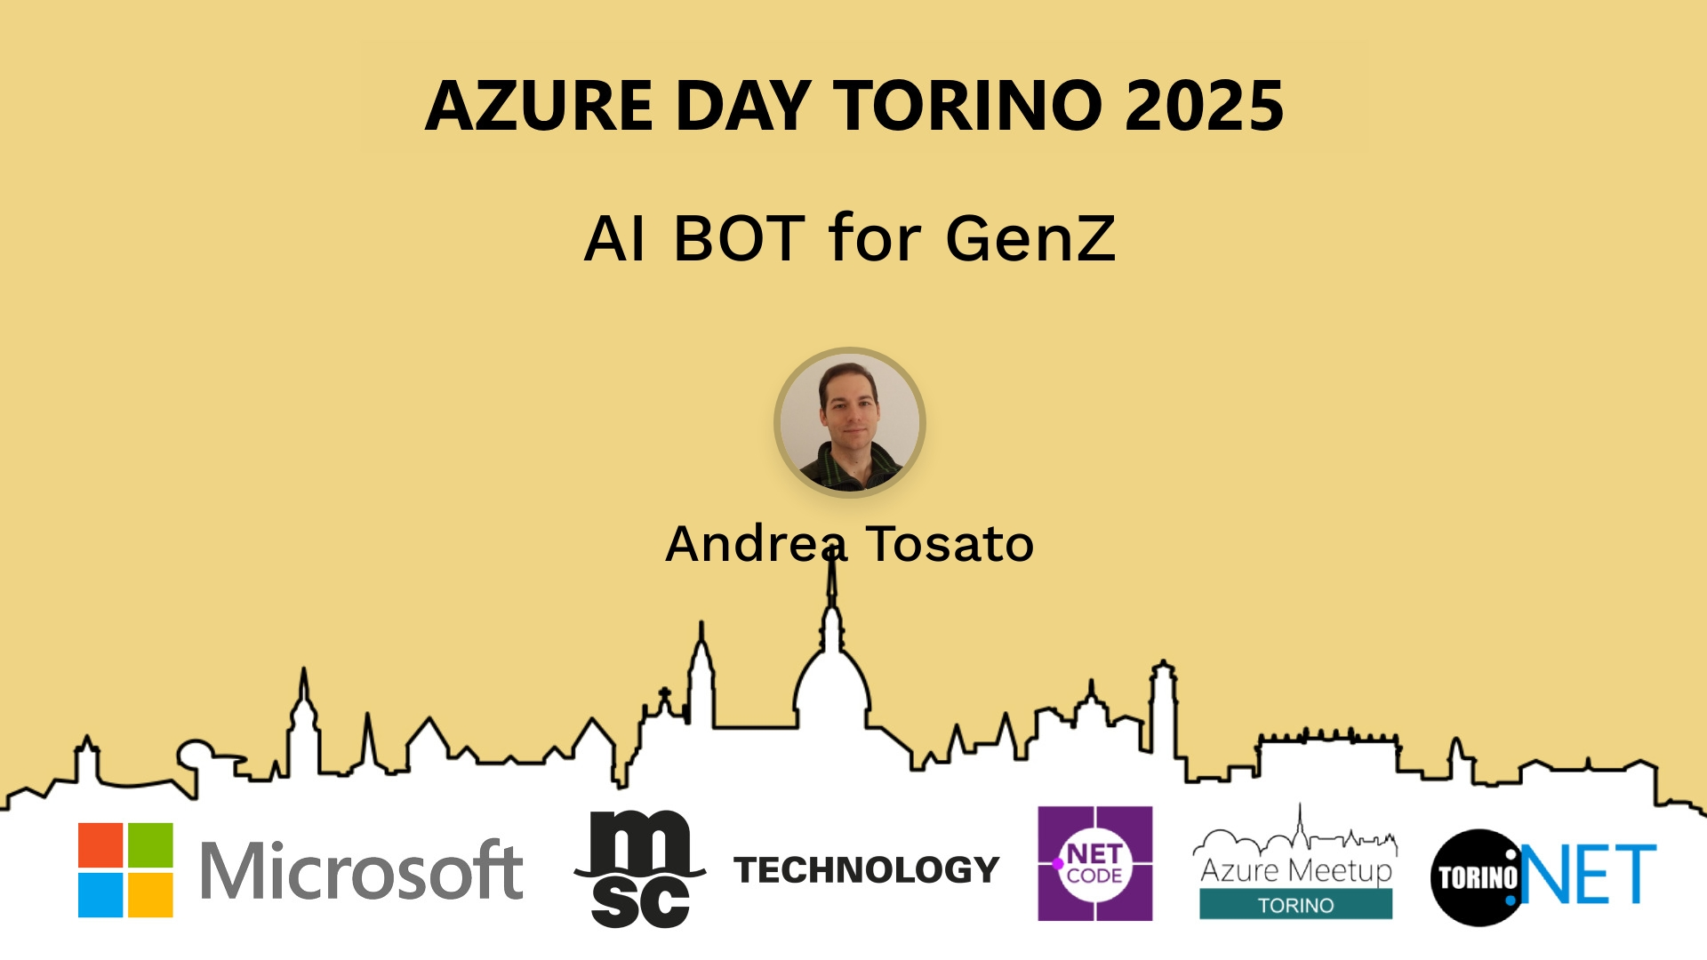
Session Banner - AI BOT for GenZ
Notes:
This is the opening banner slide for 'AI BOT for GenZ'. The session is presented by: Andrea Tosato. This slide sets the visual theme for the presentation.

Slide 2
AI BOT for GenZ
Notes:
Main title slide displaying 'AI BOT for GenZ'. Presented by: Andrea Tosato. Use this slide to introduce the session topic.

Slide 3
Event Sponsors
Notes:
Sponsor acknowledgment slide. Take a moment to thank the event sponsors and explain their support for the conference.

Slide 4
AI BOT for GenZ
Notes:
Detailed session information for 'AI BOT for GenZ'. Session description: Come possiamo aiutare a migliorare la customer experience e invogliare le persone ad essere focalizzate in un sistema intelligente?_x000D_
_x000D_
Vediamo dalle basi come implementare un sistema intelligente con .... Review the session objectives and speaker credentials.

Slide 5
Demo: AI BOT for GenZ
Notes:
Demo section for 'AI BOT for GenZ'. This slide is for live demonstrations. Ensure all demo materials are prepared and tested.

Slide 6
Questions & Discussion
Notes:
Q&A slide for 'AI BOT for GenZ'. This is time for audience questions and discussion. Prepare to address common questions about the topic and invite participation.

Slide 7
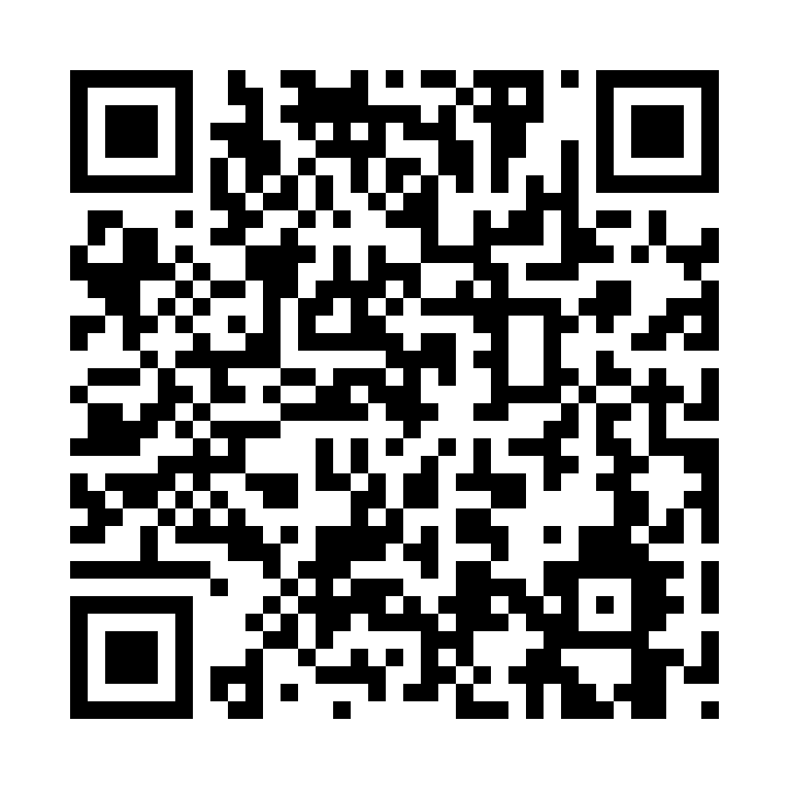
Please Vote for This Session
Vote for Session - AI BOT for GenZ
Notes:
Voting slide for 'AI BOT for GenZ'. Ask audience to scan the QR code or visit https://vote.dotnetdev.it/vote/7kjar40q/1025258 to vote. Emphasize the importance of feedback.

