Slide 1
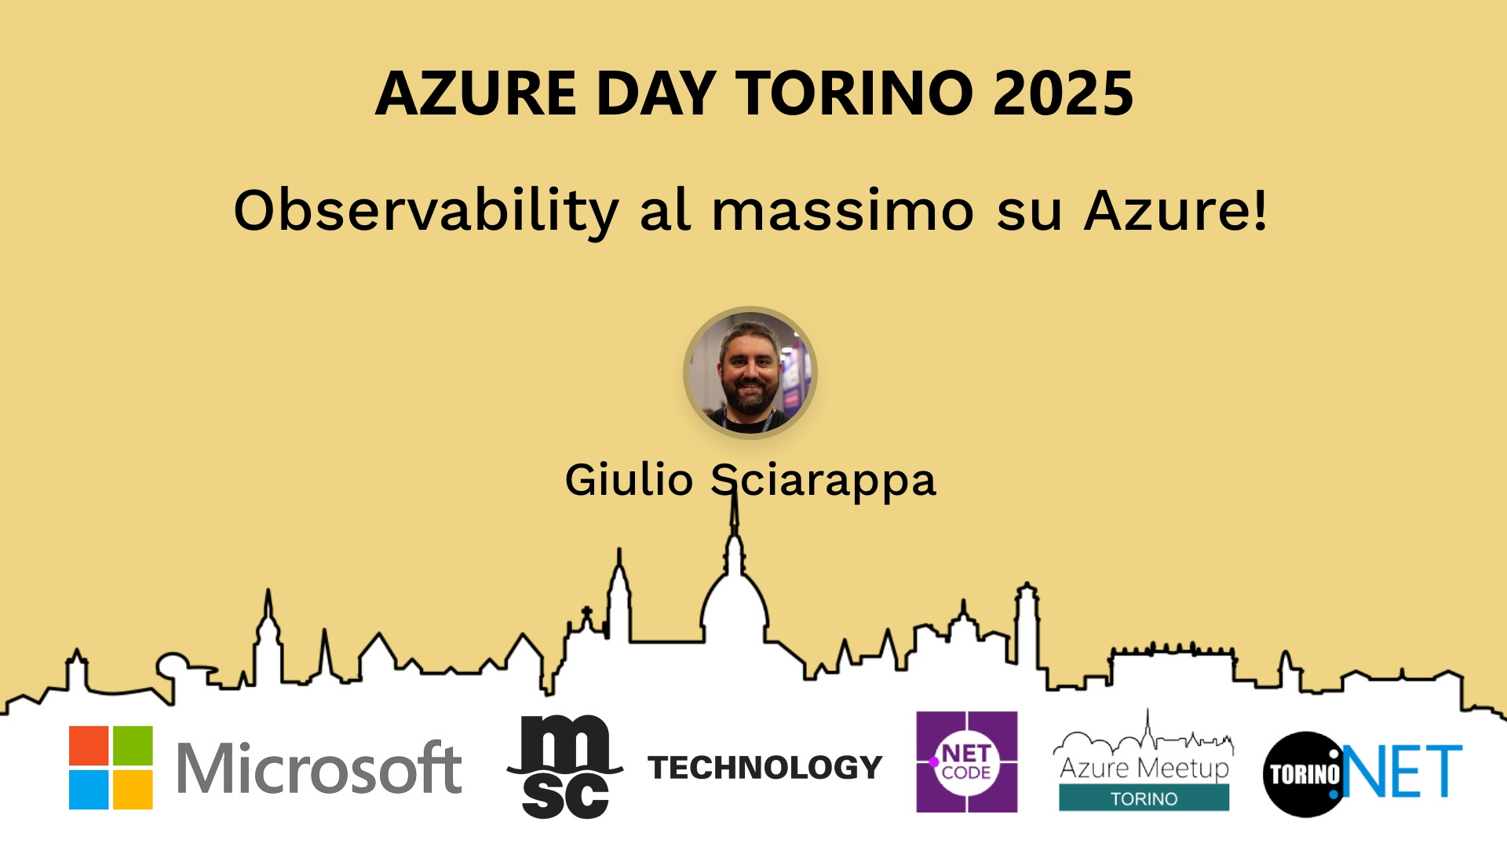
Session Banner - Observability al massimo su Azure!
Notes:
This is the opening banner slide for 'Observability al massimo su Azure!'. The session is presented by: Giulio Sciarappa. This slide sets the visual theme for the presentation.

Slide 2
Observability al massimo su Azure!
Notes:
Main title slide displaying 'Observability al massimo su Azure!'. Presented by: Giulio Sciarappa. Use this slide to introduce the session topic.

Slide 3
Event Sponsors
Notes:
Sponsor acknowledgment slide. Take a moment to thank the event sponsors and explain their support for the conference.

Slide 4
Observability al massimo su Azure!
Notes:
Detailed session information for 'Observability al massimo su Azure!'. Session description: In questa sessione vedremo le ultime novità nel mondo del monitoraggio e dell’observability presentate negli ultimi mesi._x000D_
_x000D_
Sicuro di conoscere tutti gli strumenti che Azure ti mette a disposizione? .... Review the session objectives and speaker credentials.

Slide 5
Demo: Observability al massimo su Azure!
Notes:
Demo section for 'Observability al massimo su Azure!'. This slide is for live demonstrations. Ensure all demo materials are prepared and tested.

Slide 6
Questions & Discussion
Notes:
Q&A slide for 'Observability al massimo su Azure!'. This is time for audience questions and discussion. Prepare to address common questions about the topic and invite participation.

Slide 7
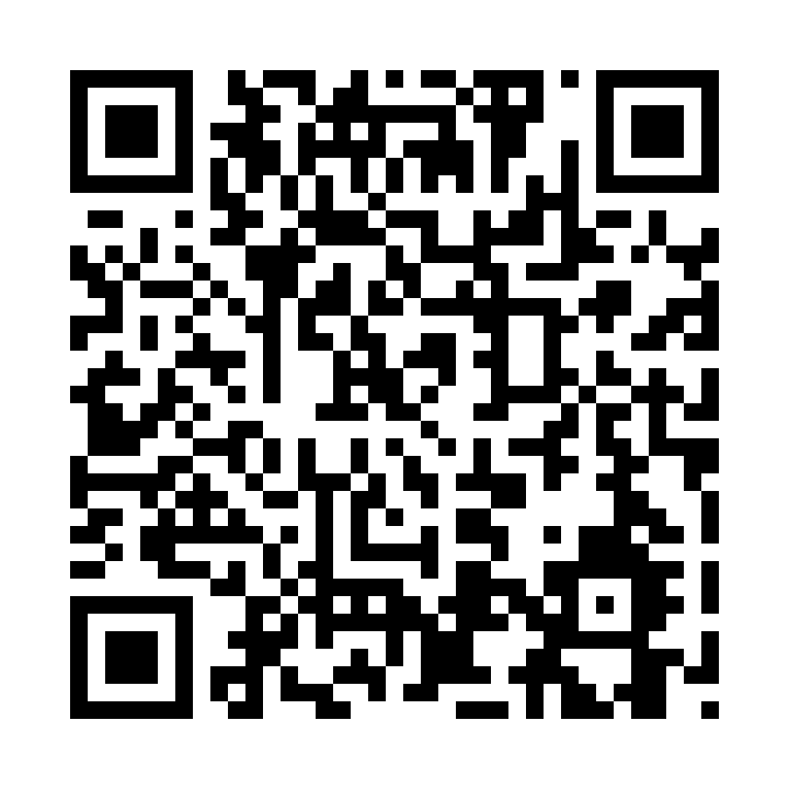
Please Vote for This Session
Vote for Session - Observability al massimo su Azure!
Notes:
Voting slide for 'Observability al massimo su Azure!'. Ask audience to scan the QR code or visit https://vote.dotnetdev.it/vote/7kjar40q/1028554 to vote. Emphasize the importance of feedback.

