Slide 1
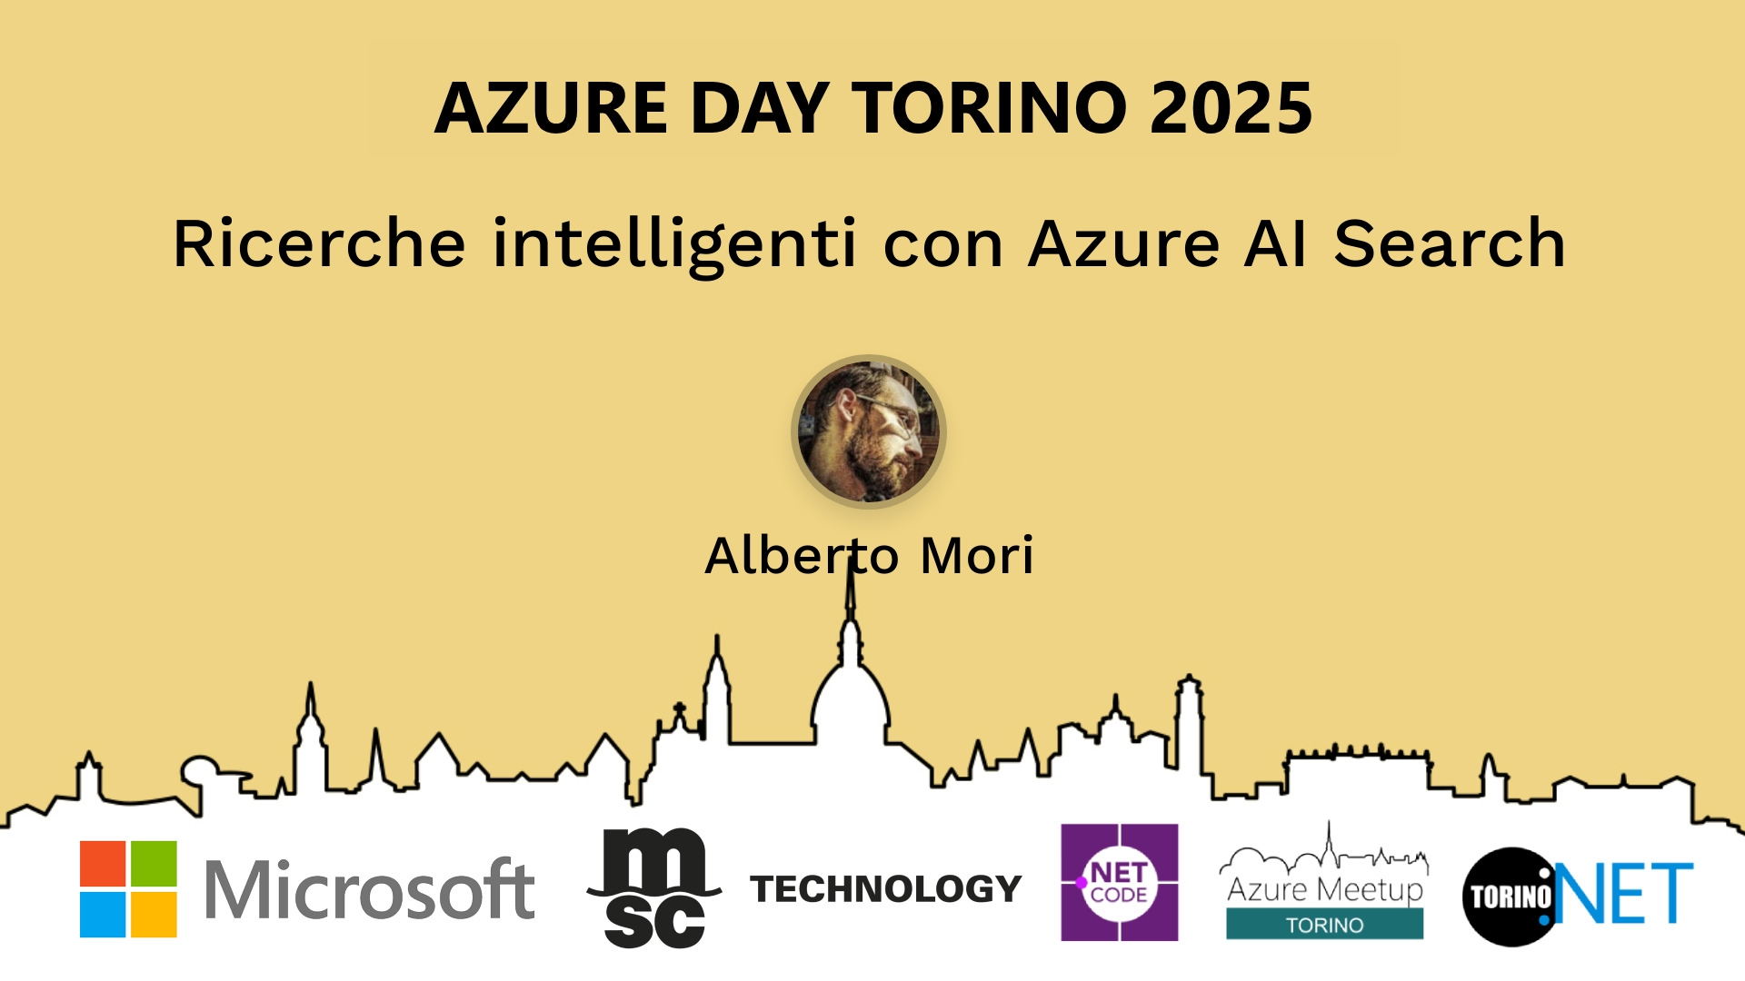
Session Banner - Ricerche intelligenti con Azure AI Search
Notes:
This is the opening banner slide for 'Ricerche intelligenti con Azure AI Search'. The session is presented by: Alberto Mori. This slide sets the visual theme for the presentation.

Slide 2
Ricerche intelligenti con Azure AI Search
Notes:
Main title slide displaying 'Ricerche intelligenti con Azure AI Search'. Presented by: Alberto Mori. Use this slide to introduce the session topic.

Slide 3
Event Sponsors
Notes:
Sponsor acknowledgment slide. Take a moment to thank the event sponsors and explain their support for the conference.

Slide 4
Ricerche intelligenti con Azure AI Search
Notes:
Detailed session information for 'Ricerche intelligenti con Azure AI Search'. Session description: L’esplosione dell'AI ha radicalmente cambiato anche l'approccio di come interagiamo con le applicazioni._x000D_
_x000D_
In questo contesto anche poter cercare le nostre informazioni in modo semantico offre un val.... Review the session objectives and speaker credentials.

Slide 5
Demo: Ricerche intelligenti con Azure AI Search
Notes:
Demo section for 'Ricerche intelligenti con Azure AI Search'. This slide is for live demonstrations. Ensure all demo materials are prepared and tested.

Slide 6
Questions & Discussion
Notes:
Q&A slide for 'Ricerche intelligenti con Azure AI Search'. This is time for audience questions and discussion. Prepare to address common questions about the topic and invite participation.

Slide 7
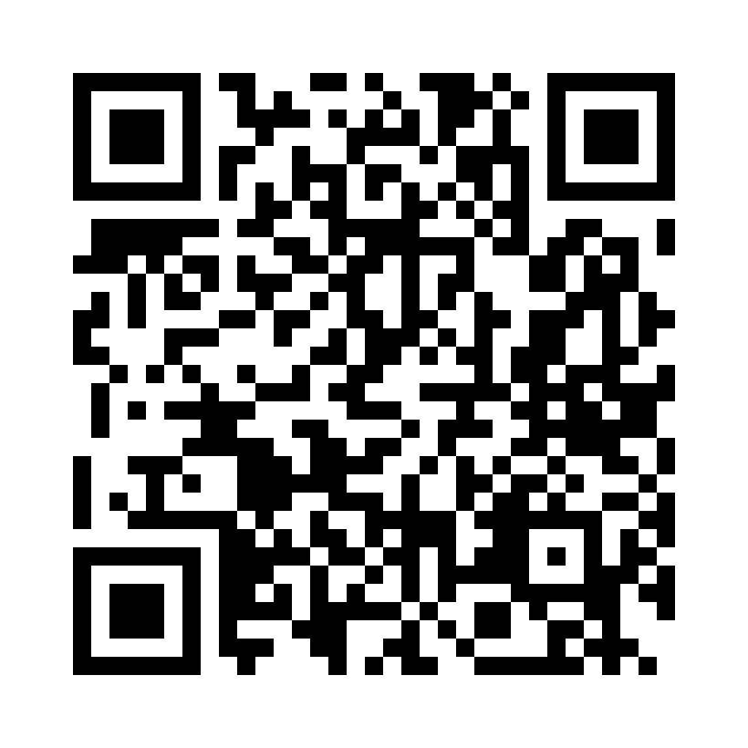
Please Vote for This Session
Vote for Session - Ricerche intelligenti con Azure AI Search
Notes:
Voting slide for 'Ricerche intelligenti con Azure AI Search'. Ask audience to scan the QR code or visit https://vote.dotnetdev.it/vote/7kjar40q/983268 to vote. Emphasize the importance of feedback.

