Slide 1
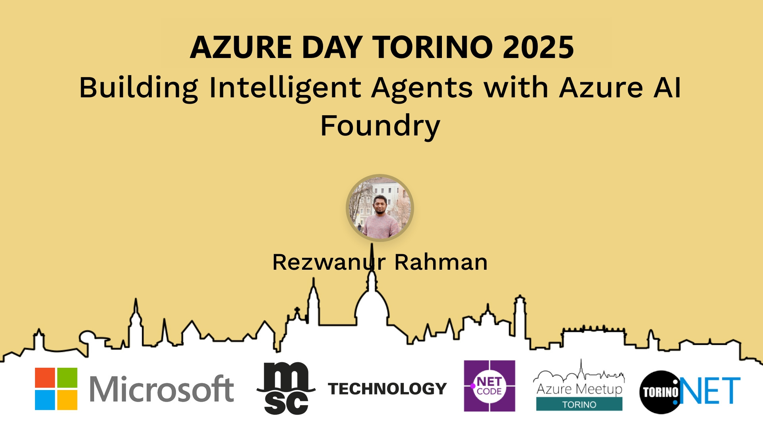
Session Banner - Building Intelligent Agents with Azure AI Foundry
Notes:
This is the opening banner slide for 'Building Intelligent Agents with Azure AI Foundry'. The session is presented by: Rezwanur Rahman. This slide sets the visual theme for the presentation.

Slide 2
Building Intelligent Agents with Azure AI Foundry
Notes:
Main title slide displaying 'Building Intelligent Agents with Azure AI Foundry'. Presented by: Rezwanur Rahman. Use this slide to introduce the session topic.

Slide 3
Event Sponsors
Notes:
Sponsor acknowledgment slide. Take a moment to thank the event sponsors and explain their support for the conference.

Slide 4
Building Intelligent Agents with Azure AI Foundry
Notes:
Detailed session information for 'Building Intelligent Agents with Azure AI Foundry'. Session description: In this session, I will showcase how to build production-grade agentic systems using Azure AI Foundry – Microsoft’s unified platform for accelerating AI development. We’ll walk through the process of .... Review the session objectives and speaker credentials.

Slide 5
Demo: Building Intelligent Agents with Azure AI Foundry
Notes:
Demo section for 'Building Intelligent Agents with Azure AI Foundry'. This slide is for live demonstrations. Ensure all demo materials are prepared and tested.

Slide 6
Questions & Discussion
Notes:
Q&A slide for 'Building Intelligent Agents with Azure AI Foundry'. This is time for audience questions and discussion. Prepare to address common questions about the topic and invite participation.

Slide 7
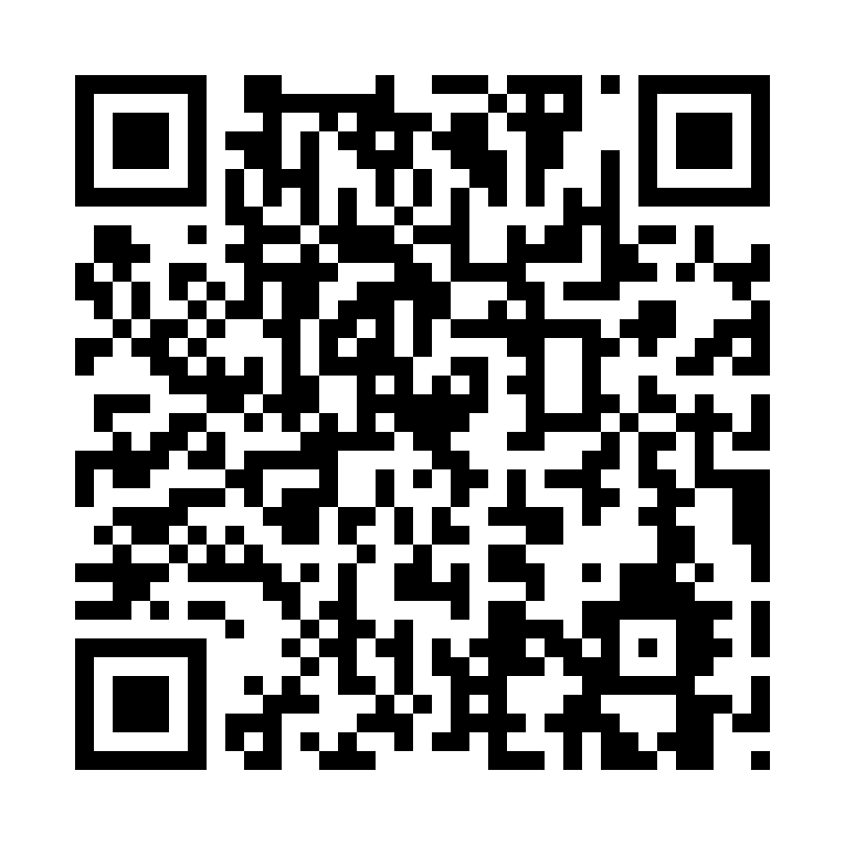
Please Vote for This Session
Vote for Session - Building Intelligent Agents with Azure AI Foundry
Notes:
Voting slide for 'Building Intelligent Agents with Azure AI Foundry'. Ask audience to scan the QR code or visit https://vote.dotnetdev.it/vote/7kjar40q/1021352 to vote. Emphasize the importance of feedback.

