Slide 1

Session Banner - GitHub Copilot: not only vibe coding
Notes:
This is the opening banner slide for 'GitHub Copilot: not only vibe coding'. The session is presented by: Lorenzo Barbieri. This slide sets the visual theme for the presentation.

Slide 2
GitHub Copilot: not only vibe coding
Notes:
Main title slide displaying 'GitHub Copilot: not only vibe coding'. Presented by: Lorenzo Barbieri. Use this slide to introduce the session topic.

Slide 3
Event Sponsors
Notes:
Sponsor acknowledgment slide. Take a moment to thank the event sponsors and explain their support for the conference.

Slide 4
GitHub Copilot: not only vibe coding
Notes:
Detailed session information for 'GitHub Copilot: not only vibe coding'. Session description: GitHub Copilot received a lot of updates in the lates months: Agentic mode, MCP support, new IDEs, new integrations._x000D_
Let's see how to use these great tools together to go from vibe coding to AI-power.... Review the session objectives and speaker credentials.

Slide 5
Demo: GitHub Copilot: not only vibe coding
Notes:
Demo section for 'GitHub Copilot: not only vibe coding'. This slide is for live demonstrations. Ensure all demo materials are prepared and tested.

Slide 6
Questions & Discussion
Notes:
Q&A slide for 'GitHub Copilot: not only vibe coding'. This is time for audience questions and discussion. Prepare to address common questions about the topic and invite participation.

Slide 7
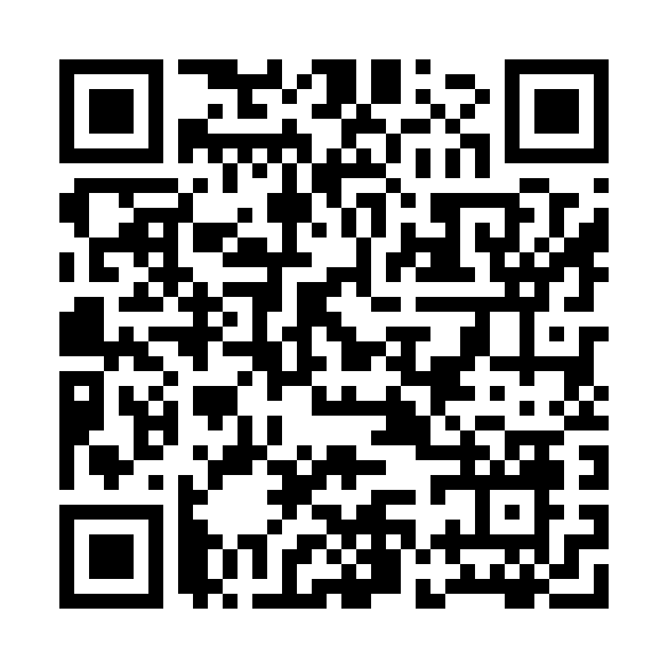
Please Vote for This Session
Vote for Session - GitHub Copilot: not only vibe coding
Notes:
Voting slide for 'GitHub Copilot: not only vibe coding'. Ask audience to scan the QR code or visit https://vote.dotnetdev.it/vote/7kjar40q/1025781 to vote. Emphasize the importance of feedback.

