Slide 2
SPONSOR

Slide 4
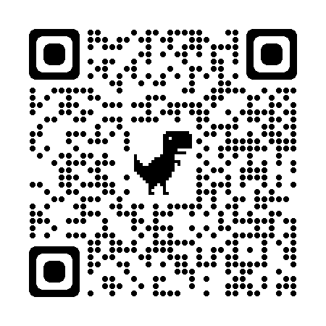
Q&A
REPLACE THIS WITH THE QR CODE YOU WILL BE PROVIDED

