Slide 1
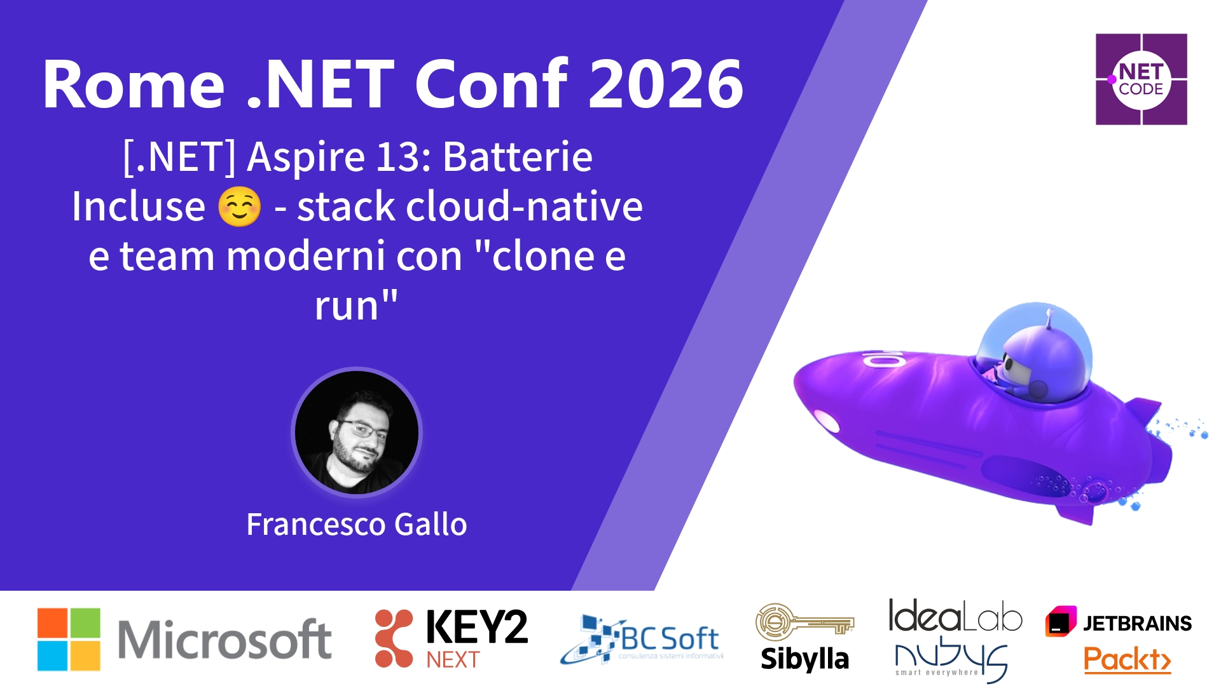
Session Banner - [.NET] Aspire 13: Batterie Incluse ☺ - stack cloud-native e team moderni con "clone e run"

Slide 2
Event Sponsors

Slide 3
[.NET] Aspire 13: Batterie Incluse ☺ - stack cloud-native e team moderni con "clone e run"

Slide 4
Demo: [.NET] Aspire 13: Batterie Incluse ☺ - stack cloud-native e team moderni con "clone e run"

Slide 5
Questions & Discussion

Slide 6

Please Vote for This Session
Vote for Session - [.NET] Aspire 13: Batterie Incluse ☺ - stack cloud-native e team moderni con "clone e run"

