Slide 1

Session Banner - Microsoft Testing Platform: la nuova era del testing in .NET

Slide 2
Event Sponsors

Slide 3
Microsoft Testing Platform: la nuova era del testing in .NET

Slide 4
Demo: Microsoft Testing Platform: la nuova era del testing in .NET

Slide 5
Questions & Discussion

Slide 6
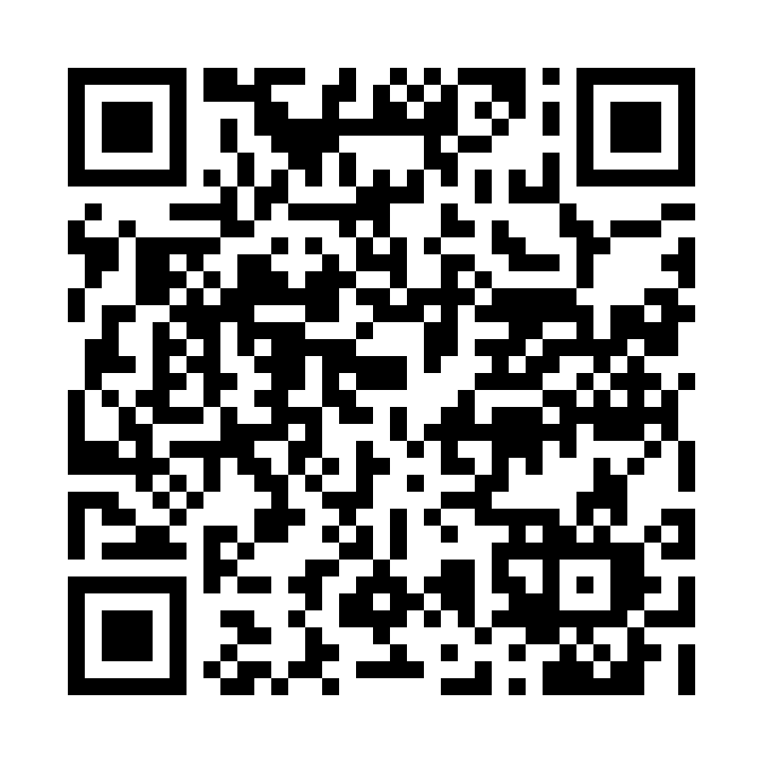
Please Vote for This Session
Vote for Session - Microsoft Testing Platform: la nuova era del testing in .NET

