Slide 1
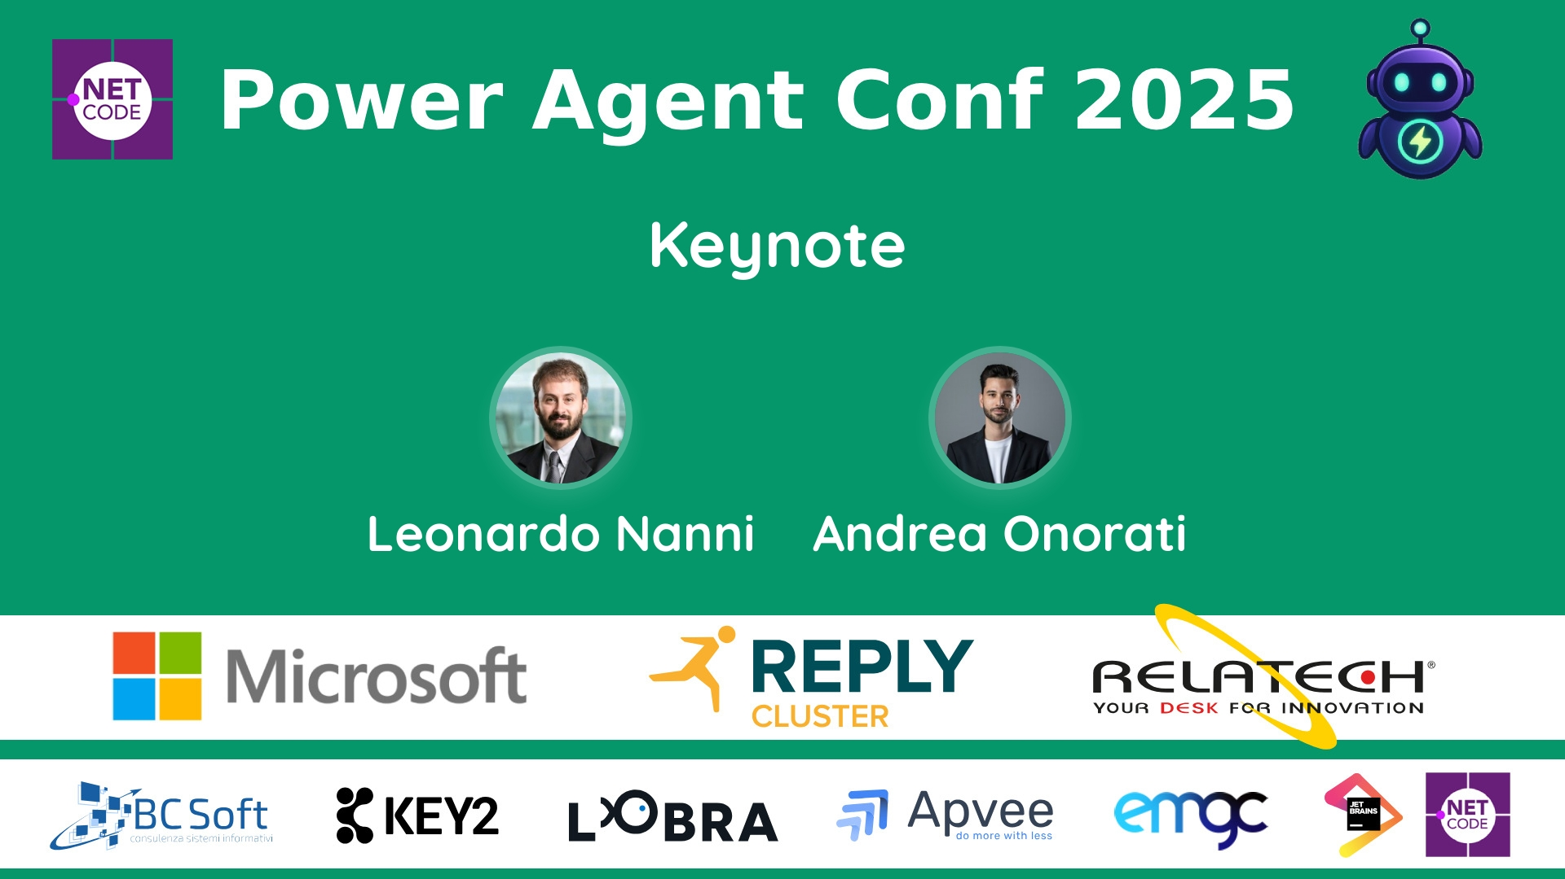
Session Banner - Keynote
Notes:
This is the opening banner slide for 'Keynote'. The session is presented by: Andrea Onorati, Leonardo Nanni. This slide sets the visual theme for the presentation.

Slide 2
Event Sponsors
Notes:
Sponsor acknowledgment slide. Take a moment to thank the event sponsors and explain their support for the conference.

Slide 3
Keynote
Speaker(s): Andrea Onorati; Leonardo Nanni
Notes:
Detailed session information for 'Keynote'. Review the session objectives and speaker credentials.

Slide 4
Demo: Keynote
Notes:
Demo section for 'Keynote'. This slide is for live demonstrations. Ensure all demo materials are prepared and tested.

Slide 5
Questions & Discussion
Notes:
Q&A slide for 'Keynote'. This is time for audience questions and discussion. Prepare to address common questions about the topic and invite participation.

Slide 6
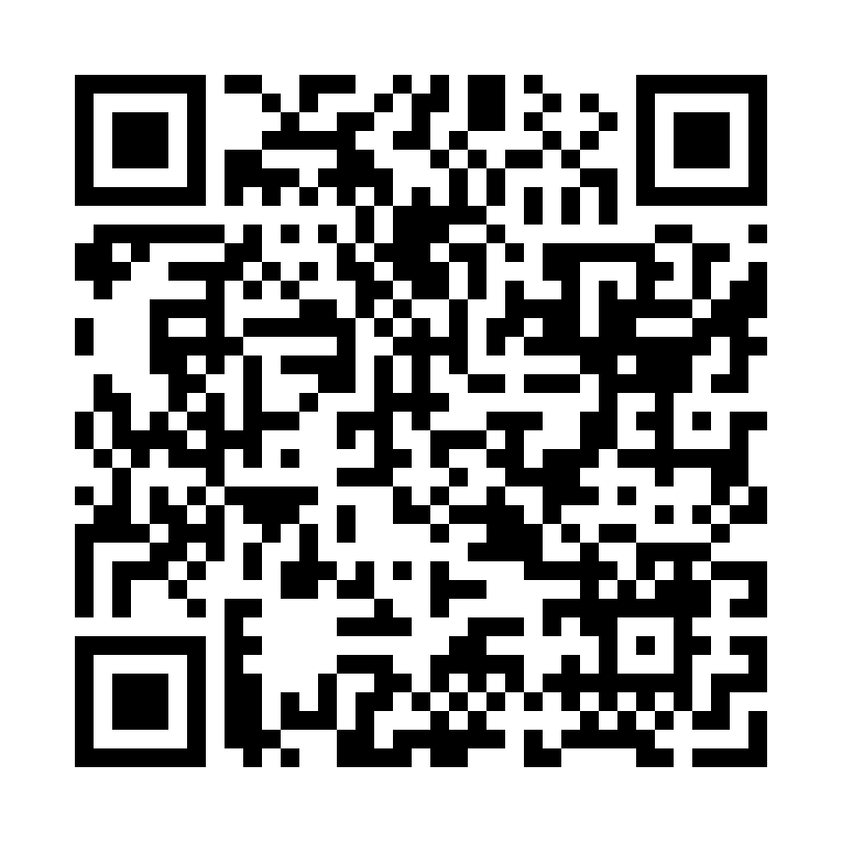
Please Vote for This Session
Vote for Session - Keynote
Notes:
Voting slide for 'Keynote'. Ask audience to scan the QR code or visit https://vote.dotnetdev.it/vote/4o2cmr0q/1029983 to vote. Emphasize the importance of feedback.

