Slide 1
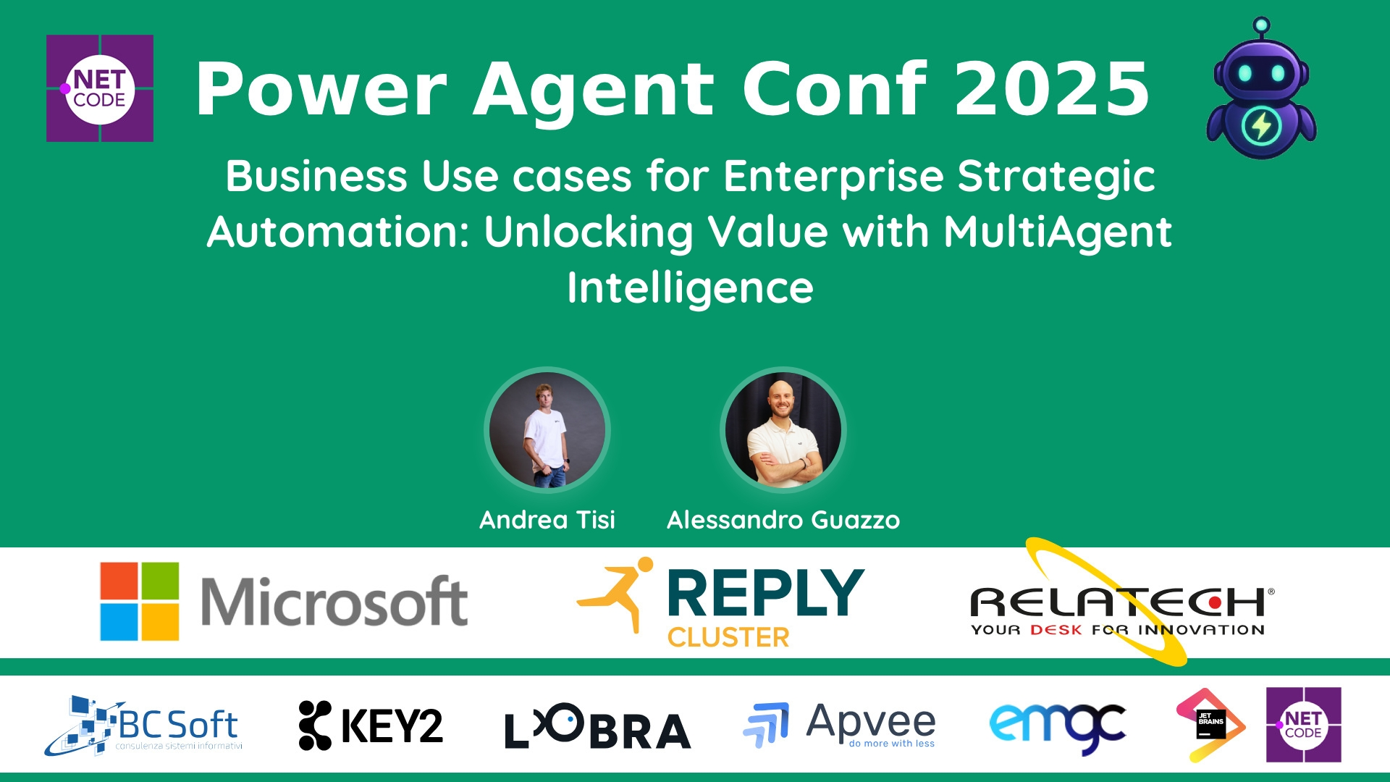
Session Banner - Business Use cases for Enterprise Strategic Automation: Unlocking Value with MultiAgent Intelligence
Notes:
This is the opening banner slide for 'Business Use cases for Enterprise Strategic Automation: Unlocking Value with MultiAgent Intelligence'. The session is presented by: Andrea Tisi, Alessandro Guazzo. This slide sets the visual theme for the presentation.

Slide 2
Business Use cases for Enterprise Strategic Automation: Unlocking Value with MultiAgent Intelligence
Presented by: Andrea Tisi, Alessandro Guazzo
Notes:
Main title slide displaying 'Business Use cases for Enterprise Strategic Automation: Unlocking Value with MultiAgent Intelligence'. Presented by: Andrea Tisi, Alessandro Guazzo. Use this slide to introduce the session topic.

Slide 3
Event Sponsors
Notes:
Sponsor acknowledgment slide. Take a moment to thank the event sponsors and explain their support for the conference.

Slide 4
Business Use cases for Enterprise Strategic Automation: Unlocking Value with MultiAgent Intelligence
Description: Want to know how your Company can turn process complecity into competitive advatages?
In today’s fast-paced business environment, complexity, scale, and variability challenge traditional automation. This session unveils multiple Business UseCases and related adopted solutions based on a produc...
Notes:
Detailed session information for 'Business Use cases for Enterprise Strategic Automation: Unlocking Value with MultiAgent Intelligence'. Session description: Want to know how your Company can turn process complecity into competitive advatages?_x000D_
_x000D_
In today’s fast-paced business environment, complexity, scale, and variability challenge traditional automation.... Review the session objectives and speaker credentials.

Slide 5
Demo: Business Use cases for Enterprise Strategic Automation: Unlocking Value with MultiAgent Intelligence
Notes:
Demo section for 'Business Use cases for Enterprise Strategic Automation: Unlocking Value with MultiAgent Intelligence'. This slide is for live demonstrations. Ensure all demo materials are prepared and tested.

Slide 6
Questions & Discussion
Notes:
Q&A slide for 'Business Use cases for Enterprise Strategic Automation: Unlocking Value with MultiAgent Intelligence'. This is time for audience questions and discussion. Prepare to address common questions about the topic and invite participation.

Slide 7
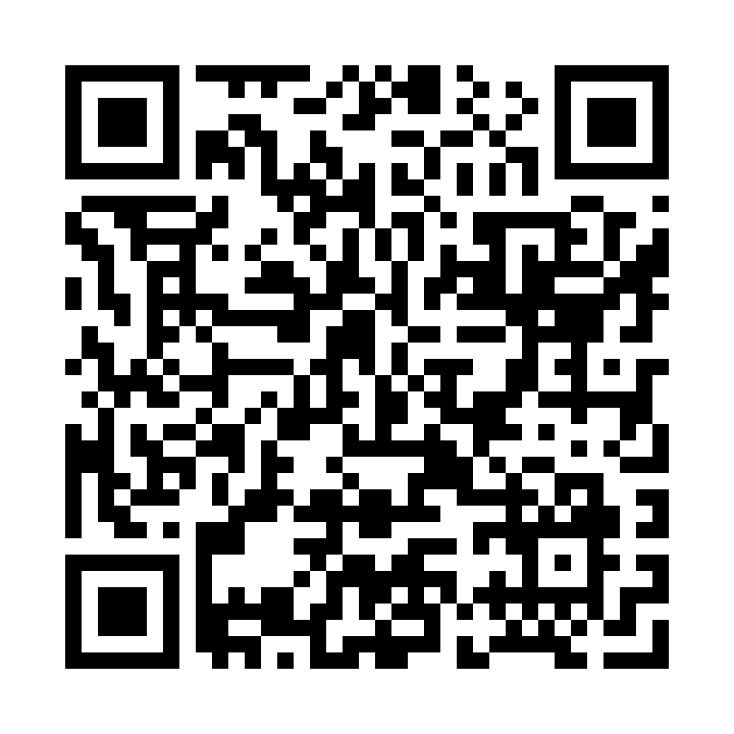
Please Vote for This Session
Vote for Session - Business Use cases for Enterprise Strategic Automation: Unlocking Value with MultiAgent Intelligence
Notes:
Voting slide for 'Business Use cases for Enterprise Strategic Automation: Unlocking Value with MultiAgent Intelligence'. Ask audience to scan the QR code or visit https://vote.dotnetdev.it/vote/4o2cmr0q/1017485 to vote. Emphasize the importance of feedback.

