Slide 1
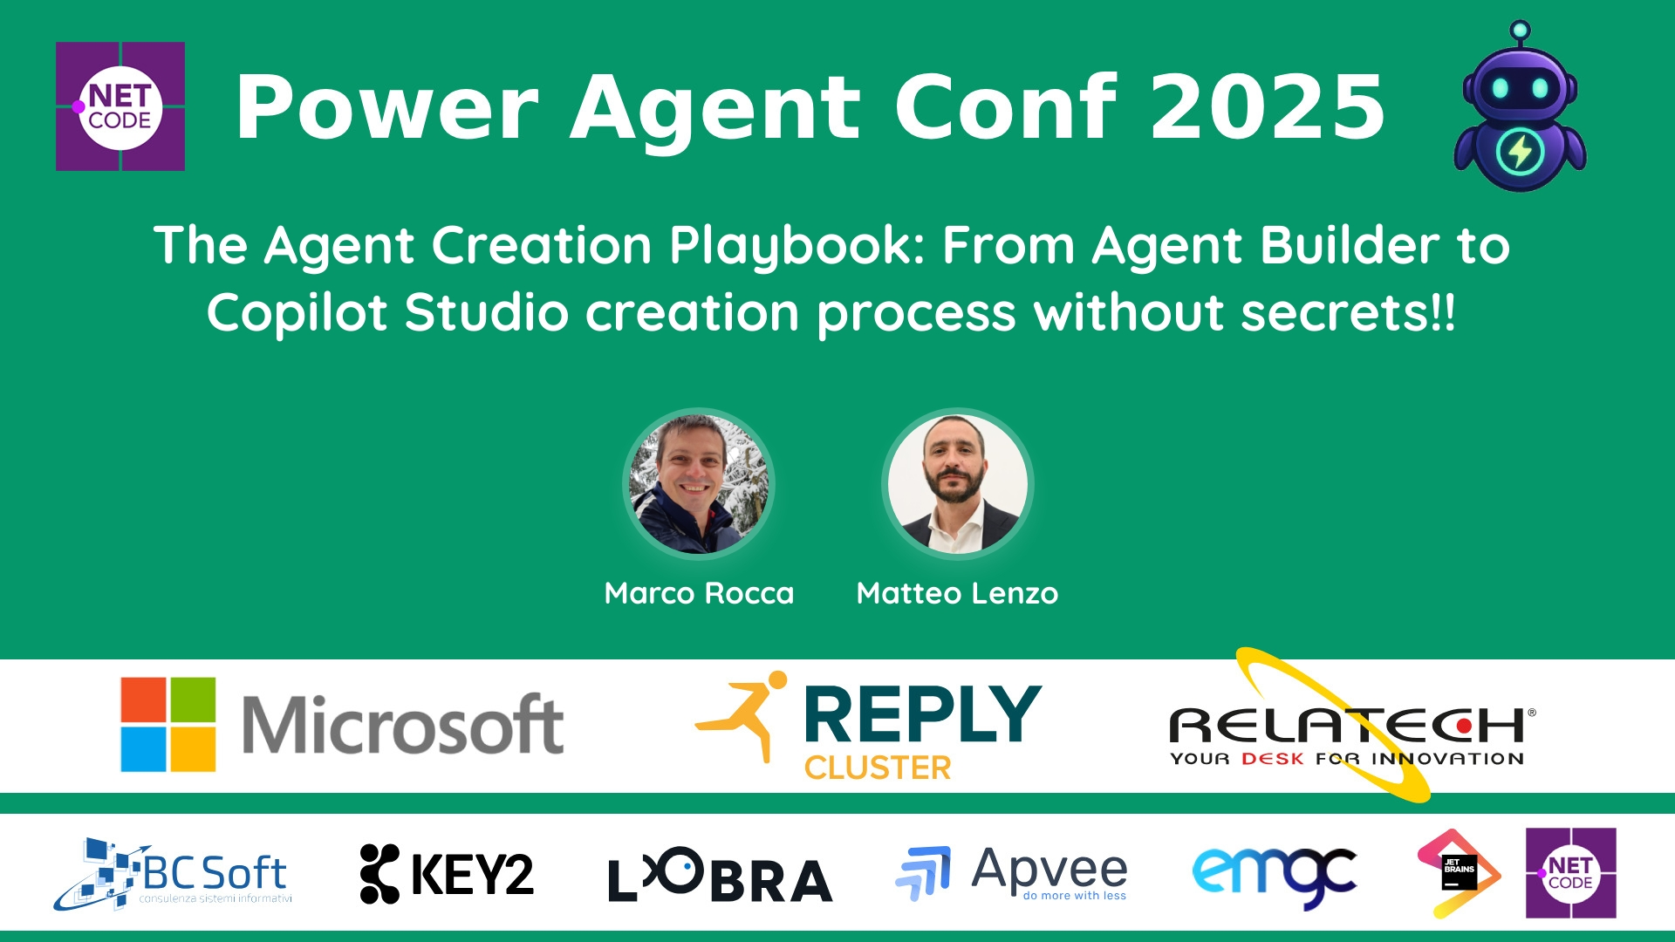
Session Banner - The Agent Creation Playbook: From Agent Builder to Copilot Studio creation process without secrets!!
Notes:
This is the opening banner slide for 'The Agent Creation Playbook: From Agent Builder to Copilot Studio creation process without secrets!!'. The session is presented by: Marco Rocca, Matteo Lenzo. This slide sets the visual theme for the presentation.

Slide 2
The Agent Creation Playbook: From Agent Builder to Copilot Studio creation process without secrets!!
Presented by: Marco Rocca, Matteo Lenzo
Notes:
Main title slide displaying 'The Agent Creation Playbook: From Agent Builder to Copilot Studio creation process without secrets!!'. Presented by: Marco Rocca, Matteo Lenzo. Use this slide to introduce the session topic.

Slide 3
Event Sponsors
Notes:
Sponsor acknowledgment slide. Take a moment to thank the event sponsors and explain their support for the conference.

Slide 4
The Agent Creation Playbook: From Agent Builder to Copilot Studio creation process without secrets!!
Description: Ready to build your own intelligent agents in Microsoft 365 Copilot? This session is your ultimate guide to creating powerful, productivity-boosting agents—no secrets, just the full playbook.
We’ll begin with Agent Builder, the no-code tool that makes it incredibly easy for anyone to create s...
Notes:
Detailed session information for 'The Agent Creation Playbook: From Agent Builder to Copilot Studio creation process without secrets!!'. Session description: Ready to build your own intelligent agents in Microsoft 365 Copilot? This session is your ultimate guide to creating powerful, productivity-boosting agents—no secrets, just the full playbook.
We’l.... Review the session objectives and speaker credentials.

Slide 5
Demo: The Agent Creation Playbook: From Agent Builder to Copilot Studio creation process without secrets!!
Notes:
Demo section for 'The Agent Creation Playbook: From Agent Builder to Copilot Studio creation process without secrets!!'. This slide is for live demonstrations. Ensure all demo materials are prepared and tested.

Slide 6
Questions & Discussion
Notes:
Q&A slide for 'The Agent Creation Playbook: From Agent Builder to Copilot Studio creation process without secrets!!'. This is time for audience questions and discussion. Prepare to address common questions about the topic and invite participation.

Slide 7
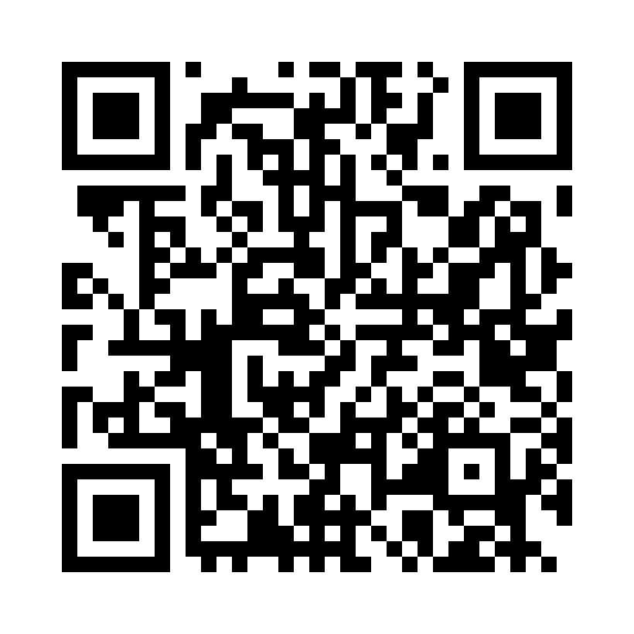
Please Vote for This Session
Vote for Session - The Agent Creation Playbook: From Agent Builder to Copilot Studio creation process without secrets!!
Notes:
Voting slide for 'The Agent Creation Playbook: From Agent Builder to Copilot Studio creation process without secrets!!'. Ask audience to scan the QR code or visit https://vote.dotnetdev.it/vote/4o2cmr0q/967080 to vote. Emphasize the importance of feedback.

