Slide 1
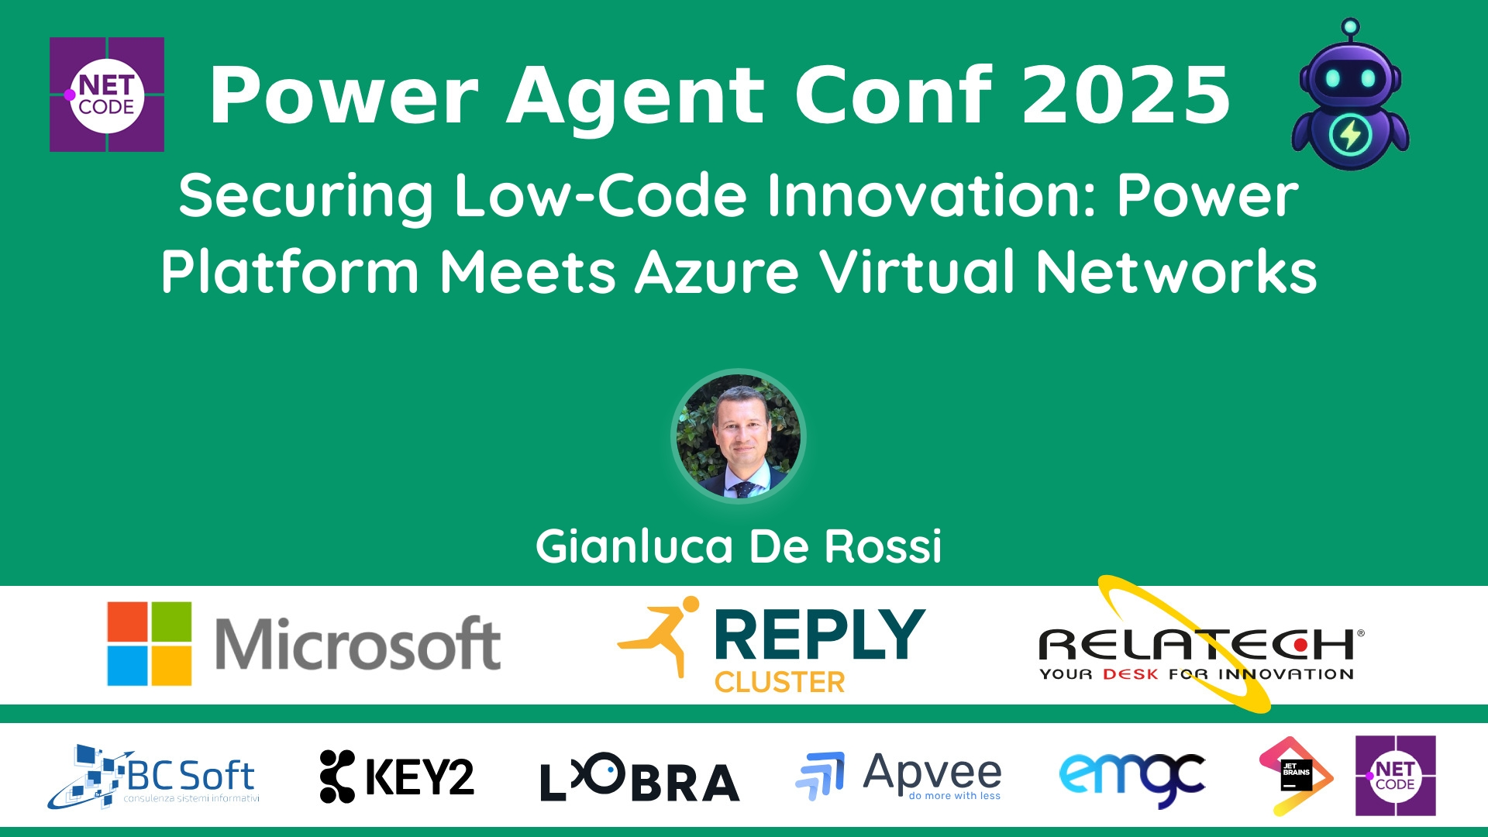
Session Banner - Securing Low-Code Innovation: Power Platform Meets Azure Virtual Networks
Notes:
This is the opening banner slide for 'Securing Low-Code Innovation: Power Platform Meets Azure Virtual Networks'. The session is presented by: Gianluca De Rossi. This slide sets the visual theme for the presentation.

Slide 2
Securing Low-Code Innovation: Power Platform Meets Azure Virtual Networks
Presented by: Gianluca De Rossi
Notes:
Main title slide displaying 'Securing Low-Code Innovation: Power Platform Meets Azure Virtual Networks'. Presented by: Gianluca De Rossi. Use this slide to introduce the session topic.

Slide 3
Event Sponsors
Notes:
Sponsor acknowledgment slide. Take a moment to thank the event sponsors and explain their support for the conference.

Slide 4
Securing Low-Code Innovation: Power Platform Meets Azure Virtual Networks
Description: Con l’adozione sempre più diffusa di piattaforme low-code per accelerare la trasformazione digitale, garantire una connettività sicura e scalabile diventa fondamentale. Questa sessione esplora come gli agenti intelligenti sviluppati con Copilot Studio possano integrarsi in modo sicuro con Azure, ...
Notes:
Detailed session information for 'Securing Low-Code Innovation: Power Platform Meets Azure Virtual Networks'. Session description: Con l’adozione sempre più diffusa di piattaforme low-code per accelerare la trasformazione digitale, garantire una connettività sicura e scalabile diventa fondamentale. Questa sessione esplora come gl.... Review the session objectives and speaker credentials.

Slide 5
Demo: Securing Low-Code Innovation: Power Platform Meets Azure Virtual Networks
Notes:
Demo section for 'Securing Low-Code Innovation: Power Platform Meets Azure Virtual Networks'. This slide is for live demonstrations. Ensure all demo materials are prepared and tested.

Slide 6
Questions & Discussion
Notes:
Q&A slide for 'Securing Low-Code Innovation: Power Platform Meets Azure Virtual Networks'. This is time for audience questions and discussion. Prepare to address common questions about the topic and invite participation.

Slide 7
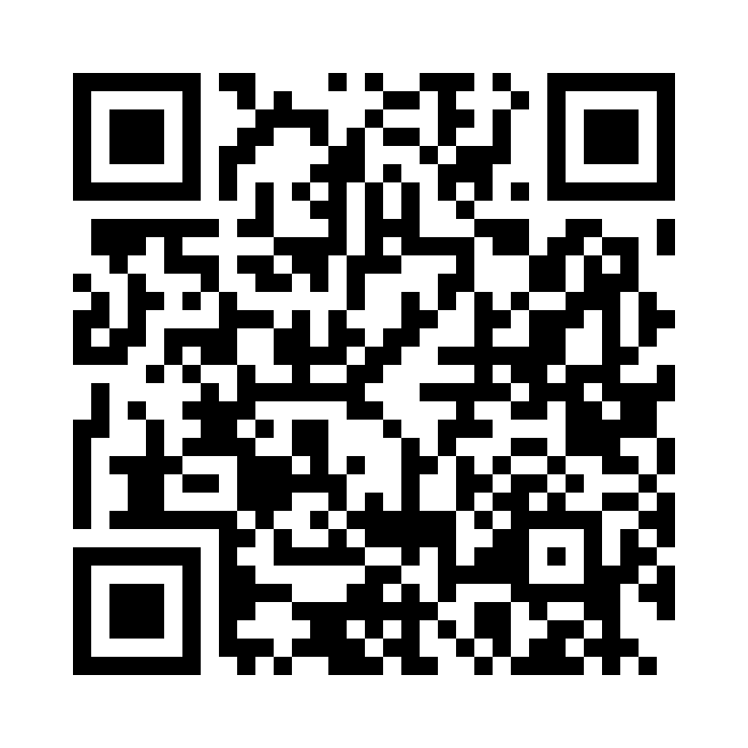
Please Vote for This Session
Vote for Session - Securing Low-Code Innovation: Power Platform Meets Azure Virtual Networks
Notes:
Voting slide for 'Securing Low-Code Innovation: Power Platform Meets Azure Virtual Networks'. Ask audience to scan the QR code or visit https://vote.dotnetdev.it/vote/4o2cmr0q/984137 to vote. Emphasize the importance of feedback.

