Slide 1
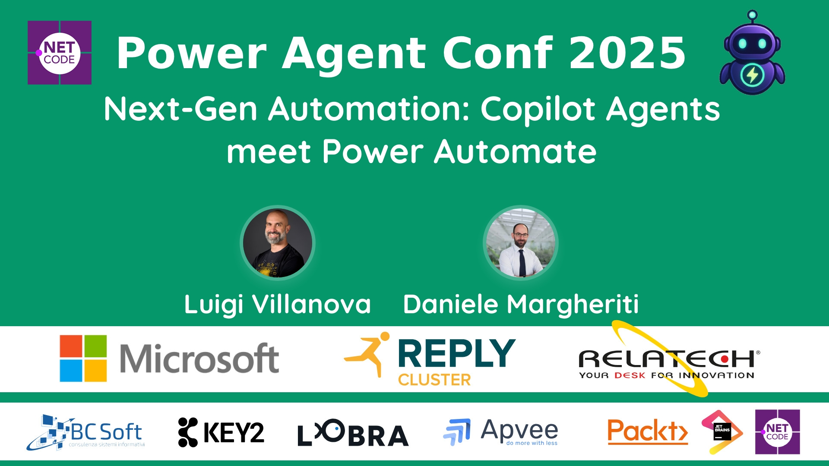
Session Banner - Next-Gen Automation: Copilot Agents meet Power Automate
Notes:
This is the opening banner slide for 'Next-Gen Automation: Copilot Agents meet Power Automate'. The session is presented by: Luigi Villanova, Daniele Margheriti. This slide sets the visual theme for the presentation.

Slide 2
Next-Gen Automation: Copilot Agents meet Power Automate
Presented by: Luigi Villanova, Daniele Margheriti
Notes:
Main title slide displaying 'Next-Gen Automation: Copilot Agents meet Power Automate'. Presented by: Luigi Villanova, Daniele Margheriti. Use this slide to introduce the session topic.

Slide 3
Event Sponsors
Notes:
Sponsor acknowledgment slide. Take a moment to thank the event sponsors and explain their support for the conference.

Slide 4
Next-Gen Automation: Copilot Agents meet Power Automate
Description: L’automazione sta entrando in una nuova fase: accanto ai flussi strutturati e ripetibili di Power Automate, emergono oggi gli AI agents di Copilot Studio, capaci di gestire interazioni conversazionali, adattive e guidate dal contesto
In questa sessione esploreremo come i due strumenti possono...
Notes:
Detailed session information for 'Next-Gen Automation: Copilot Agents meet Power Automate'. Session description: L’automazione sta entrando in una nuova fase: accanto ai flussi strutturati e ripetibili di Power Automate, emergono oggi gli AI agents di Copilot Studio, capaci di gestire interazioni conversazionali.... Review the session objectives and speaker credentials.

Slide 5
Demo: Next-Gen Automation: Copilot Agents meet Power Automate
Notes:
Demo section for 'Next-Gen Automation: Copilot Agents meet Power Automate'. This slide is for live demonstrations. Ensure all demo materials are prepared and tested.

Slide 6
Questions & Discussion
Notes:
Q&A slide for 'Next-Gen Automation: Copilot Agents meet Power Automate'. This is time for audience questions and discussion. Prepare to address common questions about the topic and invite participation.

Slide 7
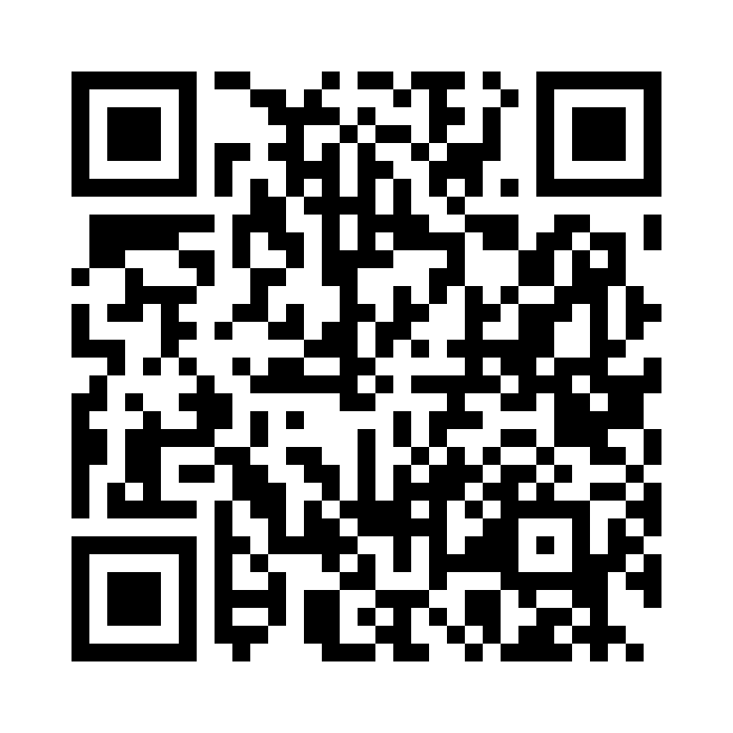
Please Vote for This Session
Vote for Session - Next-Gen Automation: Copilot Agents meet Power Automate
Notes:
Voting slide for 'Next-Gen Automation: Copilot Agents meet Power Automate'. Ask audience to scan the QR code or visit https://vote.dotnetdev.it/vote/4o2cmr0q/972997 to vote. Emphasize the importance of feedback.

