Slide 1
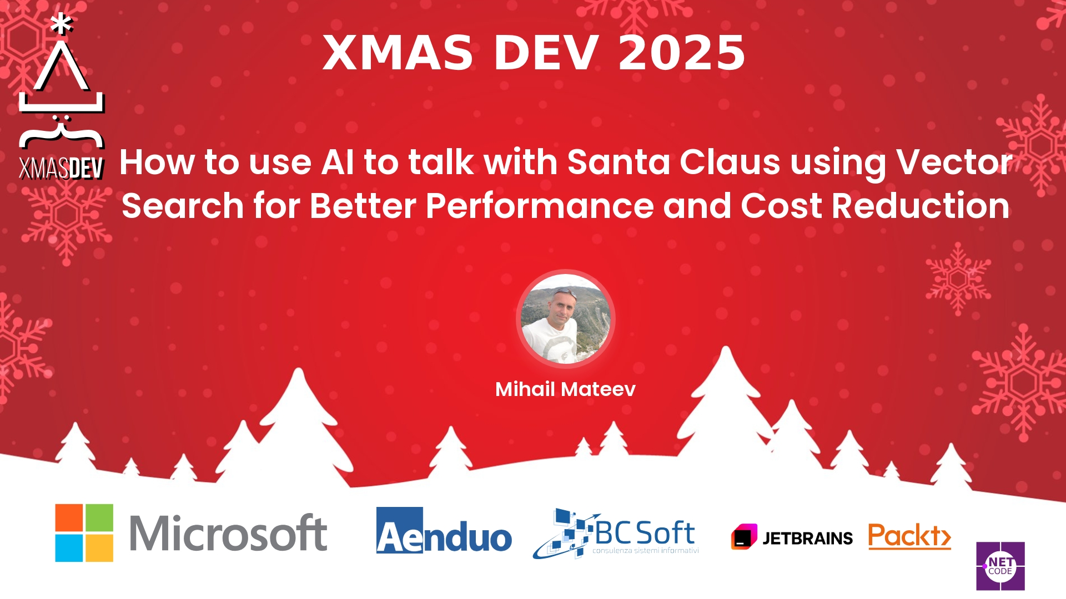
Session Banner - How to use AI to talk with Santa Claus using Vector Search for Better Performance and Cost Reduction
Notes:
This is the opening banner slide for 'How to use AI to talk with Santa Claus using Vector Search for Better Performance and Cost Reduction'. The session is presented by: Mihail Mateev. This slide sets the visual theme for the presentation.

Slide 2
How to use AI to talk with Santa Claus using Vector Search for Better Performance and Cost Reduction
Notes:
Main title slide displaying 'How to use AI to talk with Santa Claus using Vector Search for Better Performance and Cost Reduction'. Presented by: Mihail Mateev. Use this slide to introduce the session topic.

Slide 3
Event Sponsors
Notes:
Sponsor acknowledgment slide. Take a moment to thank the event sponsors and explain their support for the conference.

Slide 4




Community

Slide 5
Demo: How to use AI to talk with Santa Claus using Vector Search for Better Performance and Cost Reduction
Notes:
Demo section for 'How to use AI to talk with Santa Claus using Vector Search for Better Performance and Cost Reduction'. This slide is for live demonstrations. Ensure all demo materials are prepared and tested.

Slide 6
Questions & Discussion
Notes:
Q&A slide for 'How to use AI to talk with Santa Claus using Vector Search for Better Performance and Cost Reduction'. This is time for audience questions and discussion. Prepare to address common questions about the topic and invite participation.

Slide 7
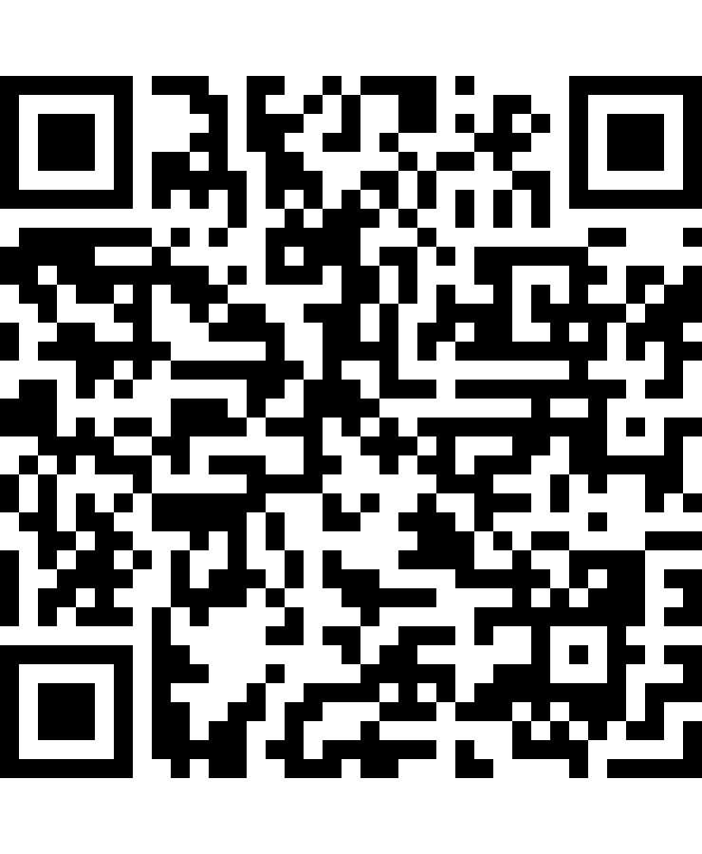
Please Vote for This Session
Vote for Session - How to use AI to talk with Santa Claus using Vector Search for Better Performance and Cost Reduction
Vote online at:
https://vote.dotnetdev.it/vote/xqt335vh/1033660
Notes:
Voting slide for 'How to use AI to talk with Santa Claus using Vector Search for Better Performance and Cost Reduction'. Ask audience to scan the QR code or visit https://vote.dotnetdev.it/vote/xqt335vh/1033660 to vote. Emphasize the importance of feedback.

