Slide 1

Session Banner - 🎅📨 “Dalla letterina a Babbo Natale all’ordine perfetto: magia (MCP) sotto l’albero”
Notes:
This is the opening banner slide for '🎅📨 “Dalla letterina a Babbo Natale all’ordine perfetto: magia (MCP) sotto l’albero”'. The session is presented by: Gaetano Paternò. This slide sets the visual theme for the presentation.

Slide 2
🎅📨 “Dalla letterina a Babbo Natale all’ordine perfetto: magia (MCP) sotto l’albero”
Notes:
Main title slide displaying '🎅📨 “Dalla letterina a Babbo Natale all’ordine perfetto: magia (MCP) sotto l’albero”'. Presented by: Gaetano Paternò. Use this slide to introduce the session topic.

Slide 3
Event Sponsors
Notes:
Sponsor acknowledgment slide. Take a moment to thank the event sponsors and explain their support for the conference.

Slide 4




Community

Slide 5
Demo: 🎅📨 “Dalla letterina a Babbo Natale all’ordine perfetto: magia (MCP) sotto l’albero”
Notes:
Demo section for '🎅📨 “Dalla letterina a Babbo Natale all’ordine perfetto: magia (MCP) sotto l’albero”'. This slide is for live demonstrations. Ensure all demo materials are prepared and tested.

Slide 6
Questions & Discussion
Notes:
Q&A slide for '🎅📨 “Dalla letterina a Babbo Natale all’ordine perfetto: magia (MCP) sotto l’albero”'. This is time for audience questions and discussion. Prepare to address common questions about the topic and invite participation.

Slide 7
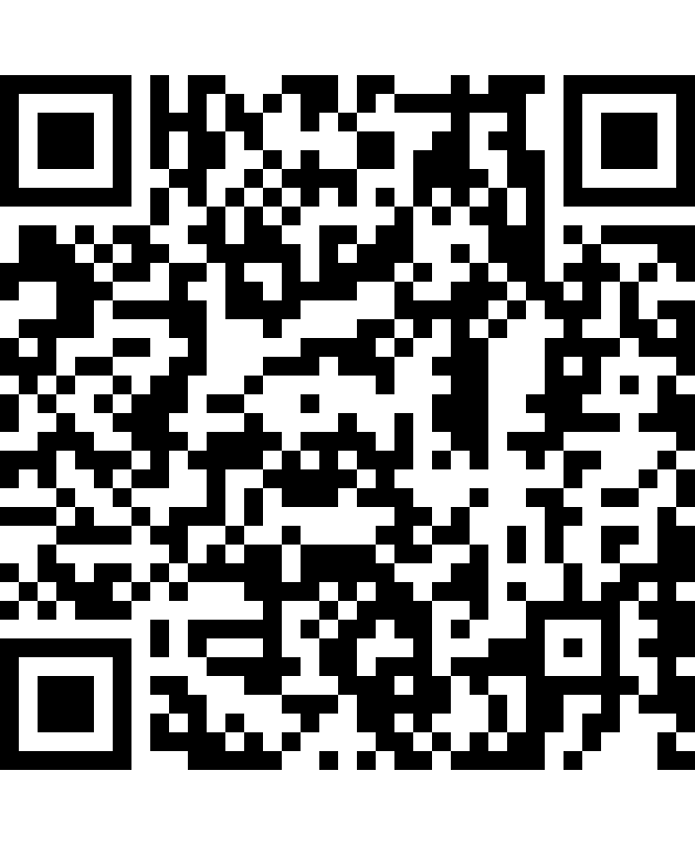
Please Vote for This Session
Vote for Session - 🎅📨 “Dalla letterina a Babbo Natale all’ordine perfetto: magia (MCP) sotto l’albero”
Vote online at:
https://vote.dotnetdev.it/vote/xqt335vh/1040445
Notes:
Voting slide for '🎅📨 “Dalla letterina a Babbo Natale all’ordine perfetto: magia (MCP) sotto l’albero”'. Ask audience to scan the QR code or visit https://vote.dotnetdev.it/vote/xqt335vh/1040445 to vote. Emphasize the importance of feedback.

