Slide 1
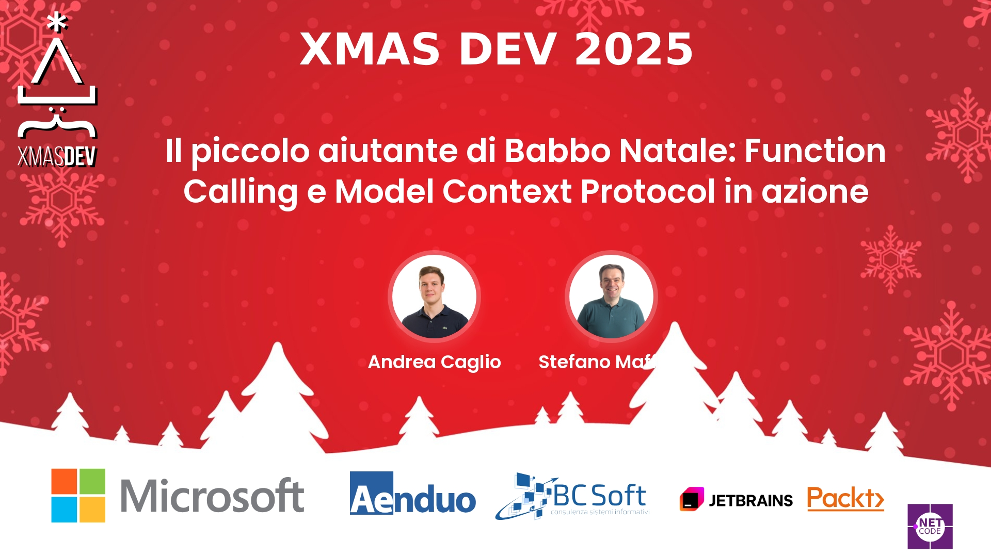
Session Banner - Il piccolo aiutante di Babbo Natale: Function Calling e Model Context Protocol in azione
Notes:
This is the opening banner slide for 'Il piccolo aiutante di Babbo Natale: Function Calling e Model Context Protocol in azione'. The session is presented by: Andrea Caglio, Stefano Maffeis. This slide sets the visual theme for the presentation.

Slide 2
Il piccolo aiutante di Babbo Natale: Function Calling e Model Context Protocol in azione
Notes:
Main title slide displaying 'Il piccolo aiutante di Babbo Natale: Function Calling e Model Context Protocol in azione'. Presented by: Andrea Caglio, Stefano Maffeis. Use this slide to introduce the session topic.

Slide 3
Event Sponsors
Notes:
Sponsor acknowledgment slide. Take a moment to thank the event sponsors and explain their support for the conference.

Slide 4




Community

Slide 5
Demo: Il piccolo aiutante di Babbo Natale: Function Calling e Model Context Protocol in azione
Notes:
Demo section for 'Il piccolo aiutante di Babbo Natale: Function Calling e Model Context Protocol in azione'. This slide is for live demonstrations. Ensure all demo materials are prepared and tested.

Slide 6
Questions & Discussion
Notes:
Q&A slide for 'Il piccolo aiutante di Babbo Natale: Function Calling e Model Context Protocol in azione'. This is time for audience questions and discussion. Prepare to address common questions about the topic and invite participation.

Slide 7
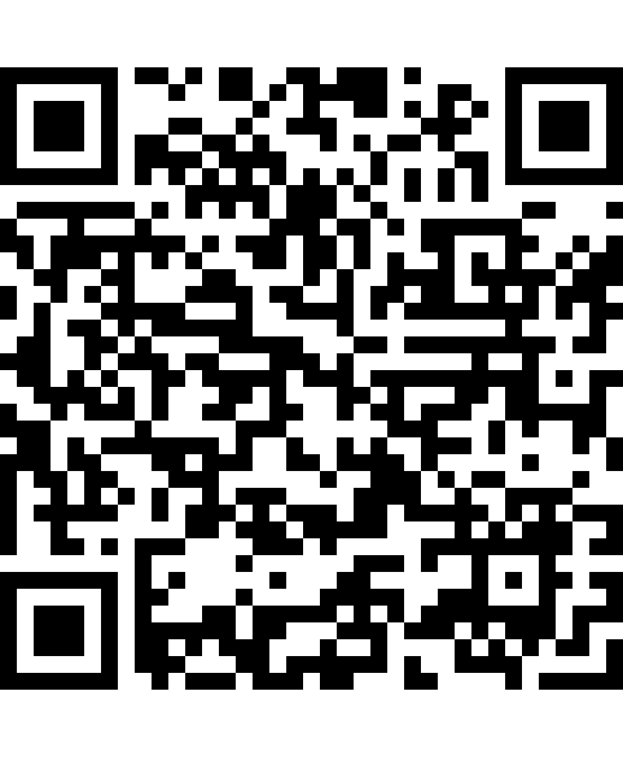
Please Vote for This Session
Vote for Session - Il piccolo aiutante di Babbo Natale: Function Calling e Model Context Protocol in azione
Vote online at:
https://vote.dotnetdev.it/vote/xqt335vh/1057873
Notes:
Voting slide for 'Il piccolo aiutante di Babbo Natale: Function Calling e Model Context Protocol in azione'. Ask audience to scan the QR code or visit https://vote.dotnetdev.it/vote/xqt335vh/1057873 to vote. Emphasize the importance of feedback.

