Slide 1

Session Banner - Caro Babbo Claude, quest'anno per Natale vorrei... un mese senza bug!
Notes:
This is the opening banner slide for 'Caro Babbo Claude, quest'anno per Natale vorrei... un mese senza bug!'. The session is presented by: Marco Consolaro, Emanuele Furlan. This slide sets the visual theme for the presentation.

Slide 2
Caro Babbo Claude, quest'anno per Natale vorrei... un mese senza bug!
Notes:
Main title slide displaying 'Caro Babbo Claude, quest'anno per Natale vorrei... un mese senza bug!'. Presented by: Marco Consolaro, Emanuele Furlan. Use this slide to introduce the session topic.

Slide 3
Event Sponsors
Notes:
Sponsor acknowledgment slide. Take a moment to thank the event sponsors and explain their support for the conference.

Slide 4




Community

Slide 5
Demo: Caro Babbo Claude, quest'anno per Natale vorrei... un mese senza bug!
Notes:
Demo section for 'Caro Babbo Claude, quest'anno per Natale vorrei... un mese senza bug!'. This slide is for live demonstrations. Ensure all demo materials are prepared and tested.

Slide 6
Questions & Discussion
Notes:
Q&A slide for 'Caro Babbo Claude, quest'anno per Natale vorrei... un mese senza bug!'. This is time for audience questions and discussion. Prepare to address common questions about the topic and invite participation.

Slide 7
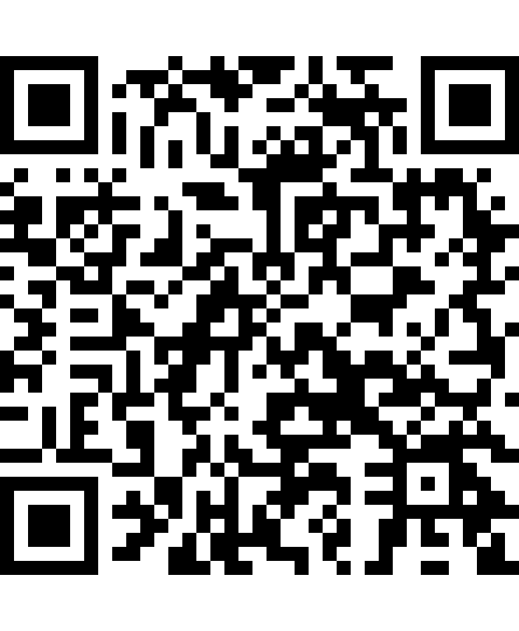
Please Vote for This Session
Vote for Session - Caro Babbo Claude, quest'anno per Natale vorrei... un mese senza bug!
Vote online at:
https://vote.dotnetdev.it/vote/xqt335vh/1067165
Notes:
Voting slide for 'Caro Babbo Claude, quest'anno per Natale vorrei... un mese senza bug!'. Ask audience to scan the QR code or visit https://vote.dotnetdev.it/vote/xqt335vh/1067165 to vote. Emphasize the importance of feedback.

