Slide 1

Session Banner - Un Natale da DevOps: Mamma, ho perso l’A.I.!
Notes:
This is the opening banner slide for 'Un Natale da DevOps: Mamma, ho perso l’A.I.!'. The session is presented by: Francesco Gallo. This slide sets the visual theme for the presentation.

Slide 2
Un Natale da DevOps: Mamma, ho perso l’A.I.!
Notes:
Main title slide displaying 'Un Natale da DevOps: Mamma, ho perso l’A.I.!'. Presented by: Francesco Gallo. Use this slide to introduce the session topic.

Slide 3
Event Sponsors
Notes:
Sponsor acknowledgment slide. Take a moment to thank the event sponsors and explain their support for the conference.

Slide 4




Community

Slide 5
Demo: Un Natale da DevOps: Mamma, ho perso l’A.I.!
Notes:
Demo section for 'Un Natale da DevOps: Mamma, ho perso l’A.I.!'. This slide is for live demonstrations. Ensure all demo materials are prepared and tested.

Slide 6
Questions & Discussion
Notes:
Q&A slide for 'Un Natale da DevOps: Mamma, ho perso l’A.I.!'. This is time for audience questions and discussion. Prepare to address common questions about the topic and invite participation.

Slide 7
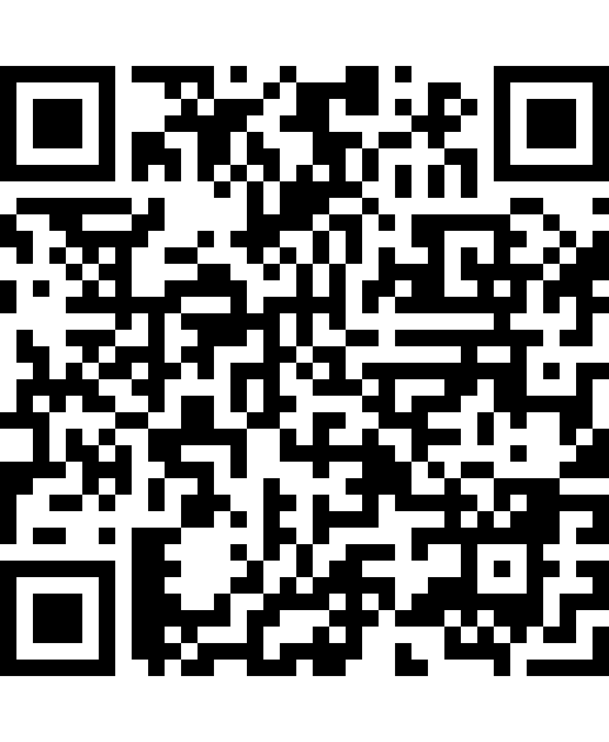
Please Vote for This Session
Vote for Session - Un Natale da DevOps: Mamma, ho perso l’A.I.!
Vote online at:
https://vote.dotnetdev.it/vote/xqt335vh/1070532
Notes:
Voting slide for 'Un Natale da DevOps: Mamma, ho perso l’A.I.!'. Ask audience to scan the QR code or visit https://vote.dotnetdev.it/vote/xqt335vh/1070532 to vote. Emphasize the importance of feedback.

