Slide 1

Session Banner - Firewall sotto l’albero: come fermare il Grinch con Azure Network Security Perimeter
Notes:
This is the opening banner slide for 'Firewall sotto l’albero: come fermare il Grinch con Azure Network Security Perimeter'. The session is presented by: Marco Obinu. This slide sets the visual theme for the presentation.

Slide 2
Firewall sotto l’albero: come fermare il Grinch con Azure Network Security Perimeter
Notes:
Main title slide displaying 'Firewall sotto l’albero: come fermare il Grinch con Azure Network Security Perimeter'. Presented by: Marco Obinu. Use this slide to introduce the session topic.

Slide 3
Event Sponsors
Notes:
Sponsor acknowledgment slide. Take a moment to thank the event sponsors and explain their support for the conference.

Slide 4




Community

Slide 5
Demo: Firewall sotto l’albero: come fermare il Grinch con Azure Network Security Perimeter
Notes:
Demo section for 'Firewall sotto l’albero: come fermare il Grinch con Azure Network Security Perimeter'. This slide is for live demonstrations. Ensure all demo materials are prepared and tested.

Slide 6
Questions & Discussion
Notes:
Q&A slide for 'Firewall sotto l’albero: come fermare il Grinch con Azure Network Security Perimeter'. This is time for audience questions and discussion. Prepare to address common questions about the topic and invite participation.

Slide 7
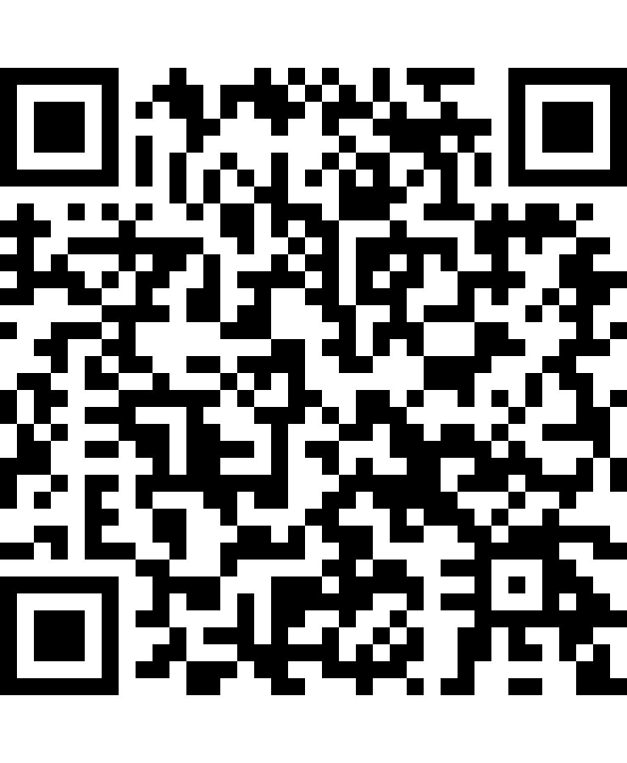
Please Vote for This Session
Vote for Session - Firewall sotto l’albero: come fermare il Grinch con Azure Network Security Perimeter
Vote online at:
https://vote.dotnetdev.it/vote/xqt335vh/1074357
Notes:
Voting slide for 'Firewall sotto l’albero: come fermare il Grinch con Azure Network Security Perimeter'. Ask audience to scan the QR code or visit https://vote.dotnetdev.it/vote/xqt335vh/1074357 to vote. Emphasize the importance of feedback.

