Slide 1


UniRx
Unity + Rx Reactive programming for game

Slide 2




Gittitat Ekcantawut
Former Senior Unity Engineer at TechnoBrave Asia
Email : menstood@gmail.com
strokecgm
gitti-ekchan
menstood

Slide 3
What is Reactive Programming;
Reactive Programming = “programming with asynchronous data streams.”;

Slide 4
Reactive Programming Core;
Observable : Messenger
Subscriber : Receiver
Operator : Middleware of Observable and Subscriber
Stream : Event of Observable and Subscriber

Slide 5
What is UniRx;
UniRX =>
{
Reactive Extension for Unity;
Official Rx doesn’t work on Unity;
Supported Multiple Platform;
}

Slide 6
Why
UniRx ?

Slide 7
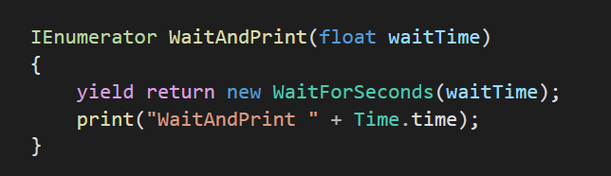
1. Coroutine isn’t good practice for asynchronous operation
This is asynchronous in Unity

Slide 8
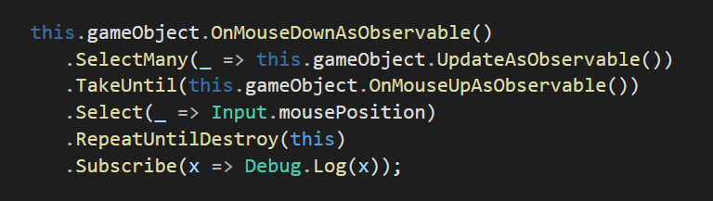
2. Use LINQ-style query operator
Easy to start for .NET user who never use Unity
We can do something like this.

Slide 9
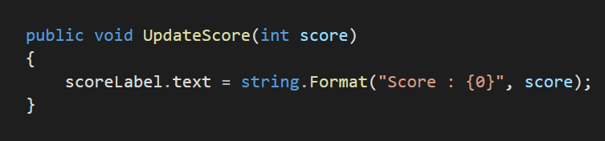
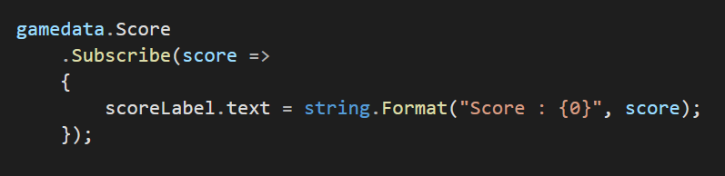
3. Improve your UI programming
No more something like this
Now we use this

Slide 10
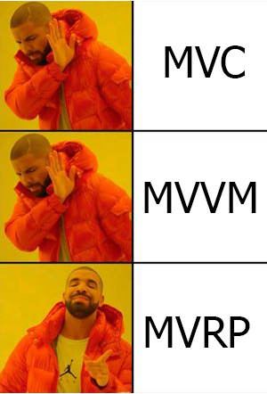
Model-View-(Reactive)Presenter Pattern

Slide 11
Demo
Available at https://github.com/menstood/dotnetcon2020

Slide 12
MonoBehaviour lifecycle
Start : Called before the first frame update
Update : Called once per frame
OnTriggerEnter : Called when object collide with other
OnDestroy : Called at the last frame of the object’s existence

Slide 13
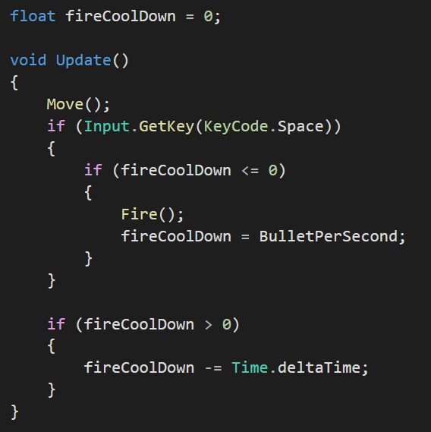
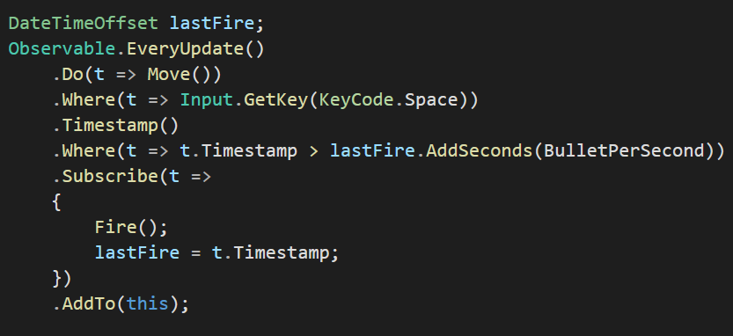
PlayerController
Old Fashioned Way
UniRx
Observable

Slide 14
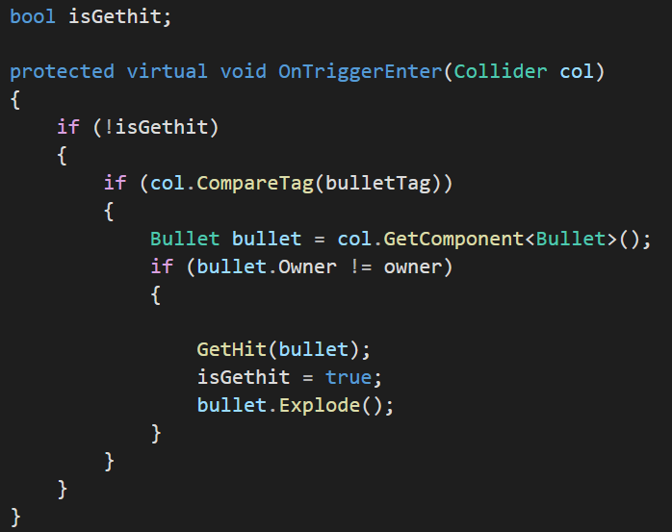
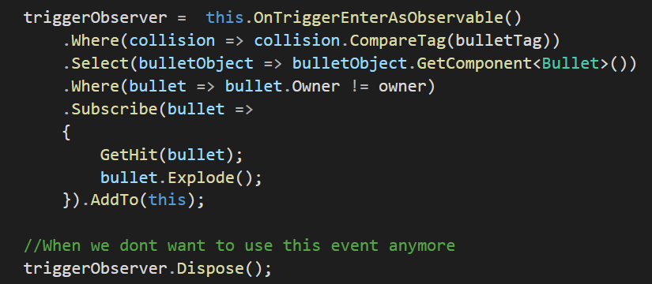
Dispose OnTriggerEnter Event
Old Fashioned Way
UniRx

Slide 15
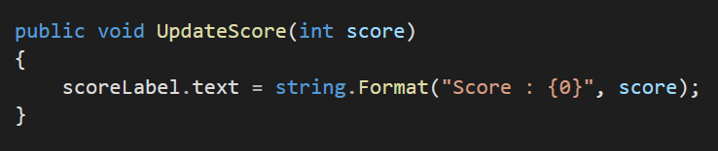
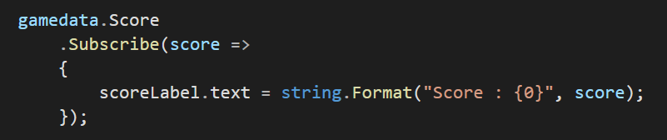
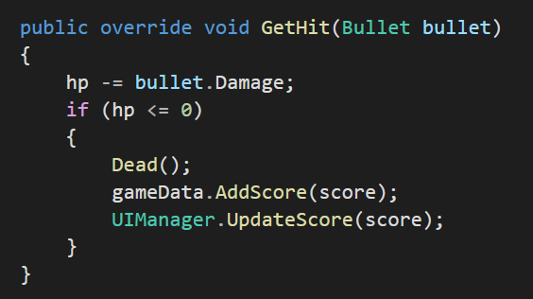
UI
Old Fashioned Way
UIManager.cs
EnemyController.cs
UniRx
UIManager.cs

Slide 16
Get UniRx
GitHub
https://github.com/neuecc/UniRx
Or
Unity Asset Store
Unirx

Slide 17
Q&A

Slide 18
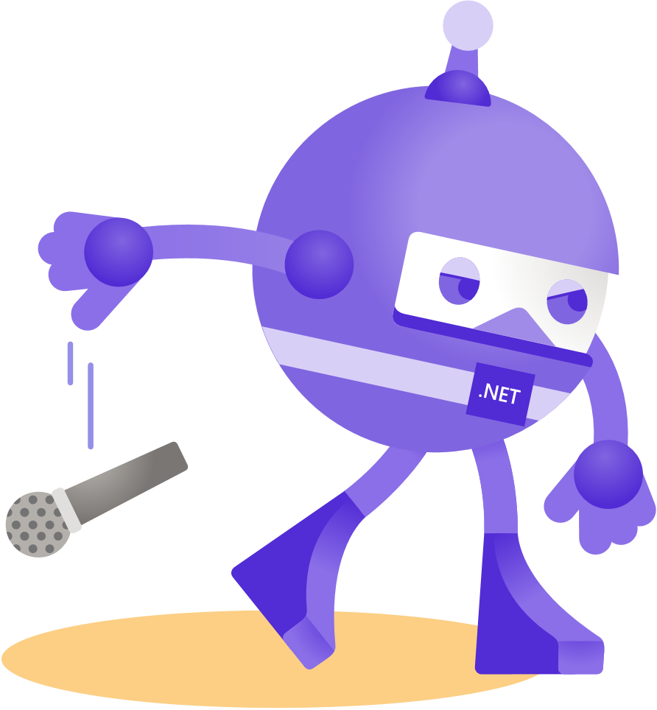
Thanks for joining!

