Slide 1
Swagger + ASP.NET Web api
swashbuckle

Slide 2
Agenda
Documentation of a RESTful Web Service today
Issues today
WTF is Swagger?
Swagger UI
Swagger CodeGen
Swagger for ASP.NET Web Api
Notes:
Fade out

Slide 3
„Can you please provide a API Specification for your existing RESTful Web Service?“
Notes:
Vorhang

Slide 4
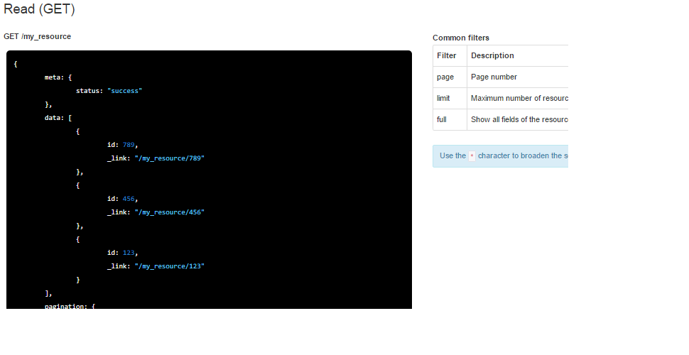
Example API Specification
Source: http://doc.iadvize.com/?p=api2-rest
Notes:
zerknüllen

Slide 5
Happy developing
Use Postman or Fiddler
Try and Error
Write own documentation
Write client code
Notes:
Türen

Slide 6
issues
API changes not refelcted
Updating of all clients
Updating of Documentation (what devs LOVE most!)
Notes:
Giltzer

Slide 7
SWAGGER
Notes:
So what is Swagger? Is it one of this? Next: Bilder

Slide 8


Wtf is swagger?

Slide 9

WTF is swagger!?
Simple representation of your RESTful API
Open Source under Apache License on GitHub
http://swagger.io
Notes:
Gives you a simple representation of…
But hey, wtf is swagger?

Slide 10
WTF is swagger!!!!
Swagger is NOT a discription language like WSDL
Swagger is a framework for RESTful Web APIs
Describing (Swagger spec)
Consuming (Swagger codegen)
Visualizing (Swagger UI)
Lots of other projects
Big Community
Notes:
Is a Framework, better say a bunch of Tools

Slide 11
Swagger spec & core
Open Source under Apache License on Github
Swagger spec syntax: JSON or YAML
https://github.com/swagger-api/swagger-spec
https://github.com/swagger-api/swagger-core
Notes:
Most importent part of swagger Spec & Core Next Swagger-UI

Slide 12
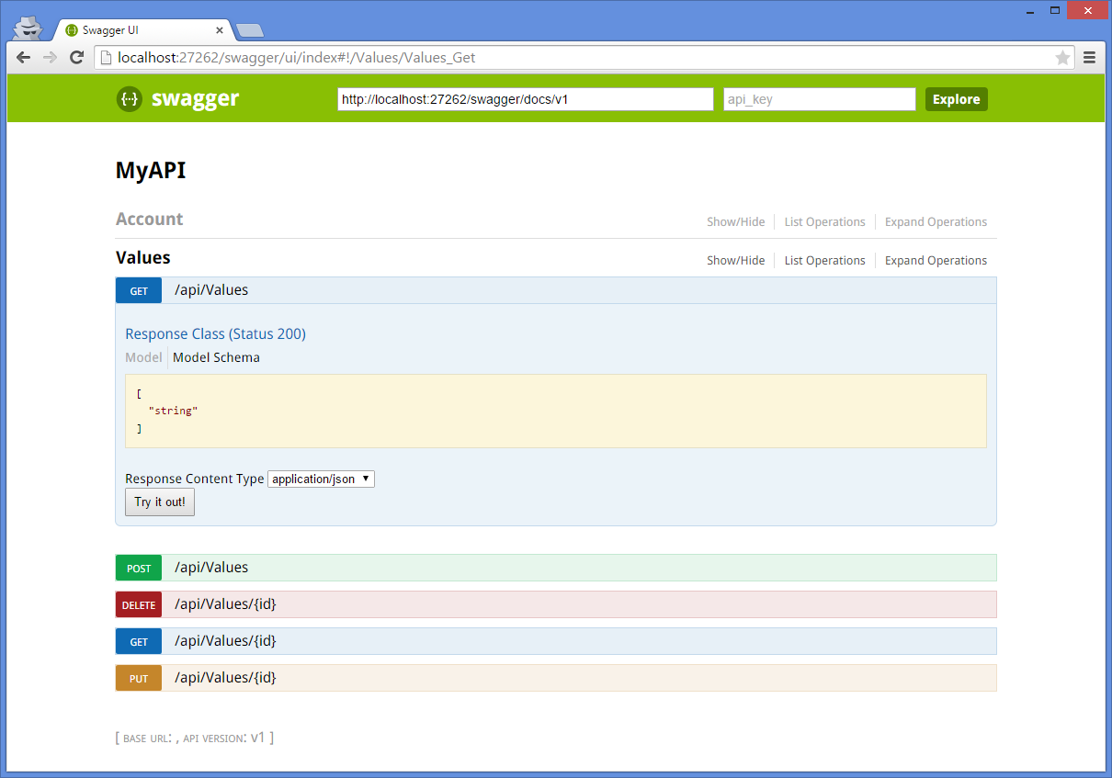
Swagger-UI

Slide 13
Swagger-ui
Human-readable documentation for RESTful Web Services
Interactive documentation → no need for Postman, Fiddler nor SoapUI*
Built-in Swagger-spec validator
Notes:
SoapUI and Postman can import swagger-spec

Slide 14
Swagger codegen
Tool for generation of Client-Code
Supports for different languages and frameworks
Customizable (open source on Github)
Java based commandline tool

Slide 15
Swashbuckle - Swagger for ASP.NET Web Api
.NET Framework to create Swagger-spec for ASP.NET Web Api
Swashbuckle-UI: Swagger-UI for .NET
Easy installation and setup:
Add NuGet-Package (required)
Detailed configuration (optional)
Notes:
swagger

Slide 16
Time for Demo!

Slide 17
Resources
http://swagger.io/
https://github.com/swagger-api/swagger-core
https://github.com/swagger-api/swagger-ui
https://github.com/swagger-api/swagger-codegen
https://github.com/domaindrivendev/Swashbuckle
https://www.nuget.org/packages/Swashbuckle
https://github.com/dersia/MeetupHH

Slide 18

Questions

