Slide 1
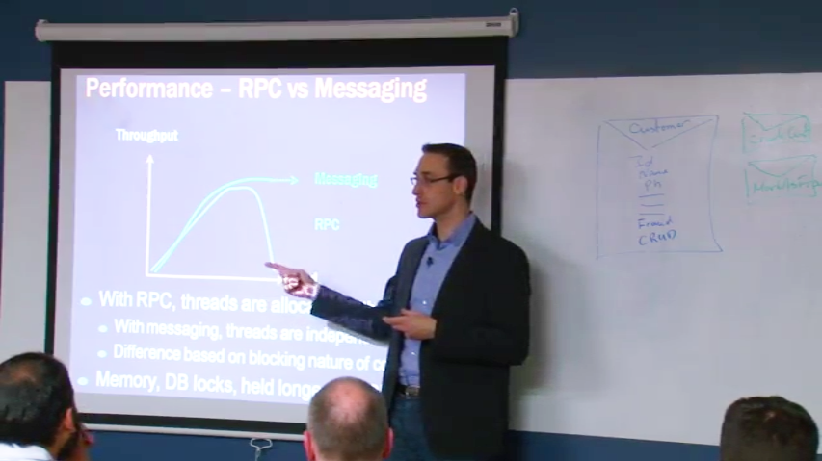

Thank you
Learn to design better systems
Get access to 2 full days of Udi Dahan's Advanced Distributed Systems Design video course.
Sign up here:
http://go.particular.net/.NETHamburg Access code: HamburgNET Expiration date: Sep 29th

