Slide 1

Sviluppo mobile con Visual Studio OnLine
Bertelli Gianluca
Technical Evangelist - Microsoft
@gianlucb
gianlucb@microsoft.com

Slide 2

Microsoft OCP - One Commercial Partner
Build-With
Marketing
Co-Sell

Slide 3
Agenda
.NET Standard
Xamarin and .NET Standard
Visual Studio Online
App Center

Slide 4
.NET Standard

Slide 5
.NET Standard
.NET Standard is a specification (a set of APIs) that are intended to be available across all modern .NET runtimes.​
.NET Standard is not a runtime target that an exe can run against.​
It’s meant to be targeted by libraries so that they can work across many .NET platforms. Like improved portable class libraries.​

Slide 6





.NET Standard
.NET Standard
.NET Core
.NET Framework
Mono
UWP
Xamarin
Windows
Windows
Linux
Windows
Windows
Linux
Android
Mac OS X
iOS
Notes:
The .NET Standard is a formal specification of .NET APIs that are intended to be available on all .NET implementations. The motivation behind the .NET Standard is establishing greater uniformity in the .NET ecosystem. ECMA 335 continues to establish uniformity for .NET implementation behavior, but there is no similar spec for the .NET Base Class Libraries (BCL) for .NET library implementations.
The .NET Standard enables the following key scenarios:
Defines uniform set of BCL APIs for all .NET implementations to implement, independent of workload.
Enables developers to produce portable libraries that are usable across .NET implementations, using this same set of APIs.
Reduces or even eliminates conditional compilation of shared source due to .NET APIs, only for OS APIs.
The various .NET implementations target specific versions of .NET Standard. Each .NET implementation version advertises the highest .NET Standard version it supports, a statement that means it also supports previous versions. For example, the .NET Framework 4.6 implements .NET Standard 1.3, which means that it exposes all APIs defined in .NET Standard versions 1.0 through 1.3. Similarly, the .NET Framework 4.6.1 implements .NET Standard 1.4, while .NET Core 1.0 implements .NET Standard 1.6.

Slide 7
.NET Standard
.NET Standard 1.0
.NET Standard 1.1
.NET Standard 1.2
.NET Standard 1.3
.NET Standard 1.4
.NET Standard 1.5
.NET Standard 1.6
.NET Standard 2.0

Slide 8
Xamarin and .NET Standard

Slide 9
.NET Standard
.NET Standard | 1.0 | 1.1 | 1.2 | 1.3 | 1.4 | 1.5 | 1.6 | 2.0
.NET Core | 1.0 | 1.0 | 1.0 | 1.0 | 1.0 | 1.0 | 1.0 | 2.0
.NET Framework | 4.5 | 4.5 | 4.5.1 | 4.6 | 4.6.1 | 4.6.1 | 4.6.1 | 4.6.1
Mono | 4.6 | 4.6 | 4.6 | 4.6 | 4.6 | 4.6 | 4.6 | 5.4
Xamarin.iOS | 10.0 | 10.0 | 10.0 | 10.0 | 10.0 | 10.0 | 10.0 | 10.14
Xamarin.Mac | 3.0 | 3.0 | 3.0 | 3.0 | 3.0 | 3.0 | 3.0 | 3.8
Xamarin.Android | 7.0 | 7.0 | 7.0 | 7.0 | 7.0 | 7.0 | 7.0 | 8.0
UWP | 10.0 | 10.0 | 10.0 | 10.0 | 10.0 | 10.0.16299 | 10.0.16299 | 10.0.16299
Windows | 8.0 | 8.0 | 8.1
Windows Phone | 8.1 | 8.1 | 8.1
Interactive table: http://immo.landwerth.net/netstandard-versions/#

Slide 10
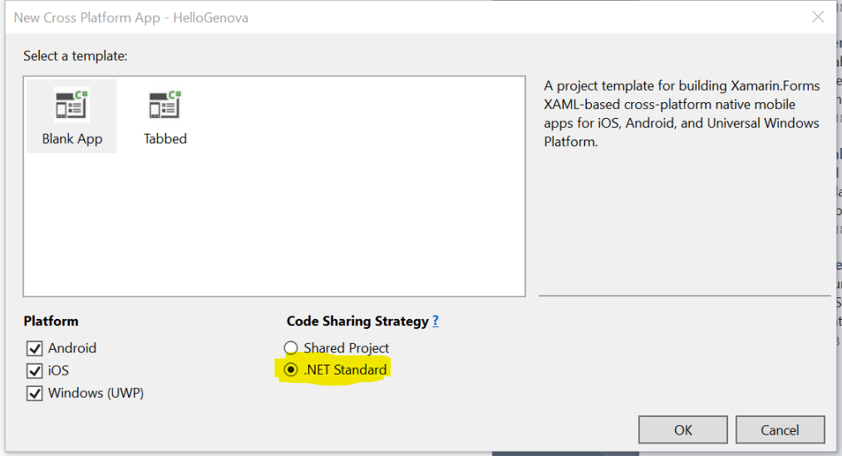
Xamarin and .NET Standard
.NET Standard is now supported by Xamarin
Will replace the PCL approach

Slide 11
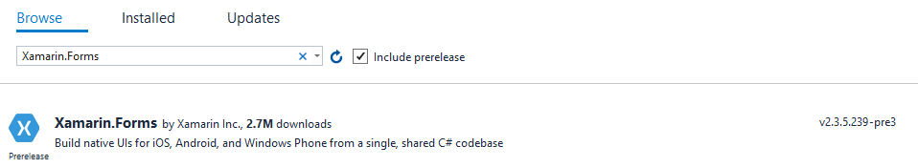
Xamarin and .NET Standard
Supported by Xamarin.Forms
Required by Xamarin.Forms 3.0
Integration with NuGet

Slide 12
Visual Studio Online (VSTS)

Slide 13
Visual Studio Online
http://yourname.visualstudio.com
Free up to 5 developers
Compile on cloud
Build on cloud
Deployment automation

Slide 14


Visual Studio Online
Continous Integration (CI)
Developer
Continous Deployment (CD)
Backend

Slide 15
App Center

Slide 16
App Center
Build
Create an installable app package automatically with every push to your repository. Supports GitHub, or Git repos on Bitbucket and Visual Studio Team Services (VSTS).
Test
Run your tests on more than 400 unique device configurations. Tests can be written for iOS and Android apps with Xamarin.UITest, Appium
Distribute
Users can install the app via email distribution lists for testing

Slide 17
App Center
Crashes
Collect crashes from all devices, prioritize them based on the number of users seeing the crash, and get the full stack traces to help you fix them.
Analytics
Get information about the number of daily, weekly, and monthly users, session duration, the top devices and more.
Push Notifications
Engage your users by sending them targeted messages to specific sets of users at exactly the right time.

Slide 18
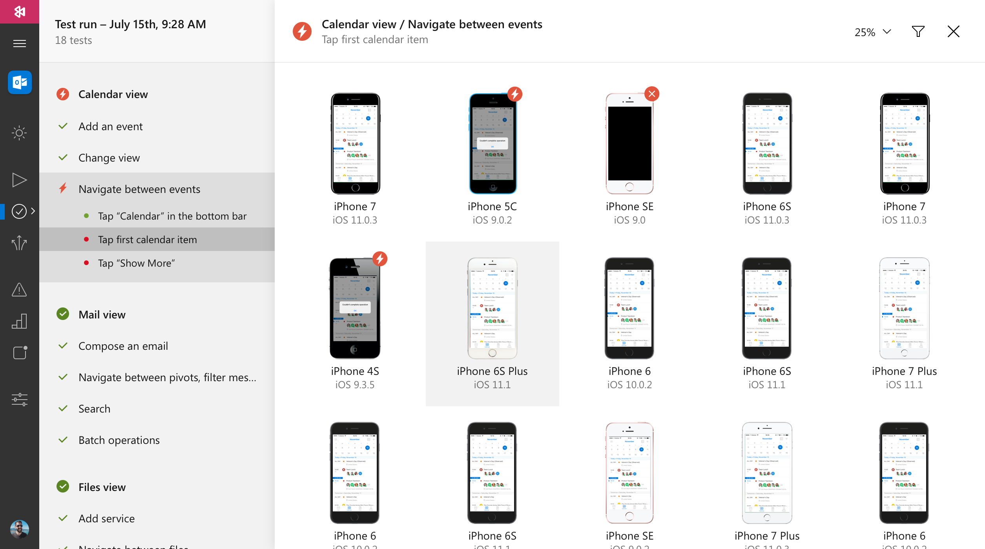
App Center – Test on real Devices

Slide 19
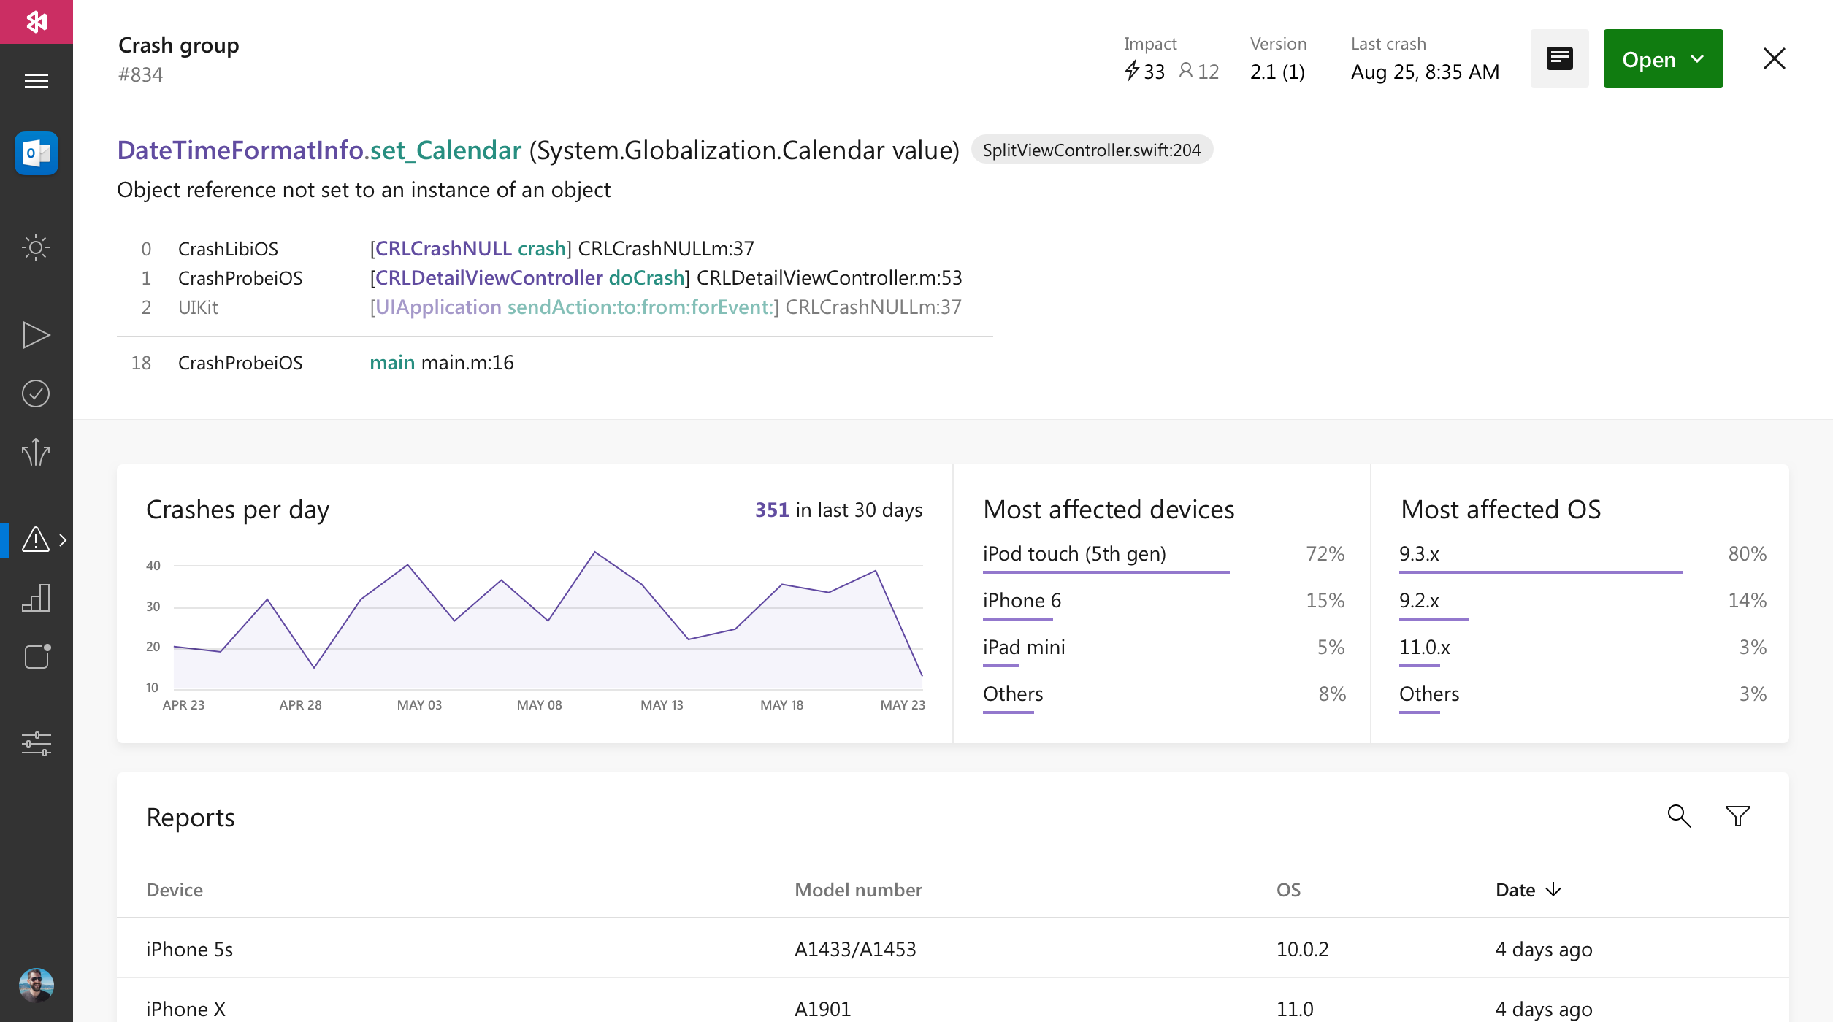
App Center – Crash analytics

Slide 20
App Center
https://appcenter.ms

