Slide 1
Eine verteilte Anwendung mit WCF und WF – in Action!
Christian Weyer
thinktecture
christian.weyer@thinktecture.com

Slide 2


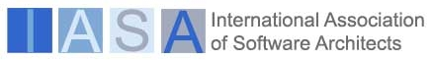
Christian Weyer and thinktecture
Co-Founder, principal consultant and architect
of thinktecture
  Support and consulting services for software
  developers and architects on the .NET platform
  Renowned experts in today’s technologies
  We track future technologies and work closely with Microsoft
My area of expertise are application architecture, distributed applications, Web Services in particular, Web Services interoperability, WCF, WF and all things service orientation
Independent Microsoft Regional Director,
Germany
Microsoft MVP Connected Systems
Member of IASA Chapter DACH
christian.weyer@thinktecture.com

Slide 3
Agenda
Demo Time
  A Sample Distributed Application
  in Action –
  built with .NET Framework 3.5
Expect code, config, tools, tips and tricks
Some deeper stuff

Slide 4
YAPOS ?
Yet Another Purchase Order Scenario?
No, don’t fear.
Let’s bring some coolness into developers life– talk about developer videos and media
Every ‘good’ developer these days needs to deal with online resources and multimedia content
  MSDN.TV
  Channel 8, 9, 10
  dotnetpro.tv (German)

Slide 5

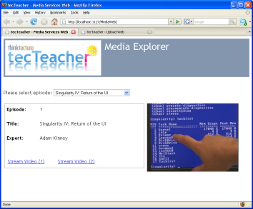


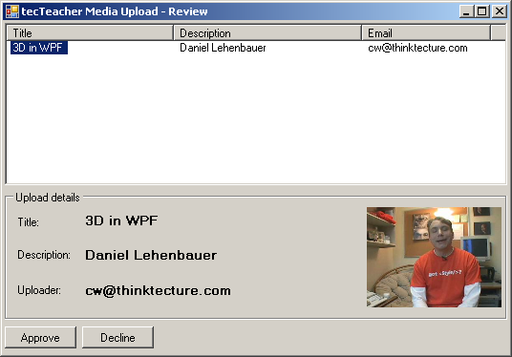
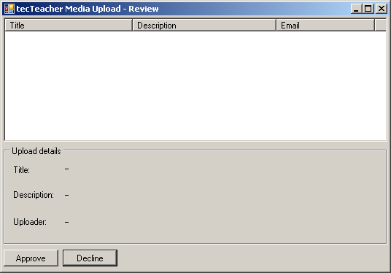


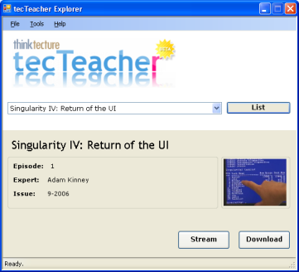
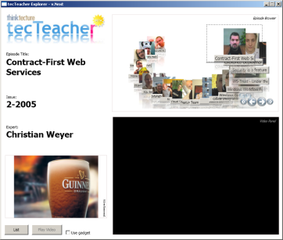

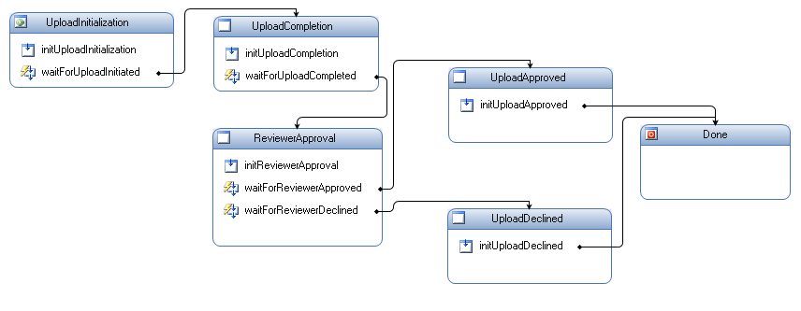
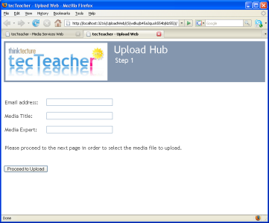
Application Scenario
Reviewer
Web Server
Media Service
User
New Media
Service
Message
Queue
Message
Queue
Web Server
Upload Service

Slide 6
Technologies Applied
.NET Framework Core
  Threading
  Patterns
  Linq, Linq-to-SQL, Entity Framework
  Exception handling & logging
Windows Workflow Foundation
  Hosting, Runtime Services
  State Machines
  Activitites
  Communication
Windows Communication Foundation
  Hosting
  Contracts
  MEPs
  Bindings
  Extensions
  Syndication

Slide 7
Technologies Applied
Windows Presentation Foundation
  Basic UI, Threading
  Carousel
Windows Forms
  Basic UI, Threading
ASP.NET
  Basic UI, Upload, Security et. al.
PPC
  Very basic UI
Java
  Very basic SWT-based UI
Silverlight 2.0
  Surface, Media, Networking
MMC
  Custom snap-in
PowerShell
  Custom CmdLet
SQL Server Compact Edition

Slide 8



WCF: Bird’s Eye View
Client
Service
Endpoint
Endpoint
Endpoint
Endpoint

Slide 9
WCF: Address, Binding, Contract
Client
Service
A
B
C
C
B
A
A
B
C
A
B
C
Address
Where?
Binding
How?
Contract
What?
Endpoint

Slide 10
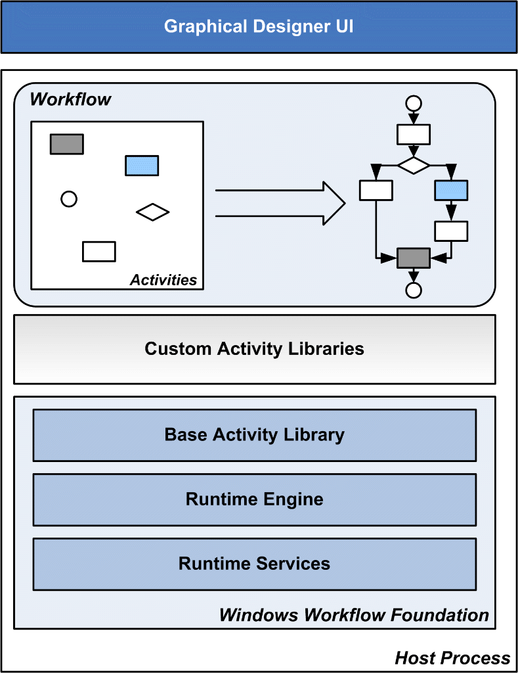
WF

Slide 11
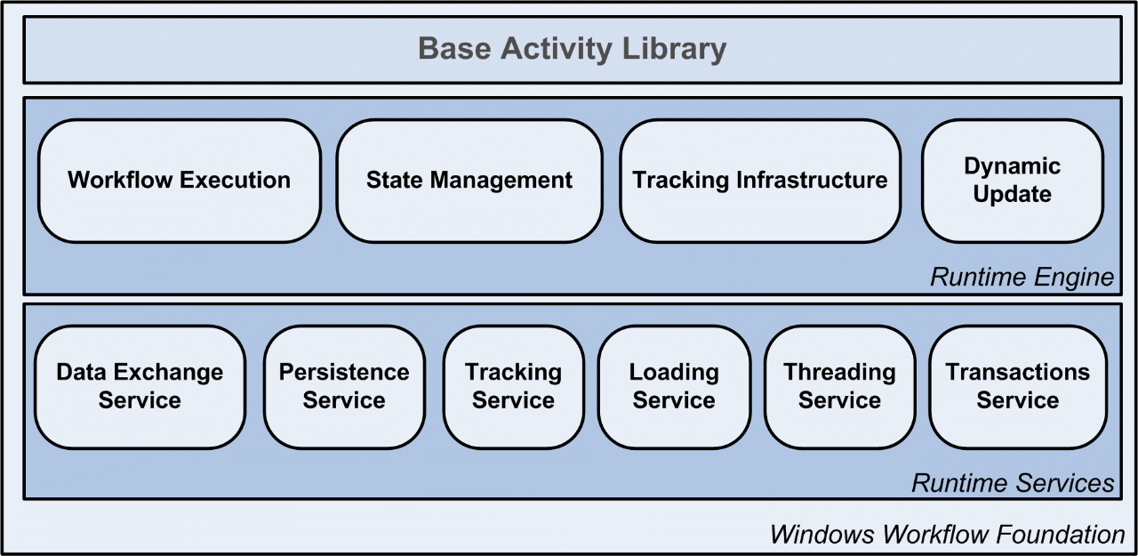
WF: Runtime

Slide 12
‚Distributed‘ Hot Spots
Overall architecture, service orientation
WCF contract design
WCF bindings
WCF without sessions
WCF duplex and callbacks
WCF streaming
WCF hosting
WCF proxy handling
Client threading
Data access & notification

Slide 13
More ‚Distributed‘ Hot Spots
WF custom activities
WF persistence, tracking, workflow monitoring
WF and WCF integration
Unit and Load Testing
Debugging
Tracing & Logging
And more… just browse the code ☺

Slide 14
Focus Area I
WCF Contract Modeling
The C of ABC
  Message Exchange Pattern (MEP)
  Data, Faults, Messages
Try thinking decoupled
  One-Way
  Notifications
POX/REST-style contract
  Addressable from any HTTP-enabled code
  Intrinsic to .NET 3.5

Slide 15
Focus Area I
WCF Contract Modeling
Syndication feeds
  RSS and Atom support in .NET 3.5
Set Name, Namespace, Action, ReplyAction
  Namespace also on ServiceBehavior and binding ☹
Consider alternative serializers
  XmlSerializer for better interop
  NetDataContractSerializer for tighter coupling
Interop with Java still a stretch
  Basic stuff works
  Try to flatten WSDL and XSDs

Slide 16
Focus Area II
WCF Binding Selection
„Choose whatever binding with whatever contract“ is not true
Almost all out-of-the-box bindings are pretty much useless in real world
  Change their settings
  Use custom bindings
Custom bindings make up your day
  Improve configurability with user-defined binding and custom config
Usually, you need one transport

Slide 17
Focus Area II
WCF Binding Selection
Beware of sessions
  netTcp and namedPipes have implicit channel-based session semantics; as well as wsHttpBinding
  Try to avoid session affinity for scalability and robustness reasons
Binary encoding over HTTP in self-host looks like a winner in many scenarios
  Always perf and load test for your scenario; no ‚guessing‘
Duplex communication fights firewalls & NATs
MSMQ is really something special
  Only one-way, no request-response, no duplex
Custom message encoder

Slide 18
Focus Area III
WCF Hosting
Please, use console applications only for testing
  … and demoing
Hosting in NT Service is straight-forward
  Leverages Windows SCM features
  Think about exception handling and logging
WCF services should run as non-admin
  HTTP.sys must be configured
IIS is robust, mature and scales
  IIS hosting has some overhead due to additional layering
  Streaming from inside IIS seems to have some problems
Windows Process Activation Service (WAS) brings non-HTTP transports into the IIS picture
  Only on Windows Vista and Windows Server 2008
  Same caveats still apply

Slide 19
Focus Area IV
WF Custom Activities and Monitoring
Custom activities for solving domain-specific tasks
WF tracking for monitoring and auditing workflows
  SQL Server 2005 (Express) as backend store
  Take config approach
Build custom MMC 3.0 snap-in for tracking
  Use WF designer rehosting
Write custom PowerShell CmdLet for leveraging tracking in scripts

Slide 20
Focus Area V
WF & WCF Integration
Service implemented as Workflow
  Leverage Workflow development experience
  Enforces application protocol by default
  Allows long-running, durable Services
Workflow hosted as Service
  ServiceContract provides typed interface for integrating with the Workflow
  Messages enforce by-value, serializable data
  Workflows can be message-activated
.NET 3.5 brings integrated solution
  Custom activities
  Custom ServiceHost, channels, bindings, behaviors

Slide 21

WSDL Importer
Contract
Contract
WSDL Exporter
Client Code
parameters
Service Type
parameters
Operation Invoker
Dispatcher Runtime
Parameter Inspector
Parameter Inspector
Client Runtime
Message Formatter
Message Formatter
Operation Selector
Message Inspector
Message Inspector
Channel
Custom Channel
Custom Channel
Channel
Channel
Custom Channel
Custom Channel
Channel
Transport Channel
byte[]
Transport Channel
byte[]
Encoder
Custom Encoder
Custom Encoder
Encoder
Custom Transport
Custom Transport
* Added by configuring the runtime with behaviors
* Added by adding binding elements to the binding

Slide 22
Is this thing ‚done‘?
No! We are constantly working on improving it
  Adding features as we see fit
Please discuss with us

Slide 23
Resources
Email Christian Weyer
  christian.weyer@thinktecture.com
Weblog Christian Weyer
  http://blogs.thinktecture.com/cweyer
thinktecture
  http://www.thinktecture.com

Slide 24

{
}
In-depth support and consulting for
software architects and developers
http://www.thinktecture.com/
christian.weyer@thinktecture.com
http://blogs.thinktecture.com/cweyer/

