Slide 1
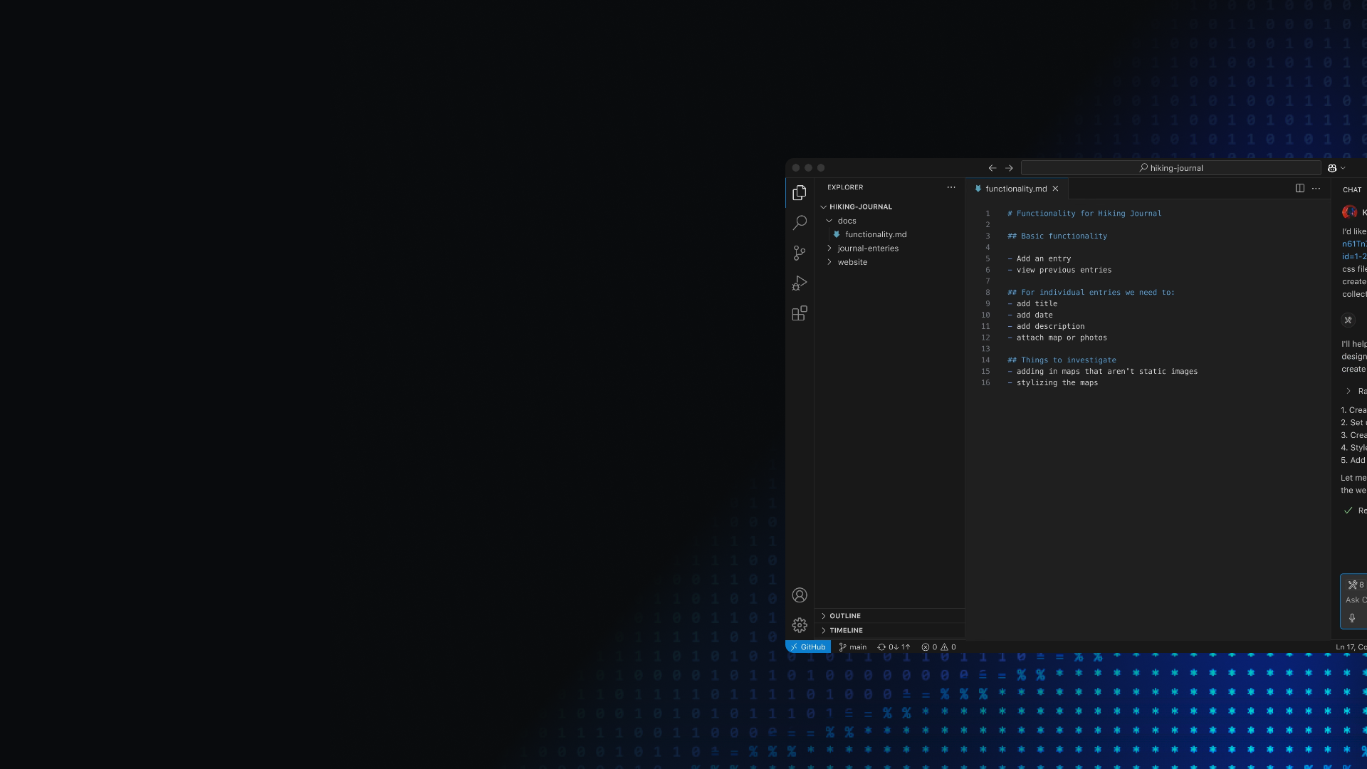






VS Code Dev Days
São Paulo
Sábado, 06/09/2025
UniFECAF – Taboão da Serra-SP

Slide 2


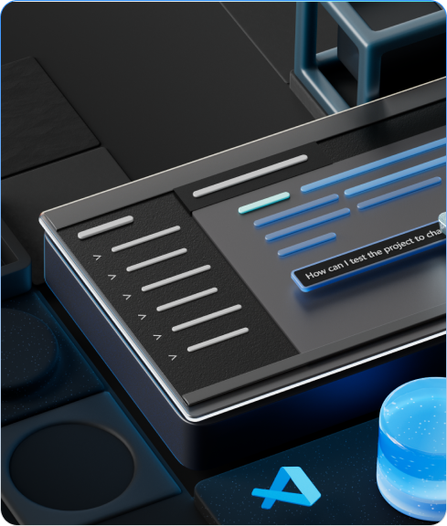
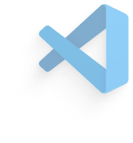




VS Code Dev Days
Model Context Protocol - MCP
Descomplicando integrações no mundo da IA
Uma visão geral

Slide 3
01
02
03
MCP: uma visão geral
Docker MCP Hub
Q&A
Notes:
Today we're going to start with giving a brief introduction to VS code if you are brand new to VS code And after that we're going to take a look at some of the new API editor features that are really turning Visual Studio code into an agentic code editor We're going to take a look at a bunch of these things in action and then give you an overview of all these new features that you can take advantage of today Then finally we'll have a little bit of time for Q&A

Slide 4
MCP: uma visão geral
Model Context Protocol
Anunciado pela Anthropic em Novembro/2024
Uma padronização para simplificar a integração das mais variadas soluções com modelos de Inteligência Artificial
Notes:
let's start at the beginning Visual Studio code is an ecosystem of amazing extensions that are built on top of the core open source vscode project
This means you can use the source control you want the programming languages the debuggers that you want databases that you want and anything in between

Slide 5
MCP: uma visão geral
Analogia com uma "porta USB"
Protocolo aberto que enfatiza flexibilidade
Comunicação via STDIO x HTTP/Streams
Suporte a desenvolvimento nas principais stacks: .NET, Java, Node/Typescript, Python, Go, Swift, Kotlin, Ruby...
Notes:
let's start at the beginning Visual Studio code is an ecosystem of amazing extensions that are built on top of the core open source vscode project
This means you can use the source control you want the programming languages the debuggers that you want databases that you want and anything in between

Slide 6
MCP: uma visão geral
MCPs Servers costumam ser distribuídos como packages (principalmente npm) ou imagens Docker
Suporte do Azure API Management (Preview)
Soluções baseadas em LangChain e Semantic Kernel podem se valer do suporte oferecido pelo projeto OpenTelemetry no monitoramento/observabilidade de aplicações
Notes:
let's start at the beginning Visual Studio code is an ecosystem of amazing extensions that are built on top of the core open source vscode project
This means you can use the source control you want the programming languages the debuggers that you want databases that you want and anything in between

Slide 7
MCP: uma visão geral
A Docker mantém uma lista de MCPs disponibilizados via container – MCP Hub
Fácil integração com Visual Studio Code/GitHub Copilot, Claude e outras soluções de IA que ofereçam funcionalidades de chat
Notes:
let's start at the beginning Visual Studio code is an ecosystem of amazing extensions that are built on top of the core open source vscode project
This means you can use the source control you want the programming languages the debuggers that you want databases that you want and anything in between

Slide 8
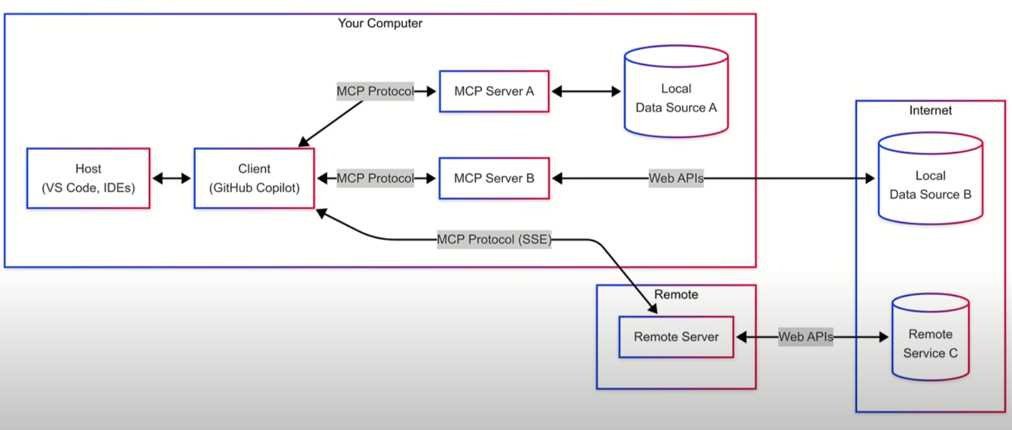
MCP: uma visão geral
Fonte: Microsoft
Notes:
let's start at the beginning Visual Studio code is an ecosystem of amazing extensions that are built on top of the core open source vscode project
This means you can use the source control you want the programming languages the debuggers that you want databases that you want and anything in between

Slide 9

Docker MCP Hub
Catálogo de MCP Servers homologados pela Docker
Possibilidade de execução via containers
Fácil integração com ferramental da Docker
Notes:
let's start at the beginning Visual Studio code is an ecosystem of amazing extensions that are built on top of the core open source vscode project
This means you can use the source control you want the programming languages the debuggers that you want databases that you want and anything in between

Slide 10
Obrigado!

