Slide 2
Blazor: a new way to build modern web applications with .NET core 3.0
Javier Vela
Twitter: @jvela
Linkedin: https://www.linkedin.com/in/javiervelaaylon/

Slide 3







https://...
JS

Slide 4


Blazor
Build client-side web UI with .NET instead of JavaScript
Write reusable web UI components with C# and Razor
Share .NET code with both the client and the server
Call into JavaScript libraries & browser APIs as needed
C#

Slide 5

How it woks? Blazor server or Blazor WebAssembly
Blazor WebAssembly
(Preview)
Blazor Server
https://...
https...
.NET Core
Razor Components
DOM
SignalR
DOM
.NET
WebAssembly
Razor Components
.NET
May 2020
.NET Core 3.0

Slide 6

.NET

Slide 7
WebAssembly (wasm)
C#, C/C++, Rust o WebAssembly text
Fast, safe, well-defined, hardware-independent, language-indendent, platform-independent,
open
Compact, modular, efficient, streamable, parallelizable, portable

Slide 8
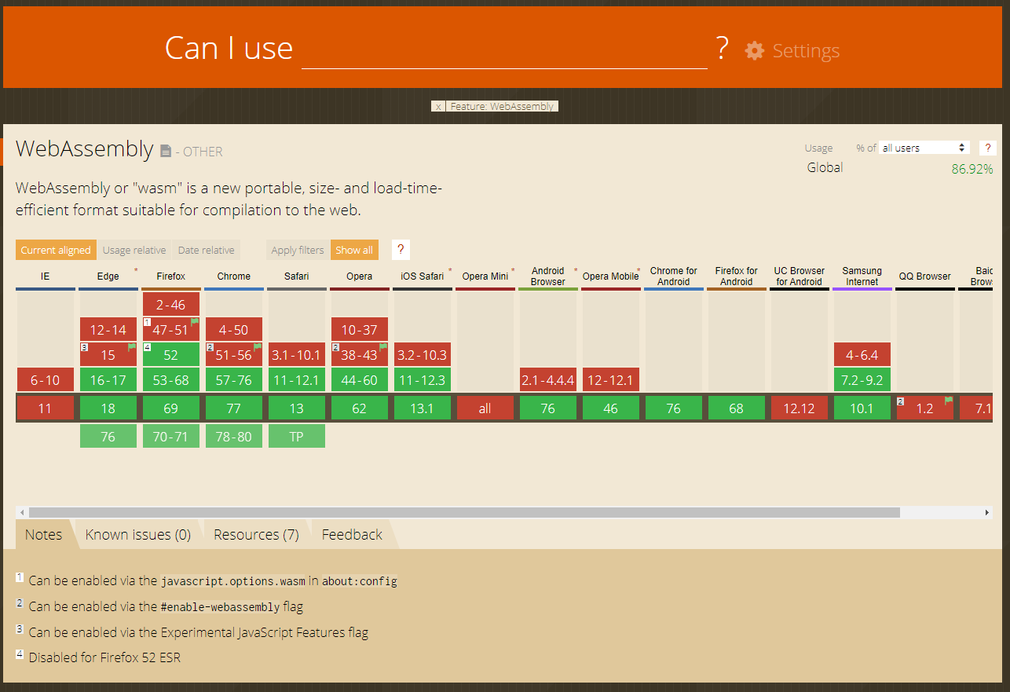
WebAssembly (wasm)

Slide 9
Blazor on client or server
Blazor WebAssembly
(Preview)
Blazor Server
Pro:
True SPA, full interactivity
Utilize client resources
Supports offline, static sites, PWA scenarios
Con:
Larger download size
Requires WebAssembly
Still in preview
Pro:
Smaller download size, faster load time
Running on fully featured .NET runtime
Code never leaves the server
Simplified architecture
Con:
Latency
No offline support
Consumes more server resources
May 2020
.NET Core 3.0

Slide 10
Blazor demo

Slide 11
Web
Blazor Server
.NET Core 3.0!
Web app
Every interaction handled on server
Prerendered HTML (optional)
Blazor WebAssembly
May 2020
Web app with client-side execution
Loaded from web server
Can work offline via Service Worker
Blazor PWA – OS installed
Previews with .NET 5
Appears as native app (own window)
Works offline or online
Blazor Hybrid
Previews with .NET 5
Native .NET renders to Electron / WebView
Appears as native app (own window)
Works offline or online
Desktop
Mobile
Blazor Native
Under I+D
Same programming model, but
rendering non-HTML UI

Slide 12
References
https://webassembly.github.io/spec/core/index.html
https://webassembly.org/
https://pablomagaz.com/blog/empezando-con-webassembly
https://developer.mozilla.org/en-US/docs/WebAssembly
https://caniuse.com/#feat=wasm
https://www.freecodecamp.org/news/get-started-with-webassembly-using-only-14-lines-of-javascript-b37b6aaca1e4/
=> https://mbebenita.github.io/WasmExplorer/
https://dotnet.microsoft.com/apps/aspnet/web-apps/blazor
https://blazor.net/docs
https://blazor.net
https://blazor.net/docs
https://aka.ms/blazorworkshop
https://aka.ms/awesomeblazor
https://github.com/danroth27/BlazorWeather

