Slide 2
¡Ya está aquí .NET Core 3!
Hugo Biarge @hbiarge

Slide 3
.NET Core versions and support policy
LTS
LTS releases are supported for three years after the initial release
LTS releases will receive only critical and compatible fixes throughout their lifecycle
Current
Current releases are supported for three months after a subsequent Current or LTS release
Current releases will receive these same fixes and will also be updated with compatible innovations and features
https://dotnet.microsoft.com/download/dotnet-core
https://dotnet.microsoft.com/platform/support/policy/dotnet-core

Slide 4
global.json updates
Did you know global.json?
Allows you to define which .NET Core SDK version is used when you run .NET Core CLI commands (also Visual Studio)
dotnet new globaljson
SDK version parts
3.0.100
[.NET Core major version].[.NET Core minor version].[xyz][-optional preview name]

Slide 5
Global and Local tools
Like npm packages ☺
Create a new manifest file and commit it to the repo
dotnet new tool-manifest
Install local tools
dotnet tool install dotnet-ef
Clone the repo and restore the installed tools
dotnet tool restore
Example: https://github.com/Xabaril/Esquio

Slide 6
gRPC

Slide 7
gRPC
Google Remote Procedure Calls
Cloud Native Computing Foundation project
Built with modern technologies
HTTP/2
Protocol Buffers (Protobuf)
Designed for modern apps
High performance
Platform independent

Slide 8
Remote Procedure Calls vs APIs
Remote Procedure Calls
Contract first (proto file)
Contract is designer for humans
Hides remoting complexity
HTTP APIs
Content first (URLs, HTTP, method)
Content is designer for humans
Emphasises HTTP

Slide 9
Key features
Performance
Low network usage
HTTP/2 multiplexing
Code generation
Multiple languages
Streaming
But we have some disadvantages
Limited browser support
No human readable

Slide 10
Demo Server and Client

Slide 11
Generic Host

Slide 12
Generic Host
Encapsulates app’s resources for all application workloads
Dependency injection (DI)
Logging
Configuration
…
Asp.Net 3.0 now use also the GenericHost
The Web Host is no longer recommended for web apps and remains available only for backward compatibility

Slide 13
Lifetimes
We can configure different hosting lifetimes depending the deployment environment
ConsoleLifetime (default)
WindowsService
systemd

Slide 14
Demo Generic Host

Slide 15
New Routing in Asp.Net Core

Slide 16
New router
Allow accessing endpoint information early in the request pipeline
We now map endpoints ☺

Slide 17
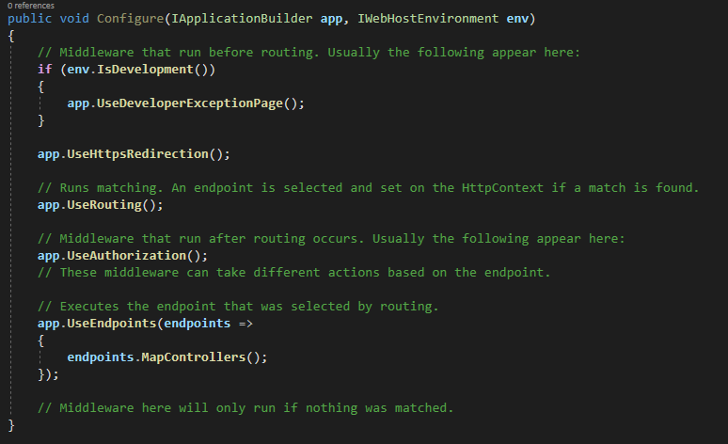
New routing middlewares

Slide 18
Demo Asp.Net Core

