Slide 1
PHIVOLCS Project

Slide 2
Problem Statement
Expensive Digitizer from Australia
Need for a digitizer for the accelerometer.

Slide 3
What should be a good digitizer?

Slide 4
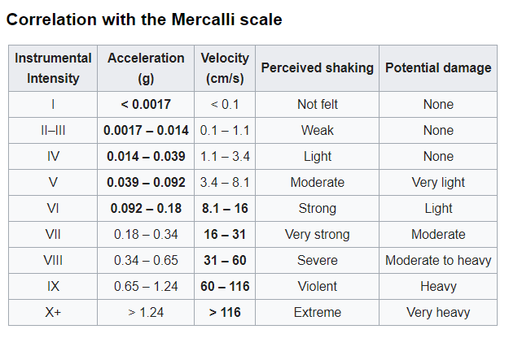

Slide 5
Factors
Detection should at least 0.0017g
Max range should at least 5g
Should be able to send data

Slide 6
Proposed Idea
ACCELEROMETER
24 bit Resolution
ADC
Microcontroller
Ethernet Module

Slide 7
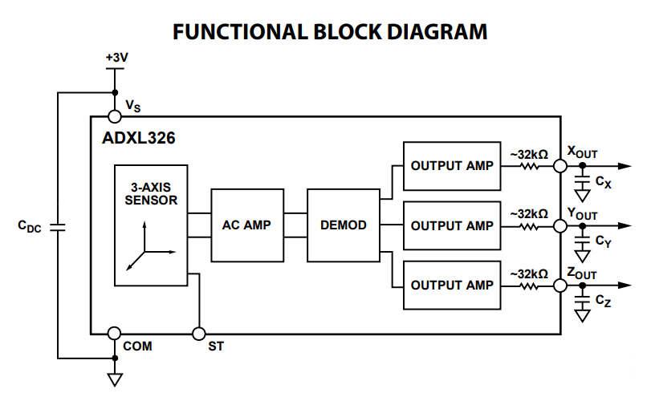
ADXL326(ACCELEROMETER)
3-axis sensing
Excellent temperature stability
minimum full-scale range of ±16 g
Analog output

Slide 8
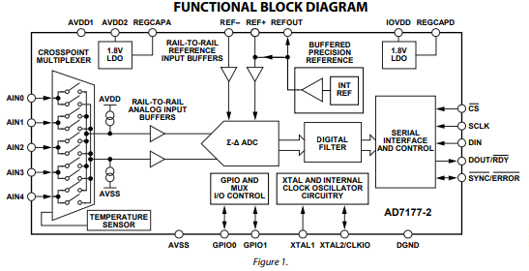
AD7177-2(ADC Module)
32-bit data output
Fast and flexible output rate: 5 SPS to 10 kSPS
2 fully differential channels or 4 single-ended channels
@59.92 SPS it has 25.8 effective resolution bits
SPI Interface

Slide 9
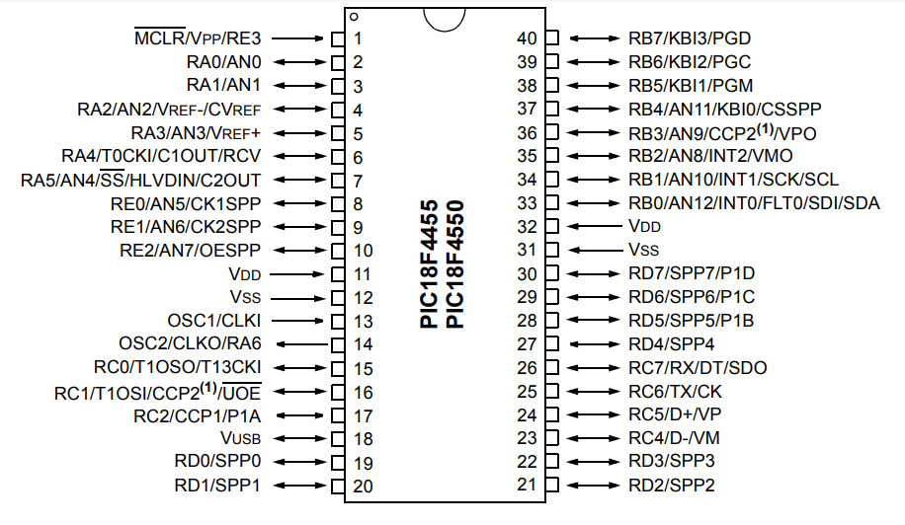
PIC18F4550(Microcontroller)
32K bytes Program Memory and 2048 bytes Data memory.
2 SPI Modules

Slide 10
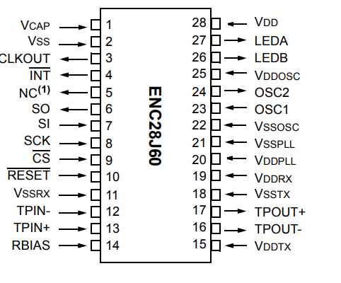
ENC28J60(ETHERNET MODULE)
Integrated MAC and 10BASE-T PHY
Supports Full and Half-Duplex modes
Programmable CRC generation and automatic rejection of erroneous packets
SPI Interface with clock speeds up to 20 MHz

Slide 11
Accessing the data
Embedded Web Server
Driver
Client Computer
Software
Logs

Slide 12
Cost
Component | Cost
ADXL326
AD7177-2
PIC18F4550
ENC28J60
Total cost

