Slide 1
Beer Data Analysis
Derek Rogers & Abhay Sharma
Notes:
Discussion on the beer data set and an analysis on what is within it
Use this analysis to build an insight into how the data works and see what useful inferences we can pull out of it.

Slide 2
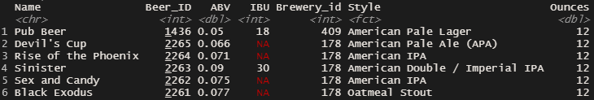
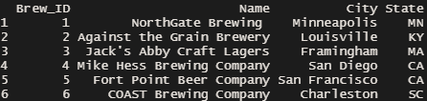
The Data
Beer Data Set
Brewery Data Set
Base Format of the Data
ABV – Alcohol by Volume
IBU – International Bitterness Units

Slide 3
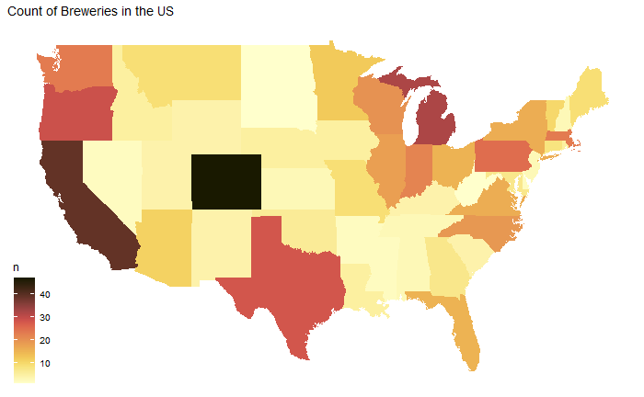
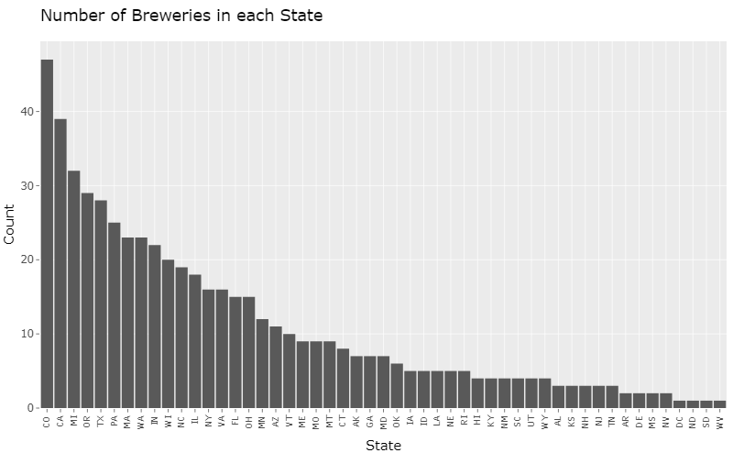
Number of Breweries Over All States
# of Breweries
Plotting the data over the US Map, we can see that Colorado has the largest number of breweries in the US, but we can see a split in the distribution, where a significant amount of the breweries are split between the west and east coast.
Notes:
How many breweries are present in each state?

Slide 4
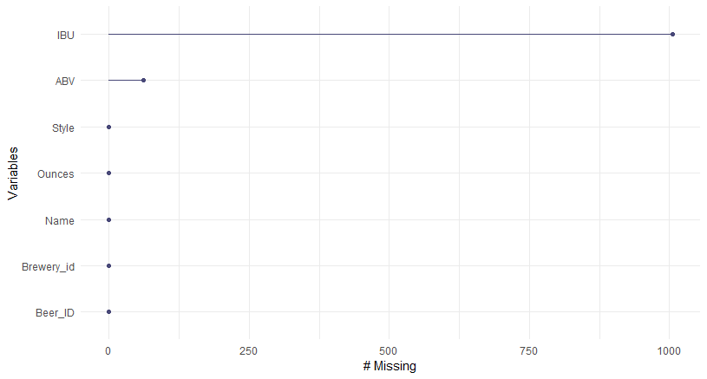
Missing Values Visualized
From all the IBU values, roughly 41% of the data is missing
From all the ABV values, roughly 2.5% of the data is missing

Slide 5
Missing Values
Abundance of Missing Values
After visualing the data, we can see that a large amount of information from both the IBU and ABV values of beer are missing. While it is possible to hand-fill out values for both, counting the total number of missing values over both groups add up to over 1000 missing values.
Approach
For the most part, we can ignore the missing data, but we cannot prove that the missing data is truly random. While we can perform an analysis on the data, we must be cautious as to the bias the exclusion of missing data could apply to our results.
Notes:
Address the missing values in each column.
Next- look at some statistics from the dataset, two of with are the median ABV and IBU values

Slide 6
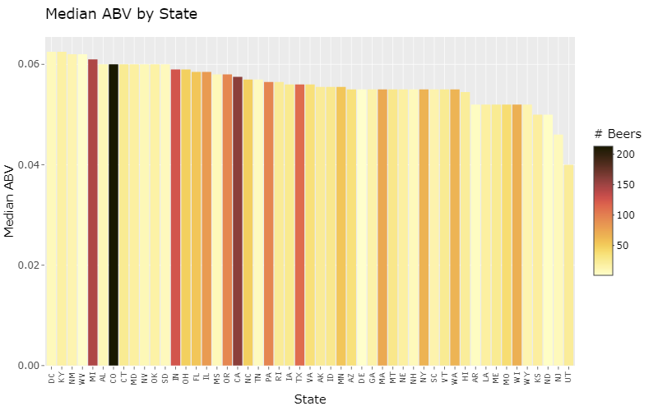
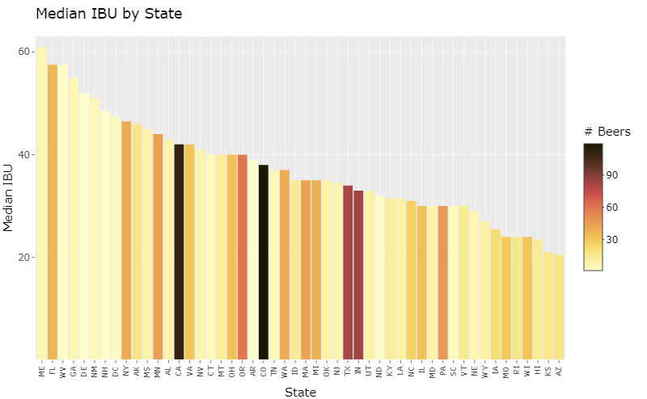
State ABV and IBU Medians
By grouping the data by State, we can pull out the median ABV & IBU for each State. When plotting the bar graphs for these datasets for highest to lowest, we can see that D.C has the highest median ABV and Maine (ME) has the highest IBU.
Notes:
Compute the median alcohol content and international bitterness unit for each state. Plot a bar chart to compare.
We can see the distribution of median ABV and median IBU by state, from which we can pick out that D.C. has the highest median ABV and Maine the highest median IBU.
We can also see the difference in scales between the datasets to further demonstrate the abundance of missing values.
Cool note: States with large numbers of beers consistently have less extreme values of IBU/ABV due to principles found in the central limit theorem.

Slide 7
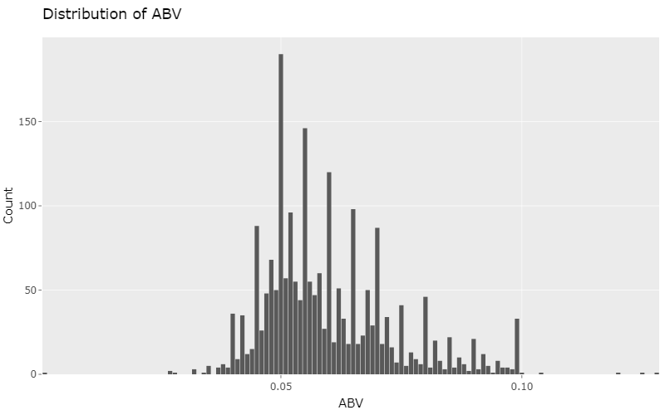
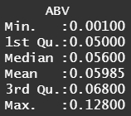
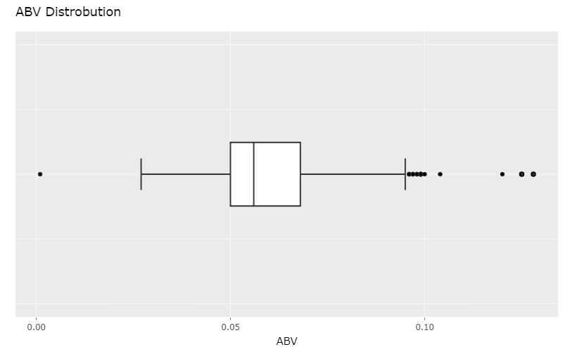
Distribution of ABV variable
We have a very robust ABV dataset, with only 60 values missing. From this dataset, we can see that:
Mean Value: 0.056
Median: 0.059
Min: 0.001
Max: 0.128
We can also see that the third quartile lies around 0.068, which indicates that a large majority of these beers are localized around 0.06, considering how close the mean/median values are.
Notes:
Comment on the summary statistics and distribution of the ABV variable.

Slide 8
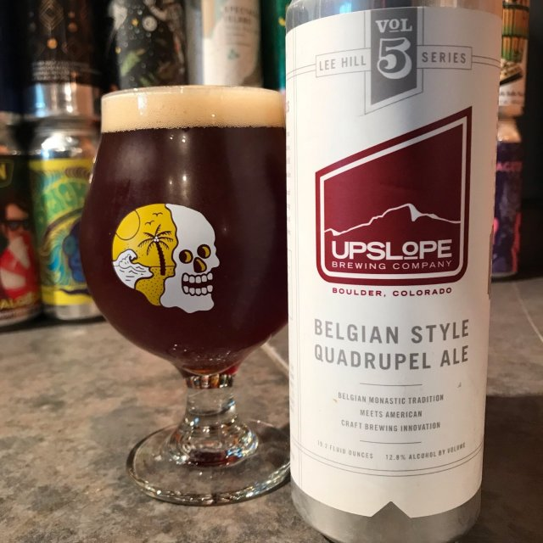
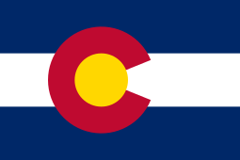
Highest ABV
Lee Hill Series Vol. 5 – Belgian Style Quadrupel Ale
ABV : 12.8%
IBU : 35
State: Colorado

Slide 9
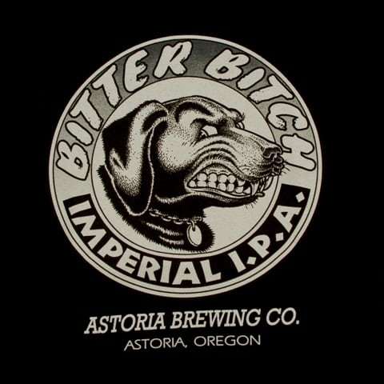
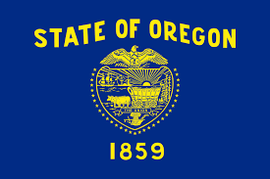
Highest IBU
Bitter Bitch Imperial IPA
ABV : 8.2%
IBU : 138
State: Oregon

Slide 10
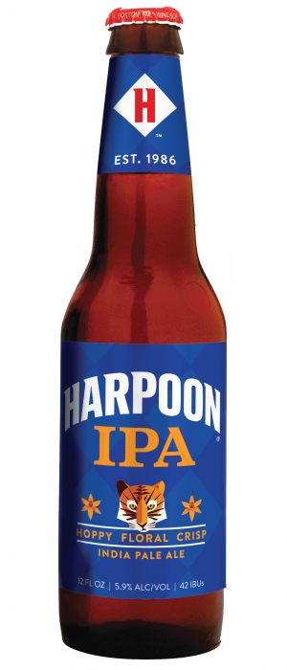
The most average beer
Harpoon IPA
Mean ABV : 5.9%
Mean IBU : 42
Style : American IPA
State: Maine
Notes:
Follows mean ABV and mean IBU while sitting in the most popular style of drink

Slide 11
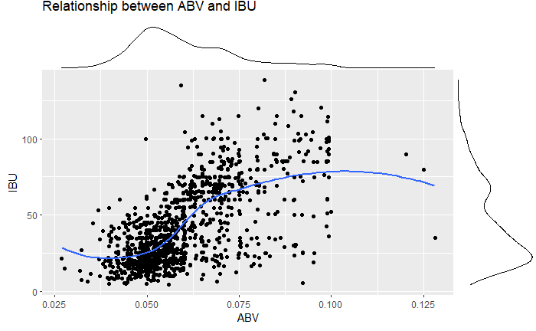
Relationship between ABV and IBU
Plotting out the datasets ABV and IBU values, we find a plausible relationship between the two variables. While ABV values are low we see a general trend of low IBUs, and on the flipside, when ABV values are high, we see a corresponding trend of high IBUs.
Naturally, there are outliers to this data, which are very likely contributing to the deviations in the trend line for the graph, but still paints a very plausible relationship.
Notes:
Is there an apparent relationship between the bitterness of the beer and its alcoholic content? Draw a scatter plot. Make your best judgment of a relationship and EXPLAIN your answer.

Slide 12
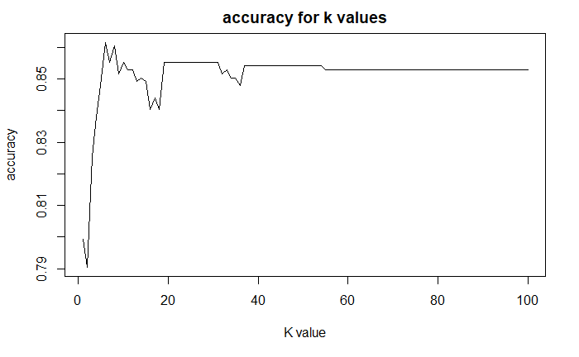
KNN Classification Model for IPA’s vs Ales
We can train a k-nearest neighbor model, using a “leave out one” cross validation method to classify IPAs against other ales
We can plot accuracy vs. K for the classification of IPA’s vs other ales based on ABV and IBU
From which, K = 6 has the highest accuracy at 86.16%

Slide 13
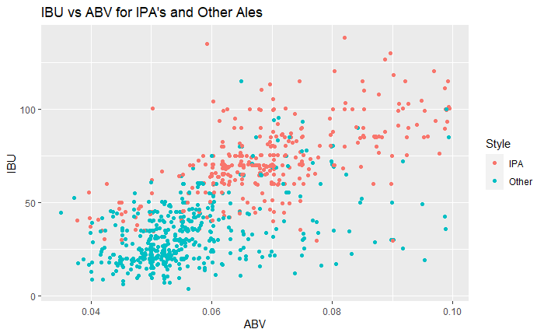
IBU and ABV for IPA’s vs Ales
Apparently clustering between Ales and Other Beers.
ABV/IBU values for IPAs are clustered near the top, whereas Other Beers tend to cluster near the bottom left.
Clear distinction between both groups.
Notes:
Important because it highlights why the knn model was accurate, with large group distinctions between ales and other types of beers

Slide 14
Cheers!
Any questions?
Derek Rogers:
derekgrogers1@gmail.com
+1 972 816 5695
Abhay Sharma:
abhays@mail.smu.edu
1 949 335 8394

Slide 15
Image Credits
beer_7987.jpg (250×447) (cloudinary.com)
Lee Hill Series Vol 5 - Belgian Style Quadrupel Ale - Upslope Brewing Company – Untappd
BITTER BITCH T-SHIRT - Astoria Brewing Company
Colorado-state-flag-letter-C-pattern-gold-1964.jpg (800×535) (britannica.com)
https://en.wikipedia.org/wiki/Flag_of_Oregon
Harpoon -https://products0.imgix.drizly.com/ci-harpoon-ipa-33b355d2242d4b66.png?auto=format%2Ccompress&ch=Width%2CDPR&fm=jpg&q=20

