Slide 1
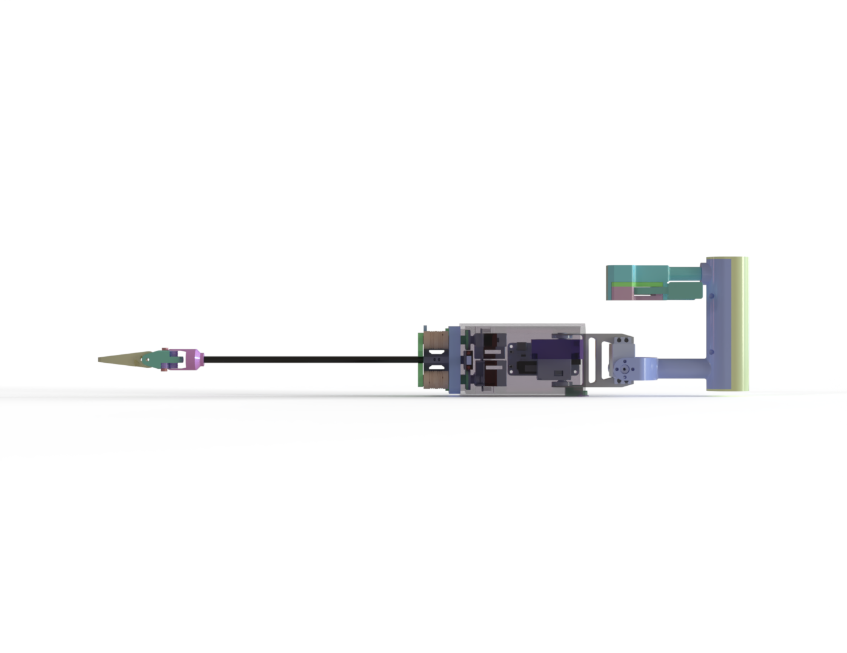
Tendon-Driven Mechanisms for Adaptive Robotic Grasping and Handheld Surgical Instruments
Yu Wang
Supervisor: Prof. Peng Lu
Department of Mechanical Engineering, HKU

Slide 2
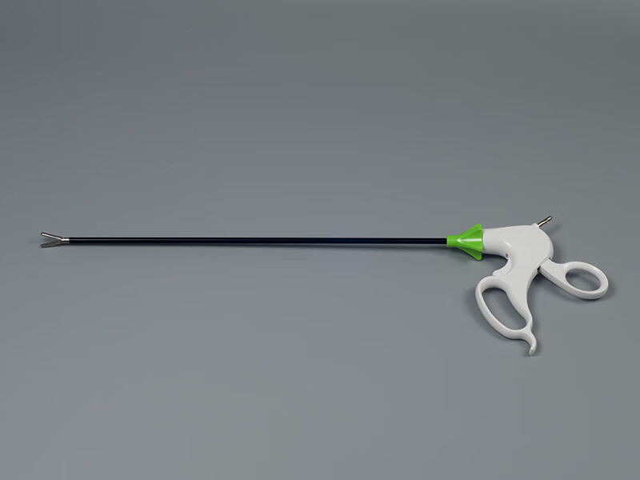
Motivation
Narrow workspaces
Fragile, irregular, or moving targets
Low distal mass is required
Tendon-driven systems offer compliance and remote actuation

Slide 3
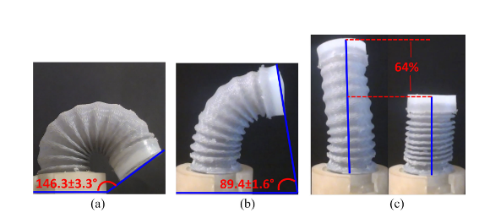
Research Gap
Surgical tools and adaptive grippers are often separate
Most designs are application-driven
A transferable tendon-driven framework is still missing

Slide 4
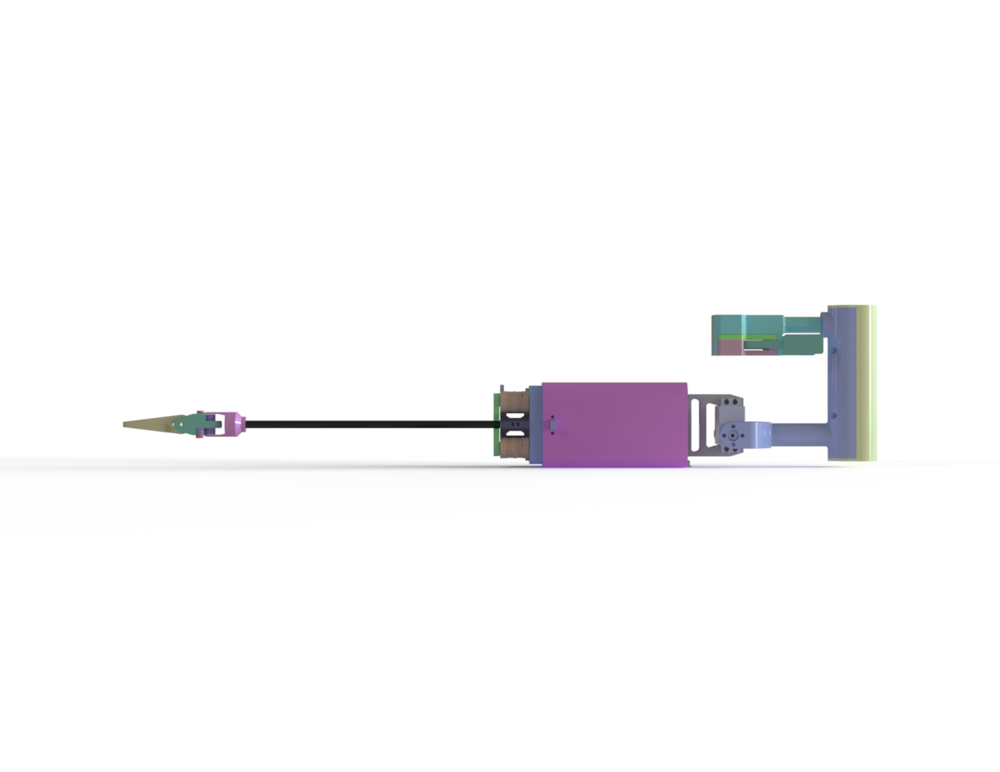
Research Question
How can tendon-driven mechanisms be systematically designed
to achieve adaptive, dexterous, and safe manipulation
under limited space, low distal inertia, and compliant contact?

Slide 5
Main Contributions
Mechanism-level study of tendon-driven systems
Lasso Gripper as the first embodiment
Transferable design principles extracted
Handheld surgical instrument as the second embodiment

Slide 6
Thesis Roadmap
Problem definition
Related work
Lasso Gripper
Extracted mechanism principles
Surgical translation

Slide 7
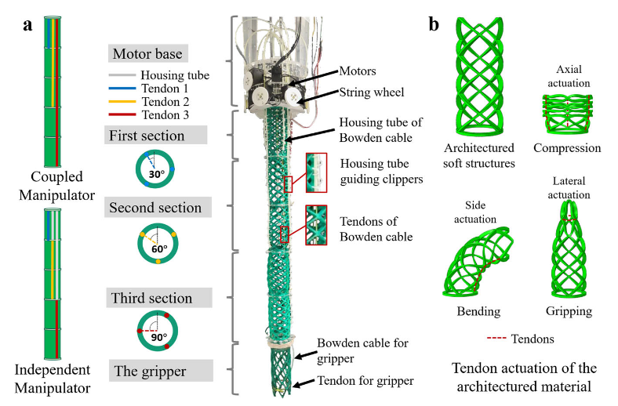
Related Work: Surgical Instruments
Cable-driven instruments improve distal dexterity
Key issues: coupling, friction, hysteresis, weight
The tradeoff between dexterity and usability remains open

Slide 8
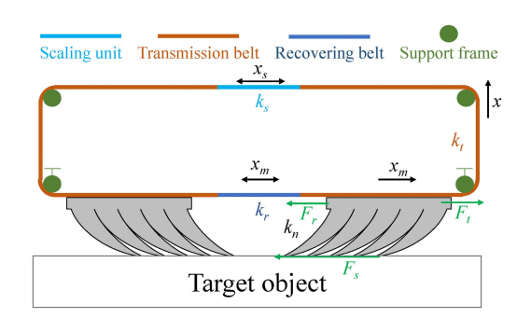
Related Work: Adaptive Grasping
Soft and enveloping grippers improve shape adaptation
Rigid grippers still struggle with fragile or oversized targets
A mechanism with both capture range and controlled force is needed

Slide 9
Common Mechanism Principles
Tension management
Proximal actuation
Differential routing
Compliant interaction
Low distal inertia

Slide 10
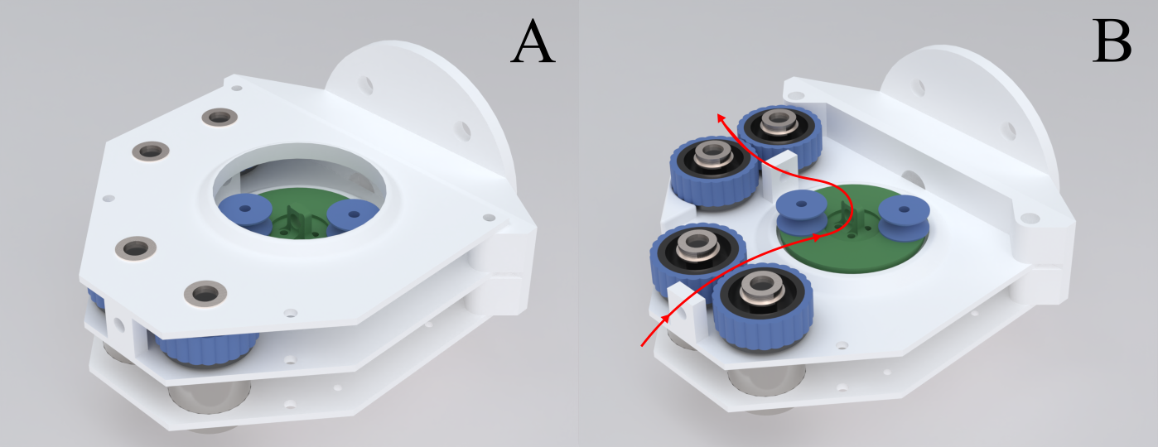
Embodiment 1: Lasso Gripper Concept
Inspired by the lasso and the uurga
Loop-based capture instead of point contact
Adaptive capture region for uncertain targets

Slide 11
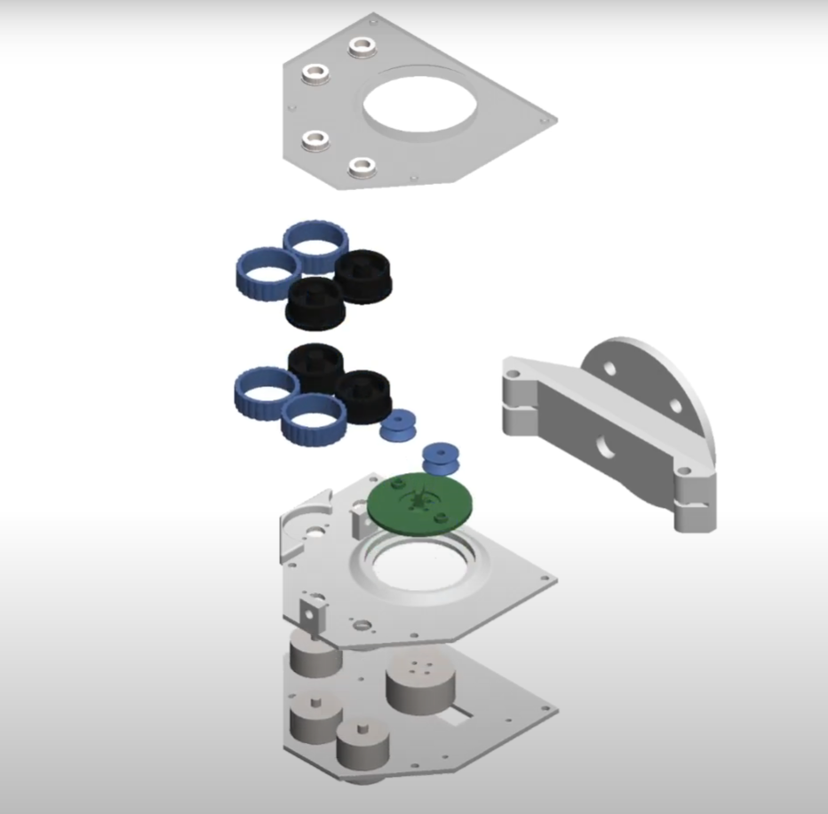
Lasso Gripper: Mechanical Design
Launch and retraction subsystems
Friction-wheel-based string propulsion
Spool mechanism for storage and recovery
ESP32-based controller integration

Slide 12
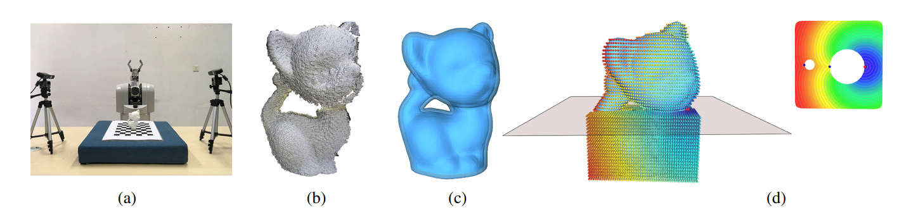
Lasso Gripper: Grasping Strategy
Point-cloud-based target understanding
Caging-loop-based placement
Controlled tightening with feedback

Slide 13
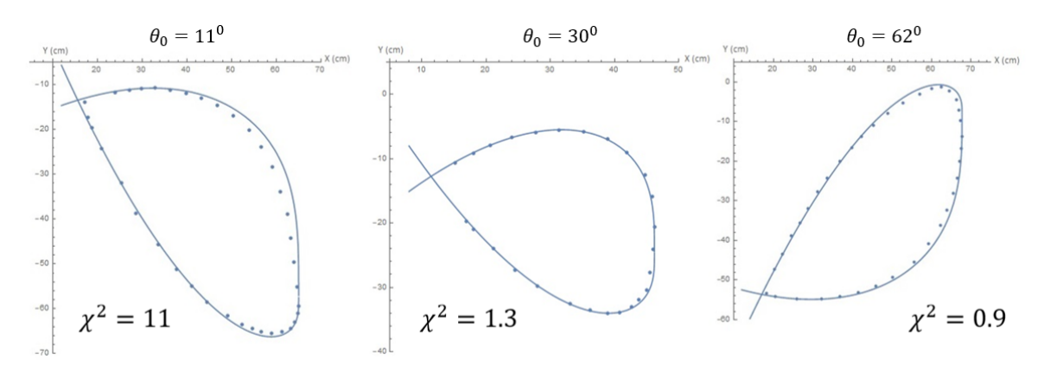
Lasso Gripper: Dynamics and Workspace
String-loop dynamics explain deployed behavior
Workspace is estimated from loop geometry
Modeling supports design and control

Slide 14
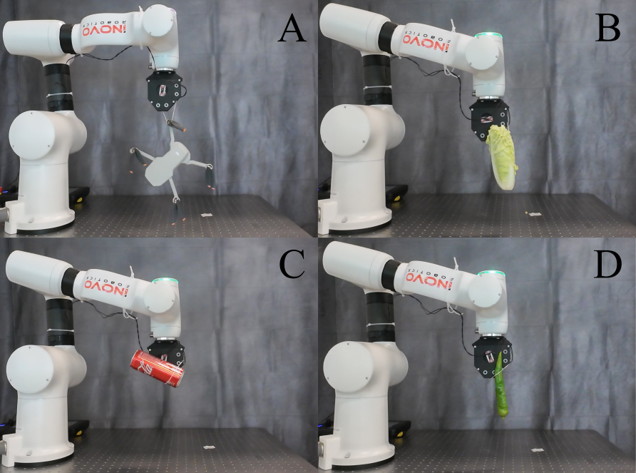
Lasso Gripper: Experimental Results
Static object capture
Shape-adaptive grasping
Oversized object handling
Moving target capture

Slide 15
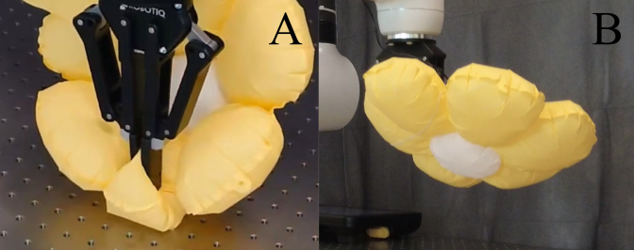
Comparison with Conventional Grippers
Antipodal gripping concentrates stress
Loop gripping distributes contact force
Better for delicate and shape-variable targets

Slide 16
Mechanism Insights from Lasso Gripper
Controlled tension improves repeatability
Flexible contact improves tolerance to uncertainty
Proximal actuation reduces distal complexity
Differential routing is transferable

Slide 17
Embodiment 2: Surgical Translation
Clinical constraints are much stricter
Need distal dexterity without heavy distal hardware
Need ergonomic balance and motion fidelity

Slide 18
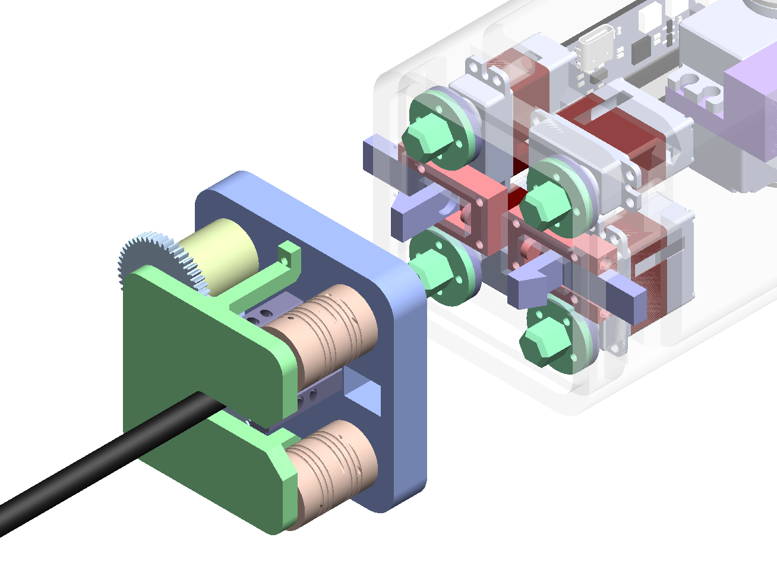
Surgical Instrument: Design
Compact output actuation and input sensing
Tension-preserving reel architecture
Cable routing and tip design
Quick-swap modular structure

Slide 19
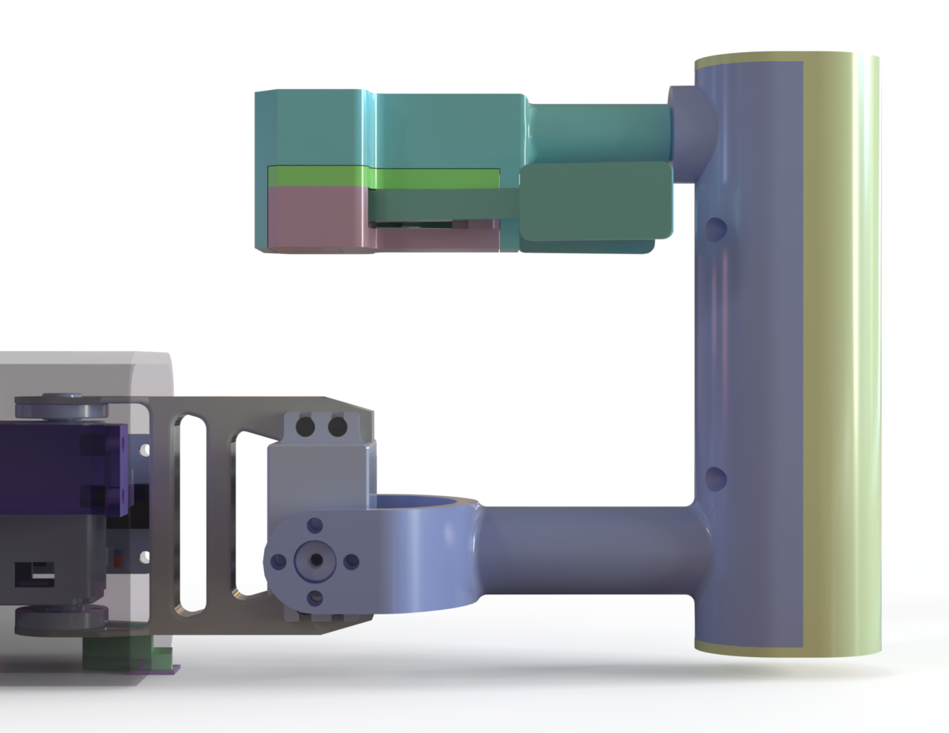
Surgical Instrument: Control and Validation
Signal filtering plus closed-loop motor feedback
Improved motion fidelity in a hand-held device
Same mechanism principles under different constraints

Slide 20
Conclusion and Future Work
A transferable tendon-driven framework is established
Validated in grasping and surgical manipulation
Future work: adaptive control, modular instruments, multi-loop grasping

